Slide 1
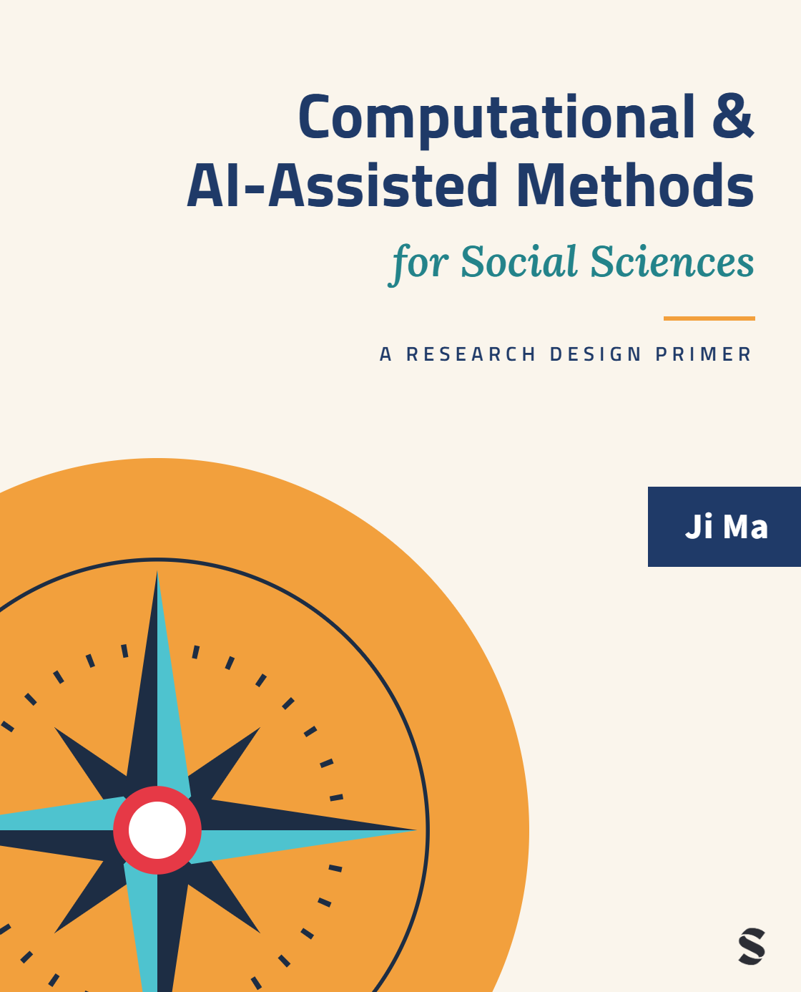
Computational & AI-Assisted Methods for Social Sciences
A Research Design Primer
Chapter 1
Introduction
Ji Ma
cssprimer.org
Instructor slides · free to adapt for course use
Notes:
Welcome to the course. This deck accompanies Chapter 1 of Computational & AI-Assisted Methods for Social Sciences. Today we ask three questions that will return all term: why researchers choose different empirical approaches, where each student might position themselves in the CSS landscape, and how AI tools are reshaping social research. Everything hangs on one idea: research design, not any particular technique, is what makes computational work social science.

Slide 2
Learning objectives
By the end of this chapter, you can:
• Recognize how data-driven and theory-driven approaches complement each other
• Apply the four stages of empirical research to evaluate any method
• Locate your preferred roles within the CSS landscape
• Assess how AI technologies may reshape social science research
Ch. 1 · Introduction · cssprimer.org
2 / 39
Notes:
These come straight from the chapter's learning-objectives box. Emphasize the second one: the four stages (data management, concept representation, data analysis, scientific communication) are the backbone of the whole book, and every later chapter slots into one of them. Students should leave today able to name the four stages and use them as a checklist on any empirical paper they read.

Slide 3
CSS is a methodology, not a buzzword
Chapter 1
• Named in 2009; still sometimes dismissed as hype
• The skepticism has a real source: tools built in computer science, questions posed in social science
• This book's answer: view every method through a research design lens
Takeaway: The mismatch between tools and questions is what a research design lens repairs.
3 / 39
Notes:
Set the stakes before any techniques appear. Lazer and colleagues named the field in 2009, and the skepticism students may have encountered is not baseless: many CSS methods were developed in computer science and need careful adaptation to social science concepts and interpretation. Existing books tend to be either technical manuals or application collections. The design lens is the alternative this book develops, and this deck previews it.

Slide 4
§1.1
“End of theory,” or new opportunities for theory?
What the big-data provocation got right, and what it got wrong.
Ch. 1 · Introduction · cssprimer.org
4 / 39

Slide 5
The Fourth Paradigm and the end-of-theory provocation
§1.1
• Anderson (2008): the data deluge makes hypothesize-test-conclude obsolete
• Hey et al.: a “Fourth Paradigm” of data-intensive science
• Patterns first, theory maybe later, was the promise
Takeaway: The provocation is worth taking seriously before rejecting it.
5 / 39
Notes:
Give the provocation its strongest form before critiquing it. Anderson's 2008 Wired essay claimed the flood of data renders the traditional model obsolete; the Fourth Paradigm framing places CSS in a historical arc from experimental to theoretical to computational and data-intensive inquiry. Ask students what would follow for their own subfield if this were true; that makes the next two slides land harder.

Slide 6
Prediction successes that fed the excitement
§1.1
• Tweet frequency outperformed market-based box-office forecasts
• Twitter mood tracked stock market trends
• Google Flu Trends matched CDC surveillance with far less lag
Takeaway: Digital traces revealed patterns beyond the reach of traditional instruments.
6 / 39
Notes:
Three canonical early studies: Asur and Huberman on box-office prediction from tweets, Bollen and colleagues on Twitter mood and the stock market, and Ginsberg and colleagues' Google Flu Trends matching CDC data with much less time lag. Let the results impress; the point of the section is that the impressiveness was real. Google Flu Trends returns in Chapter 9 as a cautionary tale, so flag that this story is not over.

Slide 7
Why pure prediction breaks down
§1.1
• Overfitting; performance decays on unseen data and new contexts
• Patterns without explanatory value (Kitchin 2014)
• Bonikowski: richer data demand more theoretical reasoning, not less
Takeaway: A method is only as good as the theoretical insights it lets us generate.
7 / 39
Notes:
The decline is systematic, not bad luck: models specialize to their training data, and atheoretical patterns fail to account for underlying social dynamics. The Bonikowski point is the hinge: theory enters at every step, from deciding what data are appropriate, to what the data represent, to method choice and interpretation. The takeaway line paraphrases Bonikowski (2022). This is the chapter's answer to the end-of-theory thesis.

Slide 8
Integration, not replacement, is the productive path
§1.1
• Computational grounded theory: machine learning plus close qualitative reading (Nelson 2020)
• Voter-behavior predictions aligned with political theory (Theocharis & Jungherr)
• Narrative-driven frameworks grounding prediction in behavioral theory
Takeaway: Blending prediction with theory both improves forecasts and deepens explanation.
8 / 39
Notes:
Three worked demonstrations that the dichotomy is false. Nelson's computational grounded theory formalizes an inductive-then-interpretive loop; Theocharis's work on political communication shows predictions aligning with established theory; Debnath's energy-policy framework grounds computational output in behavioral theory. The rhetorical question to leave open: HOW do we integrate systematically, rather than ad hoc? That is what the research design framework answers.

Slide 9
§1.2
Bridging “computational” and “social”
A definition, and the bridge the book is built on.
Ch. 1 · Introduction · cssprimer.org
9 / 39

Slide 10
What makes a method computational?
§1.2
• The book's test: inference that could not run without writing and executing code
• Regression in SPSS is computer-assisted, not computational
• Specifying the procedure in code buys iteration, non-linearity, high dimensionality
Takeaway: Using a computer is not the test; specifying the procedure in code is.
10 / 39
Notes:
This definition does real work all term, so slow down here. API collection, segregation simulations, classifying a million abstracts: none can be done by hand or with a point-and-click routine built for another purpose. A Stata regression predates computers and could in principle be worked out on paper. When you must write the decision rules yourself, down to what your simulated agents do, you gain the three capacities Chapter 7 analyzes in depth.

Slide 11
“The best way to create this powerful hybrid is not to focus on abstract social theory or fancy machine learning. The best place to start is research design.”
Matthew Salganik, Bit by Bit (2017)
Ch. 1 · Introduction · cssprimer.org
11 / 39
Notes:
This quotation is the book's thesis in one sentence. Salganik wrote it about the hybrid of readymade big data and custommade social science; this book generalizes it. Grimmer, Roberts, and Stewart's text-as-data framework makes the same move for text: organize techniques around research tasks, not around algorithms. Everything that follows in the course operationalizes this sentence.

Slide 12
§1.3
Research design: the backbone of methods
Theorization and empirical research, and the four stages inside the empirical half.
Ch. 1 · Introduction · cssprimer.org
12 / 39

Slide 13
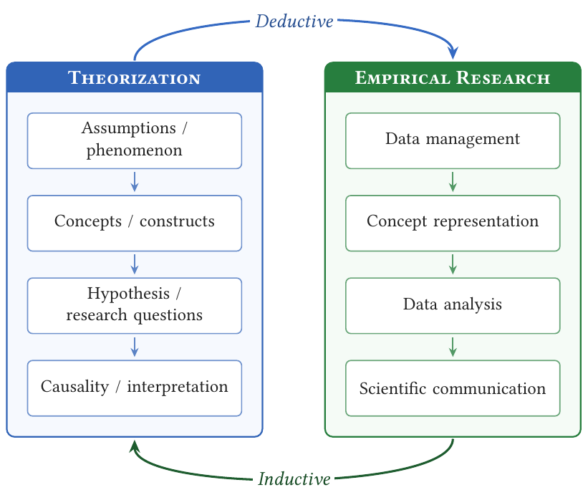
Every empirical study has two interlocking components
§1.3
Theorization develops concepts and their relations; empirical research confronts them with evidence.
Adapted from Shoemaker et al. (2003) and Ragin (2011) by Ma (2023).
Takeaway: Theory guides empirical inquiry; empirical findings reshape theory.
13 / 39
Notes:
Walk the diagram. Theorization formulates hypotheses, defines concepts, and establishes constructs; empirical research collects, analyzes, and aligns evidence with that framework. The relationship is iterative, not sequential. The book focuses on the empirical half, and the next slide names the four stages it is organized into. Students who internalize this figure can place any methods paper on the map.

Slide 14
The four stages of empirical research
§1.3
1. Data management
2. Concept representation
3. Data analysis
4. Scientific communication
The backbone of the book: each part develops one stage, in theory and in practice.
Takeaway: Any computational method ultimately serves one or more of these stages.
14 / 39
Notes:
This is the single most important slide of the course. Data management organizes and stores data; concept representation turns abstract ideas into measurable variables; data analysis extracts patterns and tests relationships; scientific communication makes the pipeline inspectable and the findings interpretable. The book pairs a theory chapter and an exercise chapter for each stage. Students will see this diagram again at every section divider of the course.

Slide 15
Data management: source, structure, standardization
§1.3
• Source: repurposed digital footprints, administrative records, multimedia
• Structure: relational tables to JSON to raw text and images; tidy data principles
• Standardization: documented, reproducible workflows with traceable lineage
Takeaway: Repurposed data must be contextualized before they can answer research questions.
15 / 39
Notes:
The three S's preview Chapter 3. What distinguishes computational data management from a survey's contained workflow: the data were usually generated for some other purpose, so repurposing needs care about bias and representation; structure varies wildly and tidy-data principles impose order; and multi-stage pipelines make documentation and standardization the difference between reproducible work and chaos. Chapter 4 has students build a literature corpus applying all three.

Slide 16
Concept representation: measures are theory-informed proxies
§1.3
• Featurization turns raw records into socially meaningful variables
• Auxiliary instruments in between: networks, document-topic matrices
• Deductive coding, inductive discovery, or an integrative loop
Takeaway: A measure is not the concept itself; different goals justify different proxies.
16 / 39
Notes:
The book prefers "representation" over "operationalization" to stress that a measure is a proxy. Give the connectedness example: build a coauthorship network, then represent connectedness as degree or network distance. The network is the instrument; the statistics are the measures. Deductive approaches code data into predefined categories (dictionaries, supervised classifiers); inductive ones let structure emerge and then require interpretation (topic models); most real projects iterate between them. Chapter 5 develops all of this.

Slide 17
Data analysis: capacities and epistemic purposes
§1.3
• New capacities: fast iteration, non-linear relationships, high-dimensional data
• Same foundations: probability, hypothesis testing, regression baselines
• Four purposes: descriptive, explanatory, predictive, integrative
Takeaway: The four purposes are not a hierarchy; each is valuable matched to the right question.
17 / 39
Notes:
Two messages must both land. First, computational analysis extends rather than replaces statistics: many computational projects still rest on regression. Second, organize analysis by epistemic purpose, the kind of knowledge sought: describing social structure, identifying causal effects, forecasting new observations, or integrating explanation and prediction for changed settings. Also flag the distinctive challenges: epistemic opacity and the interpretive work of translating model output into social concepts. Chapter 7 is devoted to this.

Slide 18
Scientific communication: making work inspectable
§1.3
• Sharing data and code; documenting workflows
• Visualization for high-dimensional results, including interactive forms
• Not mere dissemination: a social process of scrutiny and critique
Takeaway: Stochastic algorithms and API dependencies make reproducibility a deliberate effort.
18 / 39
Notes:
Communication is where a computational project earns trust. Because pipelines involve stochastic algorithms, API dependencies, and heavy preprocessing, reproducibility does not happen by default; it must be designed in. The framing to plant now, which Chapter 9 develops: communication is constitutive of scientific objectivity, not a final chore. With all four stages introduced, the book's claim is that this lens turns a pile of methods into a methodology.

Slide 19
§1.4
Comparing empirical approaches
Experiments, surveys, and computational methods through the same four-stage lens.
Ch. 1 · Introduction · cssprimer.org
19 / 39

Slide 20
Three approaches, four stages
§1.4
Approach | Data management | Concept representation | Data analysis | Communication
Experiment | Structured tabular files | Treatments and instruments | Design-based inference; regression | Tables and figures
Survey | Structured tabular files | Questionnaire items and scales | Descriptive and regression models | Tables and figures
Computational | Large-scale digital traces; text, networks, images | Automated measurement and coding | High-dimensional models; prediction | Reproducible code; interactive visuals
↗ CSS Empirical Studies Database · cssprimer.org/studies/
Takeaway: The same design questions arise everywhere; the answers differ by approach.
20 / 39
Notes:
Walk one row at a time and stress the comparability: every approach must manage data, represent concepts, analyze, and communicate. Computational data are not necessarily unstructured; they are differently structured (relational, temporal, nested). Note the cost that arrives with algorithmic measurement: epistemic opacity, the black-box critique. Invite students to place their own planned thesis method into a row of this table.

Slide 21
The comparison is a deliberate oversimplification
§1.4
• Pairwise-comparison experiments collect high-dimensional behavioral data
• Multidimensional scaling and PCA long predate CSS
• Every approach keeps evolving; the boundaries are porous
Takeaway: High-dimensional thinking is older than computational social science.
21 / 39
Notes:
Preempt the objection that the table caricatures experiments and surveys. Pairwise comparison designs plus multidimensional scaling recover latent structure from experimental data; principal component analysis has done dimension reduction in psychometrics for a century. The point of the table is not that traditional approaches are simple, but that the four-stage lens applies to all of them, which is what makes integration across approaches thinkable.

Slide 22
Integration in practice: advocacy organizations on social media
§1.4
• Automated text analysis of cognitive and emotional language at scale
• Surveys captured organization and audience context
• Each method supplied what the other lacked
Takeaway: Combining approaches at different stages yields more robust designs.
22 / 39
Notes:
Bail's study of how advocacy organizations channel public conversation is the chapter's model integration: computational text analysis processed vast social media data to track rational versus emotional language over time, while surveys supplied the organizational context and audience detail that traces cannot give. Scale without depth meets depth without scale. Ask students to sketch a two-method design for their own question using the four-stage table.

Slide 23
§1.5
“Know thyself”: find your sweet spot in CSS
Three roles, usually overlapping, always collaborating.
Ch. 1 · Introduction · cssprimer.org
23 / 39

Slide 24
Three roles in the CSS landscape
§1.5
Role | Focus | Example work
Algorithmic methodologist | Creates and tests algorithms for social research | Structural topic model; community-detection modularity
Applied methodologist | Validates existing methods in a substantive domain | Benchmarking embeddings on political corpora; fine-tuned classifiers
Computational social scientist | Answers social science questions with computational tools | Word embeddings mapping the cultural meaning of class
Takeaway: Same field, three centers of gravity: build methods, validate methods, use methods.
24 / 39
Notes:
Roberts and colleagues' structural topic model shows the algorithmic role: adding covariates to topic models made them useful for political methodology. Rodriguez and Spirling benchmarking embeddings, and Laurer's few-hundred-example fine-tuning, show the applied role. Kozlowski's geometry of culture and McMahan's ambiguity measure show the computational social scientist. The author's own citation-pattern work sits in the third role. None of these projects happened without the other two roles' output.

Slide 25
The roles overlap, and that is the point
§1.5
• Most projects need collaboration across all three roles
• Individuals move between roles over a career
• This book's vantage: a computational social scientist often working as applied methodologist
Takeaway: Choose a home base, not a cage.
25 / 39
Notes:
Reassure students who felt the previous slide asked them to pick a permanent identity. The roles describe centers of gravity, not job titles; many researchers occupy two at once, and moving between them is normal. The book is written to help graduate students incorporate computational methods into their own research whether they work independently or in teams. Good moment for a quick poll: which role attracts you today?

Slide 26
§1.6
Doing social science research in the age of AI
What AI can assist, what it cannot replace, and how to use it responsibly.
Ch. 1 · Introduction · cssprimer.org
26 / 39

Slide 27
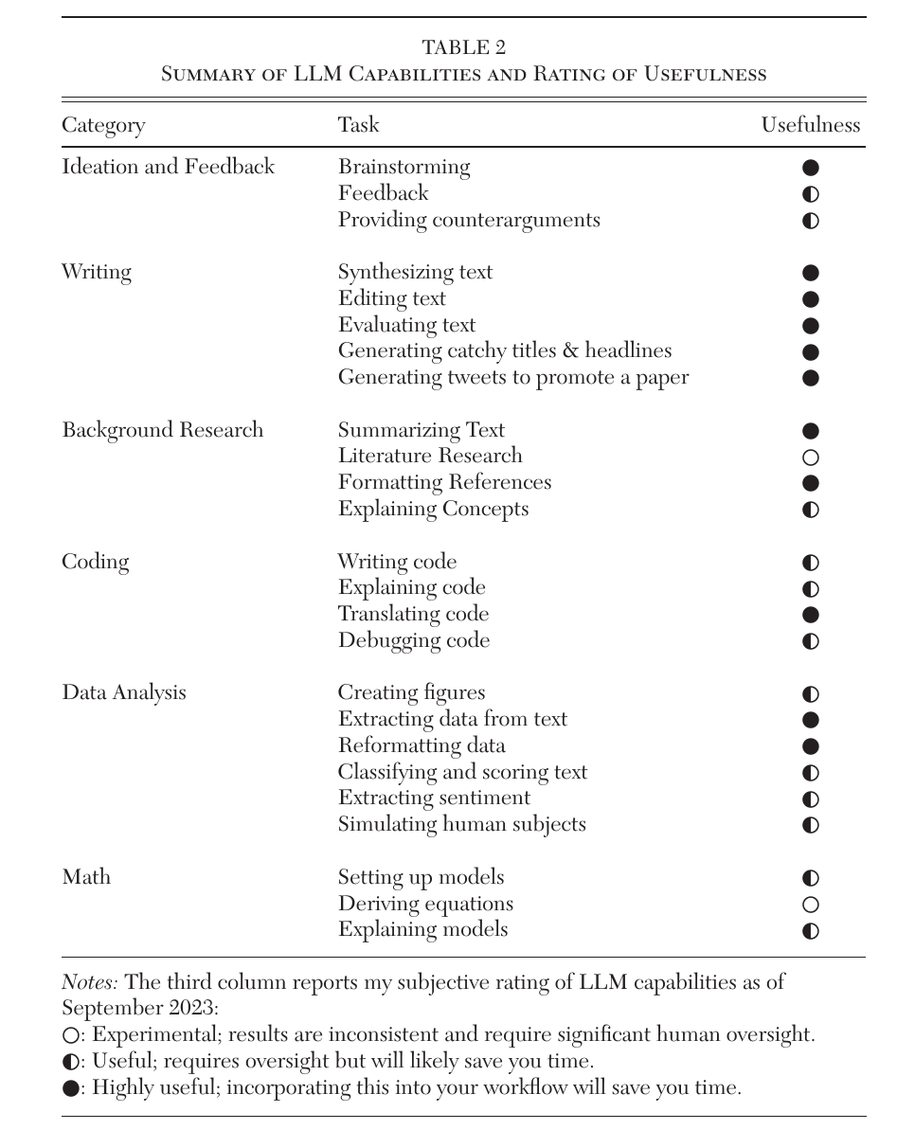
What LLMs could already assist by 2023
§1.6
Brainstorming, writing, and data reformatting rated most useful; the frontier has moved since.
Source: Korinek (2023), Table 2, Journal of Economic Literature. © American Economic Association. Included for instructional use.
Takeaway: Capability keeps moving into tasks previously rated “not useful.”
27 / 39
Notes:
Korinek's snapshot is deliberately dated: as of September 2023, LLMs assisted nearly the whole research pipeline, strongest at brainstorming, writing, and extracting or reformatting data. Since then, reasoning models and multi-agent systems have pulled tasks like literature research and deriving equations within reach. The meta-lesson for students: specific models date quickly; the pattern of capability expansion does not. Use the table as a checklist of what to try, not a verdict on what works.

Slide 28
Five task families where AI assists research
§1.6
• Idea generation and hypothesis formation
• Research design and experimentation
• Data collection and preprocessing
• Simulation and modeling, including LLM-based agents
• Writing and dissemination
Takeaway: From ideation to dissemination, assistance is available at every step.
28 / 39
Notes:
Give one concrete per family: fine-tuned models producing hypotheses rivaling human experts in clarity and originality; AI structuring protocols and tailoring study instructions; automated cleaning and sentiment extraction; LLM agents simulating human behavior in surveys and experiments; drafting, editing, and translating manuscripts. Also flag the flip side that returns two slides ahead: participants use AI too, which contaminates open-ended responses. Assistance everywhere does not mean reliability everywhere.

Slide 29
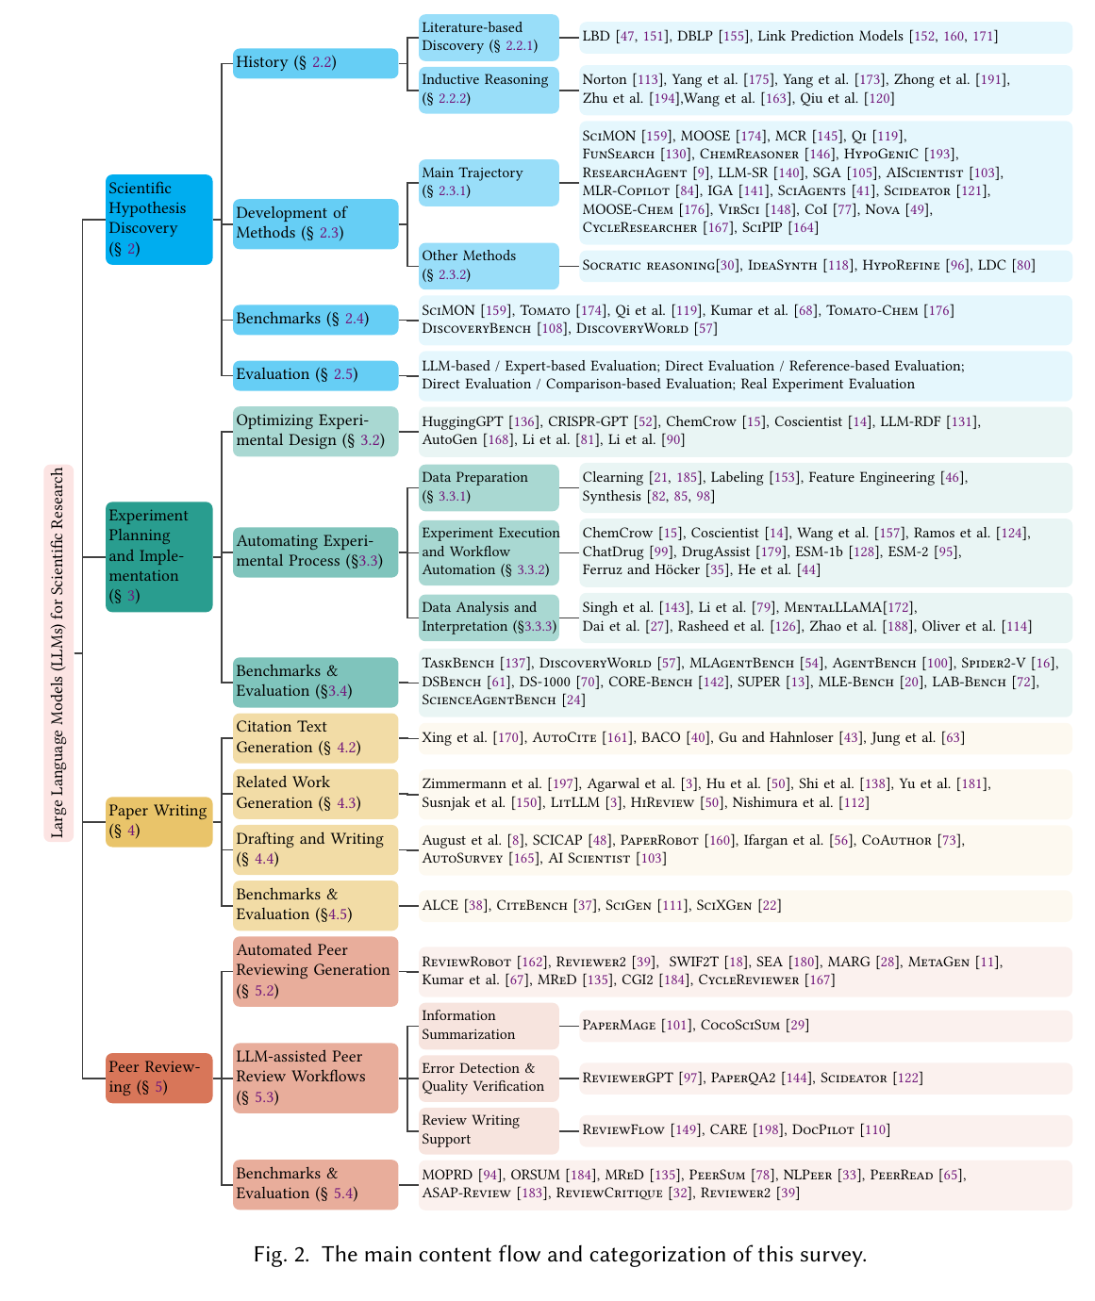
The expanding map of LLMs in scientific research
§1.6
A field survey of LLMs across the scientific workflow, as of late 2024.
Source: Luo et al. (2025), Fig. 2, arXiv preprint. Included for instructional use.
Takeaway: Expect this landscape to change in months, not years.
29 / 39
Notes:
Luo and colleagues survey LLMs across scientific research in general, not from a social science perspective; that caveat is in the book. The figure's value for this course is breadth: hypothesis generation, experiment planning, writing, and review are all active research areas. Encourage students to treat any capability map, including this one, as provisional. What matters is the verification discipline they build, which outlives every model generation.

Slide 30
Three functional roles of generative AI in research
§1.6
• Measurement tool: turning text, images, audio into variables
• Prediction and simulation: synthetic respondents and agents
• Research environment: participants, coders, and institutions use AI too
Takeaway: The third role changes what counts as a human baseline.
30 / 39
Notes:
Davidson's triad organizes everything that follows in the book. As measurement tool, the LLM enters Chapter 6's coding exercises; as simulation, it appears in Chapters 7 and 8 with synthetic respondents; as environment transformer, it returns in Chapter 11's ethics. Dwell on the third: when respondents draft answers with AI, the data-generating process itself has changed, which is a validity problem no amount of clever modeling downstream can fully repair.

Slide 31
Try out: three basic moves
§1.6
• Summarize and interrogate a paper; demand supporting quotations
• Draft a literature search; run the strings yourself
• Critique a design; treat objections as hypotheses, not verdicts
↗ Getting started · cssprimer.org/setup/
Takeaway: Every move pairs with a verification habit; the habit is the skill.
31 / 39
Notes:
These are this week's homework moves. Upload a paper, ask for a structured summary, then interrogate it seminar-style and make the model quote the passage behind each claim. Describe a topic and get search strings, synonyms, and neighboring vocabularies, then run them in a real database; never ask the model for references directly, since fabricated citations remain common. Paste a draft design and ask for a skeptical reviewer's attack. A summary that cannot point to its passages is a summary you cannot use.

Slide 32
What current AI still lacks for social inquiry
§1.6
• Causal models that support explanation, not just pattern recognition
• Grounding in intuitive theories of the physical and social world
• Compositional learning that generalizes to genuinely new tasks
• Model collapse: training on synthetic output degrades diversity
Takeaway: Assigning a human-like identity to an LLM does not produce human-like behavior.
32 / 39
Notes:
The first three criteria are Lake and colleagues' requirements for human-like machines, and social research needs exactly those capacities. Model collapse adds a systemic worry: models retrained on model output magnify their own errors. The takeaway quotes the author's own Dictator Game experiments: LLMs given human-like personas made inconsistent, unpredictable allocation decisions, so they are tools to assist research, not substitutes for human participants, at least for now.

Slide 33
Ethical stakes are already visible
§1.6
• “Junk science”: convincing outputs without empirical grounding
• Contaminated data: 37% of an MTurk sample said yes to “are you an LLM?”
• Synthetic respondents pass attention checks at near-perfect rates
• Opaque models undermine reproducibility; biased training data propagate
Takeaway: Treat unsupervised online responses as potentially mixed-origin data.
33 / 39
Notes:
Ground each risk in its evidence: arXiv banned computer-science review submissions after a flood of low-quality AI-generated content; Kay's MTurk study found 37 percent of an open sample, and 22.5 percent of high-reputation workers, answering yes when asked if they were an LLM; Westwood shows an LLM respondent passing standard attention checks 99.8 percent of the time. Once coherence stops signaling humanity, validation and robustness checks must be designed into data collection, not bolted on.

Slide 34
Practical takeaways for working with AI
§1.6
• Curate a verified knowledge base; constrain the model to it
• Keep intellectual ownership of questions, frameworks, designs
• Maintain a promptbook: the prompt is a research instrument
• Verify outputs: hand-audit samples, test every code snippet
• Patience: reflection must keep pace with generation
Takeaway: These five habits become a full project framework in Chapter 2.
34 / 39
Notes:
Each habit previews the Rules-Memory-Knowledge framework of Chapter 2. The promptbook deserves emphasis: when model output becomes data you will analyze, the prompt encodes inclusion rules and decision criteria exactly as a codebook does for human coders, so record task definitions, prompts, model versions, and audited failure modes. Small but structured errors bias downstream estimates. Patience is listed last because generation speed now outruns critical thinking by default.

Slide 35
What remains distinctly human
§1.6
• Three pillars: domain knowledge, analytical reasoning, innovation
• AI streamlines the first; the other two stay ours to sharpen
• “Taste”: knowing when a result is elegant but wrong
Takeaway: Delegate execution and drafting; protect framing, mechanism, and inference.
35 / 39
Notes:
End the section on agency rather than anxiety. LLMs approach expert-level access to domain knowledge, which frees attention for verification, interpretation, and asking consequential questions. The author's own workflow makes it concrete: design the pipeline first, inputs, transformations, outputs, validity checks, then delegate implementation, then test and revise. Taste, the trained sense of what a good solution looks like, is what distinguishes a substantive pattern from an artifact. That judgment cannot be outsourced.

Slide 36
Discussion
Reflective exercises
• How does theorization guide the collection and interpretation of data in a study you admire?
• Why treat the four stages as interconnected rather than isolated steps?
• Which of the three CSS roles fits you today, and what would move you toward another?
• What ethical considerations apply when AI tools enter your own research tasks?
Ch. 1 · Introduction · cssprimer.org
36 / 39
Notes:
Drawn from the chapter's Reflective Exercises. Run the third prompt as a think-pair-share; it surfaces the mix of backgrounds in the room and sets up collaborations for the exercise chapters. For the fourth, push past generic answers toward the concrete failure modes just discussed: fabricated citations, contaminated respondent pools, unverifiable coding. Close by connecting answers back to the four-stage checklist.

Slide 37
Key concepts from Chapter 1
Theorization: Developing concepts and their interrelations; grounds research in established knowledge
Algorithmic methodologist: Creates, adapts, and tests algorithms for social science research
Empirical research: Confronting concepts with evidence to support or refute the framework
Applied methodologist: Validates existing computational methods within a substantive domain
Four stages: Data management, concept representation, data analysis, scientific communication
Computational social scientist: Uses computational tools to answer questions of real-world significance
Computational method: Inference that could not be carried out without writing and executing code
Human-like machines: Would need causal models, grounded learning, and compositional generalization
Ch. 1 · Introduction · cssprimer.org
37 / 39
Notes:
Quick self-test rather than re-lecture: cover the glosses and have students supply them from the terms. The four stages and the definition of a computational method are the two items they must carry into next week; the three roles will recur when teams form. The full key-concepts table with citations is in the chapter, and the glossary at the back of the book defines each term with a social science example.

Slide 38
Materials on the companion site
cssprimer.org
Getting started cssprimer.org/setup/
Environment setup and the pages that close the first-week programming gap
Materials by chapter cssprimer.org/chapters/
One hub per chapter: the page to open at the start of each unit
CSS Empirical Studies Database cssprimer.org/studies/
122 annotated studies, filterable by design stage
Library cssprimer.org/library/
Primers and tool guides organized by function rather than by chapter
Ch. 1 · Introduction · cssprimer.org
38 / 39
Notes:
Walk the site live in the first session if you can. Students who bookmark the setup page and their current chapter hub rarely need support email later. The studies database returns in every theory chapter's Practice assignment, so a two-minute demonstration of its stage filter now pays off four times. Everything on the site is free and requires no login.

Slide 39
Where to go next
• Read: Chapter 2, the AI-assisted research framework (rules, memory, knowledge)
• Set up: the Getting Started guide and project skeleton at cssprimer.org/setup
• Try: the three basic moves on a paper from your own field
All materials: cssprimer.org
Notes:
Chapter 2 builds the structured project environment every later exercise assumes, so the setup homework is not optional busywork. Students should arrive next session with the project skeleton downloaded and the three basic moves attempted on a paper they care about, ready to report where the model's summary failed verification.

