Slide 1

Computational & AI-Assisted Methods for Social Sciences
A Research Design Primer
Chapter 4
Gathering Literature in Your Field
Ji Ma
cssprimer.org
Instructor slides · free to adapt for course use
Notes:
This is the exercise session for stage one, data management. Today students stop reading about data and build some: a personalized literature corpus from OpenAlex that returns in nearly every later chapter and, ideally, in their own research. The session mirrors Chapter 3's arc — source, structure, quality, workflow — with an exercise at each station. Set the expectation now: the deliverables are small individually, but together they constitute a documented, reproducible dataset, and later chapters assume it exists.

Slide 2
Learning objectives
By the end of this chapter, you can:
• Find candidate data sources through repositories, published studies, and informal networks
• Evaluate a source at four levels: raw data, preprocessing, content, retrieval
• Normalize retrieved records into tidy, relational tables documented by an ERD and a codebook
• Screen a corpus for relevance with an LLM and verify the screening with an agreement check
• Design and document a reproducible retrieval-and-preprocessing workflow
Ch. 4 · Gathering Literature · cssprimer.org
2 / 38
Notes:
Chapter 4 states its purpose in prose rather than a learning-objectives box, so these five objectives distill the chapter's sections and exercises. The arc is deliberately cumulative: evaluating a source (Exercise 4.1) feeds retrieval, whose output gets normalized (4.2) and documented (4.3), then quality-checked (4.4), relevance-screened (4.5), and wrapped in a workflow diagram (4.6). Tell students which exercises are due when in your course; the codebook and workflow documentation are the two artifacts later chapters read directly.

Slide 3
This chapter builds the dataset you will keep
• Exercises are built around literature in your own field
• The corpus returns in later chapters — and in your own projects
• Mirrors Chapter 3's structure: source → structure → quality → workflow
Takeaway: A runnable OpenAlex retrieval notebook and sample output are at cssprimer.org/ch04.
3 / 38
Notes:
Compiling a dataset is the first step of data analysis, and the book's solution to diverse student backgrounds is to make everyone's dataset personal: literature from your own field. That choice has pedagogical teeth — students can judge relevance and spot errors in their own literature far better than in anyone else's, which is exactly the judgment the exercises train. Point to the companion notebook so nobody burns the week on API mechanics; the intellectual work here is evaluation, structure, and documentation, not the retrieval code.

Slide 4
§4.1
Source: finding and evaluating data
Where data live, and the four-level inspection before you commit.
Ch. 4 · Gathering Literature · cssprimer.org
4 / 38

Slide 5
Where researchers actually find data
§4.1
• Formal channels: publications and data repositories (Gregory et al. 2020)
• Informal channels: colleagues, mentors, conference conversations
• Consider sources early; align questions with data you can realistically access
Takeaway: We practice on scholarly literature; the strategies transfer to any data type.
5 / 38
Notes:
Gregory and colleagues found data discovery runs through two channel types: formal ones — publications and repositories — and informal ones built on personal contact. Both matter, and seasoned researchers develop a feel for which archives serve which topics. The design lesson sits in the third bullet: source scouting belongs in the planning stage, because a research question you cannot feed is a question you will quietly abandon. This session works the formal channels first, returns to informal ones, then narrows to the source the course standardizes on.

Slide 6
Data from existing studies
§4.1
• Every empirical article has a data-and-methods section
• Open science mandates: journals and funders increasingly require shared data and code
• A peer-reviewed use helps you judge fitness for your purpose
• Read the methodology and documentation before reusing anything
Takeaway: Reuse cuts initial effort and enables direct comparison and replication.
6 / 38
Notes:
The most underused discovery tool is the literature itself. Data-and-methods sections describe collection and analysis in detail, and the shift toward open science means the underlying datasets and scripts are increasingly deposited alongside the paper. Seeing how a dataset performed in a peer-reviewed study is evidence about fitness that no repository listing provides. The caution is equally important: context, sampling strategy, and known biases live in the original methodology and documentation, and skipping them is how repurposing mistakes begin — the next slides catalog those mistakes.

Slide 7
Repositories, catalogs, and search engines
§4.1
• Research repositories: ICPSR, Dataverse, OSF — documentation and quality control
• Open catalogs: Zenodo, Kaggle, GitHub
• Search engines: Google Dataset Search, Data Commons, re3data
Takeaway: Curation varies widely; relevance and robustness remain your call.
7 / 38
Notes:
Sort the landscape into three tiers. Dedicated research repositories impose real quality control — ICPSR specializes in social science data and typically includes codebooks. Open catalogs are broader and shallower: Kaggle may ship sample notebooks, GitHub may ship nothing. Data search engines aggregate and index across repositories, good for rapid comparison of candidate sources. The constant across tiers: inclusion in a repository certifies documentation standards at best, never fitness for your question. The companion site keeps a curated, updated catalog of repositories at cssprimer.org/tools/data as archives and access terms change.

Slide 8
Five ways repurposed data mislead (Twidale & Marty)
§4.1
• Labels lie: “Urban Residence” differs across regions and years
• Collection practices evolve — race questions shift from one box to many
• “Cleanup” overwrites historical values
• Automated systems silently alter records, erasing address histories
• The original purpose decided what was recorded at all
Takeaway: Understand why and how the data were collected before drawing conclusions.
8 / 38
Notes:
Repurposing — transactional data answering consumer-psychology questions, chat logs revealing language change — is powerful precisely because the data were not designed for you, and each failure mode follows from that. Walk one or two: merging older single-checkbox race data with newer multiple-choice data corrupts a longitudinal analysis unless the transition is modeled; a social services database that auto-updates addresses destroys the mobility history a researcher wanted. The fifth is the deepest — a program tracking only what funders require omits the participation details sociology needs. This is Chapter 3's process view, cashed out as a checklist.

Slide 9
Personal ties and informal sources
§4.1
• Conference conversations surface little-known datasets
• Mentors and collaborators share unpublished data — and hard-won context
• Verify provenance, ethics clearance, and usage conditions first
Takeaway: Unique access arrives with documentation gaps; clarify terms before you build on it.
9 / 38
Notes:
The informal channel deserves respect, not just caution. What colleagues pass along with a dataset — how collection actually went, which analytical approaches failed — is context no codebook records. But data from personal networks often lack documentation and may carry confidentiality requirements, so the discipline is to settle conditions before the data enter your project: provenance, ethical clearance, non-disclosure terms, citation expectations. A useful classroom prompt: who in this room has access, through an advisor or a job, to data nobody outside could get? Most hands go up, and most had not considered it data.

Slide 10
Evaluate a source at four levels
§4.1
• Raw data: who gathered it, for what purpose, by what method
• Preprocessing: what was imputed, recoded, merged — and by whom
• Content: which variables, in which formats
• Retrieval: API or scraping, volume, rate limits
Takeaway: Weeks of analysis can die on a sampling choice you never checked.
10 / 38
Notes:
Evaluation is a skill that takes practice, and the chapter grounds it in the author's own scars: weeks spent on a dataset whose sampling skewed urban when the study was rural, and projects where formatting alone turned cleaning into a multi-month task. The four levels order the inspection from origin to logistics. Raw: clinical trial or convenience sample changes everything downstream. Preprocessing: imputed class-average scores or pre-assigned sentiment labels are someone else's decisions inside your data. Content: no affiliation field, no collaboration study. Retrieval: rate limits and storage decide your timeline. Next slide applies all four to the course's source.

Slide 11
OpenAlex under the four-level lens
§4.1
• Raw: metadata from Microsoft Academic, Crossref, and others — each with its own history
• Preprocessing: duplicates removed, author names harmonized
• Content: bibliographic records, citation links, concept tags, in JSON
• Retrieval: free API and bulk snapshots; rate limits apply
Takeaway: Does its sourcing overlook the journals most relevant to your field? Always trace the roots.
11 / 38
Notes:
OpenAlex is the course's standard source: an expansive, free, open catalog of global research. The four levels still apply. Its raw layer inherits its contributors' histories — Crossref centers DOI-registered publications, Microsoft Academic once prioritized certain publishers — so niche fields and preprints may be undercovered. Its curation, deduplication and name harmonization, is a preprocessing layer you did not perform. Its JSON content demands planning for Python, R, or SQL handling. Its API is generous but rate-limited. In Chapter 3's taxonomy it is featurized, published, and compiled-or-API: cheap on all three axes, which is why it suits a course.

Slide 12
Exercise: inspecting a data source
Exercise · §4.1
• Read the OpenAlex help documentation — no retrieval yet
• Work through the four levels: raw, preprocessing, content, retrieval
• Classify the source on Chapter 3's axes: format, security, interface
• Ground every claim in concrete examples from the documentation
You will need
• A browser and the OpenAlex documentation at help.openalex.org
• No data retrieval yet — this exercise decides whether the source is worth retrieving
Deliverable
A one-page source review answering the five prompts, ending with the three-axis classification and a stated decision on whether to build your corpus from OpenAlex.
↗ Chapter 4 hub · cssprimer.org/ch04/
Ch. 4 · Gathering Literature · cssprimer.org
12 / 38
Notes:
The framing matters more than the mechanics: treat every new data source like a collaborator — ask probing questions, test its limits, verify alignment with your goals. Students who skip this step assume comprehensive means fit-for-purpose and discover coverage gaps months later. The classification step connects directly back to Chapter 3's taxonomy table, and the required decision at the end keeps the review from being a book report: they must commit, in writing, to using the source or not, with reasons. Reviews that quote specific documentation passages are the ones worth sharing with the class.

Slide 13
§4.2
Structure: from JSON to relational tables
Normalization in practice: three normal forms, one diagram, one dictionary.
Ch. 4 · Gathering Literature · cssprimer.org
13 / 38

Slide 14
Two tools capture your data's organization
§4.2
• JSON is built for transmission, not analysis
• Strategy: tidy within each table, relational across tables
• ERD shows how tables relate; codebook says what variables mean
Takeaway: The diagram and the dictionary together make a dataset legible to others.
14 / 38
Notes:
Retrieved data rarely arrive analysis-ready: OpenAlex ships nested JSON, other sources ship inconsistent spreadsheets. The two strategies from Chapter 3 apply jointly — tidy each table, link tables relationally — and two documents capture the result. The entity relationship diagram is the visual blueprint of tables and keys; the codebook is the dictionary defining each variable's meaning and coding. The distinction is worth stating twice: the ERD can show that Participants links to Responses, but only the codebook says that response value 1 means strongly disagree. This section builds both.

Slide 15
Normalization: store each fact exactly once
§4.2
• User details live in one Users table; other tables hold only the foreign key
• Update a screen name in one place, not everywhere it appears
• Three normal forms steer the design: 1NF, 2NF, 3NF
Takeaway: Less duplication means fewer chances for your tables to disagree.
15 / 38
Notes:
Normalization is the principle underneath a well-structured ERD: arrange data so duplication is minimized and integrity preserved. The running example for the next three slides is a study of public discourse on healthcare policy across social media platforms — users, posts, reactions, comments. The intuition to plant before the formalism: every duplicated fact is a future inconsistency, because someday one copy gets updated and the others do not. The three normal forms are simply three named ways duplication sneaks in, each with a standard fix. Reassure students the forms are guidelines for thinking, not laws — the balance point returns at the ERD exercise.

Slide 16
First normal form: one value per cell
§4.2
• A Hashtags cell holding “#Healthcare, #Reform” cannot be queried or updated safely
• Fix: a PostHashtags table, one row per post–hashtag pair
• Now “which posts used #Policy?” is a simple filter
Takeaway: Atomic values are what make filtering and joining possible at all.
16 / 38
Notes:
1NF: eliminate repeating groups; every cell holds one atomic value. The violation is the most natural spreadsheet habit there is — comma-separated hashtags in one cell. Show why it hurts: you cannot filter posts by a single hashtag without string-parsing, and a bulk correction fails silently on inconsistent spellings inside cells. The fix splits repeating items into their own rows: Posts keeps PostID and Content, PostHashtags pairs each PostID with exactly one hashtag. Students will meet this exact pattern in OpenAlex records, where a work's authors and concepts arrive as nested lists begging to become bridge tables.

Slide 17
Second normal form: depend on the whole key
§4.2
• Composite key {PostID, Platform}: publish time genuinely needs both
• PlatformOwner depends on Platform alone — a partial dependency
• Fix: a separate Platforms table keyed by Platform
Takeaway: If a rebrand forces edits to many rows, the schema is telling you something.
17 / 38
Notes:
2NF: every non-key attribute must depend on the entire primary key. The example tracks cross-posting — the same content on Twitter, Facebook, Reddit, sometimes deliberate propaganda — in a bridge table keyed by post and platform together. PublishDateTime belongs there: a post appears at different times on different platforms. PlatformOwner does not: it is determined by the platform alone, so if Company A rebrands, every Twitter row needs editing — redundancy inviting inconsistency. Moving owners into a Platforms table keyed by platform restores full-key dependency. The diagnostic question generalizes: does this column need the whole key to make sense?

Slide 18
Third normal form: no transitive dependencies
§4.2
• PostID → City, and City → RegionName: a chain through a non-key attribute
• A spelling fix to “Seattle” should not touch many rows
• Fix: a Locations table keyed by CityID; Posts stores only the foreign key
Takeaway: City–region facts change once, in one table — and the payoff is integrity plus simpler queries.
18 / 38
Notes:
3NF: no non-key attribute may depend on another non-key attribute. Adding City and RegionName to Posts creates the chain — PostID determines City, City determines RegionName — so region facts are duplicated across every post from the same city. The fix is a Locations table keyed by CityID, referenced by a foreign key. Close the trilogy with the cumulative payoff: reduced redundancy, data integrity, simpler joins for analysis, and a structure collaborators can understand, replicate, and extend. Then the counterweight the book insists on — you are a social scientist, not a database engineer, and the next exercise makes that trade-off explicit.

Slide 19
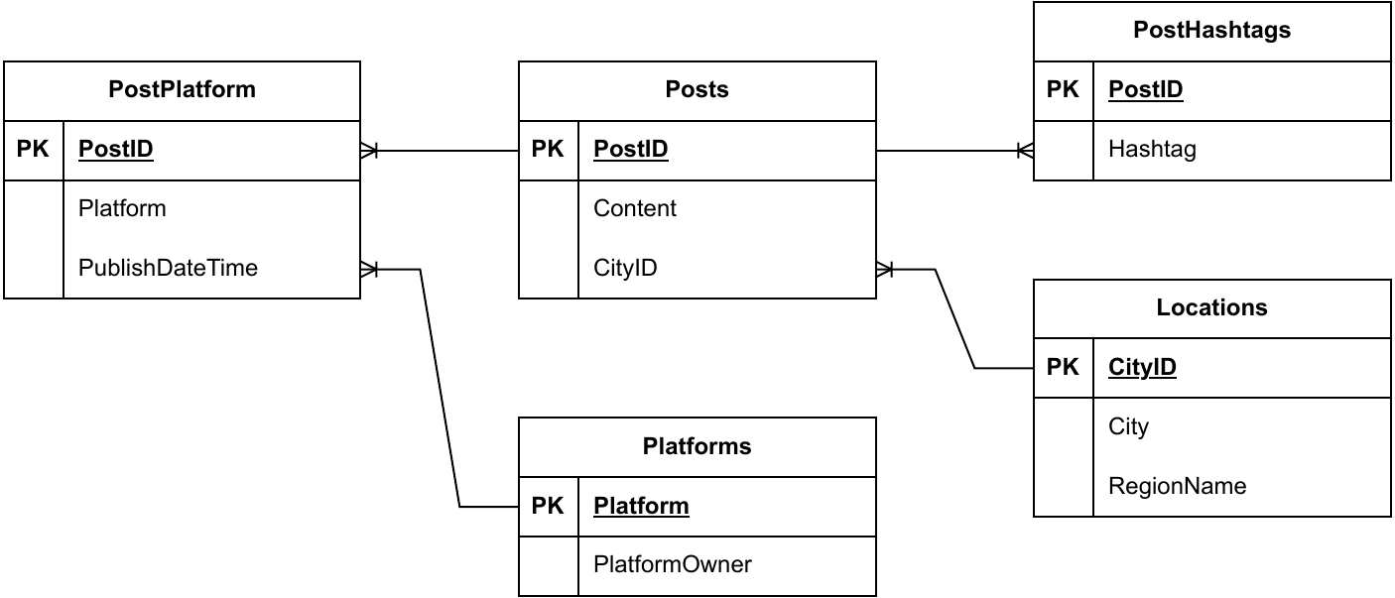
The normalized tables, assembled into an ERD
§4.2
Each box is a table with its columns; lines mark one-to-many links through primary and foreign keys.
Takeaway: One glance shows how to query the database for any analysis.
19 / 38
Notes:
This is the healthcare-policy database after all three normal forms: Posts at the center, PostHashtags absorbing the 1NF fix, Platforms absorbing the 2NF fix, Locations absorbing the 3NF fix, PostPlatform bridging posts to platforms. Walk one relationship aloud — Posts to PostHashtags via PostID, one-to-many — and note the PK markers. The diagram simplifies to one-to-many links only; one-to-one and many-to-many exist but are not needed here. The point to land: this single picture is what lets a newcomer, including your future self, plan a query without reading any code.

Slide 20
Exercise: drawing an entity relationship diagram
Exercise · §4.2
• Understand your JSON's content and structure — a JSON viewer helps
• Normalize into tables against the three normal forms
• Draw the ERD: MySQL Workbench, draw.io, dbdiagram.io, or pen and paper
• Optional: have an LLM draft the schema, then audit it against your own
You will need
• Your retrieved OpenAlex records in JSON
• A JSON viewer
• A diagramming tool — or pen and paper
Deliverable
An ERD of your normalized tables, plus a short note naming each table's unit of analysis and any structure you deliberately did not build.
Ch. 4 · Gathering Literature · cssprimer.org
20 / 38
Notes:
The deliverable's second half is the pedagogical heart: naming what you chose not to build forces the balance the book preaches — weight the actual research over data tidying. OpenAlex works, authors, venues, and citations map cleanly onto the normalization principles just shown. For the optional AI step, the audit questions come from Chapter 3: does each proposed table have a defensible unit of analysis, and do the proposed keys actually identify records in this data? Expect the model to over-engineer; noticing where it added structure the research does not need is precisely the skill being trained.

Slide 21
Codebook — and promptbook
§4.2
• The ERD shows relations; the codebook defines each variable's meaning
• Per variable: name, type, range or categories, coding rules, missing-value codes
• LLM-built variables get a promptbook entry: prompts, model version, settings, audit plan
Takeaway: Clear enough that another researcher needs no questions answered.
21 / 38
Notes:
The codebook preserves meaning over time and across users: that response value 1 means strongly disagree, that age is an integer, that 999 means missing. The contemporary addition is the promptbook. When an LLM extracts metadata, classifies documents, or validates records, those prompts, model settings, and output formats produced your variables just as a human coder's instructions would have — so document them with the same discipline. In the Chapter 2 project structure, codebooks and promptbooks live in kb/ as project knowledge, while audit logs and decisions belong in memory/. The standard is stated in the takeaway; hold students to it literally.

Slide 22
Exercise: creating a codebook
Exercise · §4.2
• Variable name and data type
• Range or valid categories
• Definitions and coding rules
• Missing values and special codes
• Promptbook entry wherever an LLM contributed
You will need
• Your normalized tables from the ERD exercise
• Any prompts you used if an LLM helped build a variable
Deliverable
A codebook covering every variable you intend to analyze, saved to kb/codebooks/ in the Chapter 2 project structure. Later chapters read from it, so build it carefully once.
Ch. 4 · Gathering Literature · cssprimer.org
22 / 38
Notes:
This is the session's most consequential deliverable: later chapters read from kb/codebooks/ directly, so corners cut here surface as confusion in the concept representation and analysis exercises. The test of adequacy is in the box text — another researcher could pick it up and understand the dataset without ambiguity. Suggest students trade codebooks with a partner and attempt exactly that; the questions the partner asks are the gaps to fix. The promptbook entries matter even when the LLM contribution felt trivial, because a variable's provenance is invisible six months later without them.

Slide 23
§4.3
Quality: checking and improving data
Garbage in, garbage out — and the screening pass that keeps your corpus on topic.
Ch. 4 · Gathering Literature · cssprimer.org
23 / 38

Slide 24
Garbage in, garbage out — compounded at scale
§4.3
• Errors propagate through millions of intricately linked records
• OpenAlex refreshes records and takes community-driven updates
• Responsibility for fitness stays with you, question by question
Takeaway: Platform quality control is a floor, not a warranty.
24 / 38
Notes:
The adage earns its keep on scholarly databases: OpenAlex links millions of publications, authors, and institutions, so a single bad linkage multiplies through every query touching it. The platform's mechanisms — frequent refreshes, community updates, documentation — address some challenges, but the chapter's position is unambiguous: researchers bear responsibility for examining quality in the context of their own questions and strategies. Chapter 3 supplied the systematic approaches — sampling checks, clean subsets, robustness tests. The next exercise is a lighter, guided version aimed at the corpus students just retrieved.

Slide 25
Exercise: inspecting data quality in OpenAlex
Exercise · §4.3
• Source: which APIs, dumps, and fields did you retrieve — and what do those choices exclude?
• Accuracy: missing DOIs, empty abstracts, authors without affiliations?
• Consistency: date formats and journal names standardized across records?
• Timeliness and cleaning: current enough? What did your cleaning change?
You will need
• Your retrieved OpenAlex dataset
• Your codebook — it tells you which fields matter enough to check
Deliverable
A one-page data-quality assessment covering source, accuracy and completeness, and consistency — each with a concrete example from your own records and a stated plan for handling it.
Ch. 4 · Gathering Literature · cssprimer.org
25 / 38
Notes:
The exercise turns Chapter 3's validation logic into a guided inspection. The codebook dependency is deliberate: without it, students check everything shallowly; with it, they check the fields their analysis will actually consume. Push for concrete examples — an actual work ID with a missing abstract beats a sentence about missing abstracts — and for consequences: how would that gap bias a citation analysis or a collaboration study? The final prompt about sensitivity analyses previews the robustness-test habit. One page is a feature, not a limit; prioritizing which problems matter is part of the assessment.

Slide 26
Keyword queries over-collect by design
§4.3
• “Civic participation” sweeps in patient participation and participatory sensing
• Systematic reviews screen titles and abstracts against explicit criteria
• An LLM can run the exhausting first pass — under the same discipline
Takeaway: Vague criteria produce confident, arbitrary screening; the model fills gaps with its own defaults.
26 / 38
Notes:
Keyword retrieval matches words, not meaning, so every corpus starts with topical contamination. The systematic-review tradition answers with human screening against explicit inclusion criteria, and that discipline is worth keeping when an LLM takes the first pass. The design principle: write criteria as if briefing a new research assistant — what is in scope, what is explicitly out, what to do when unsure. The takeaway names the failure mode to fear most: not visible errors, but invisible ones, where underspecified criteria let the model substitute its own defaults and nothing looks wrong. That is why the next exercise builds in verification.

Slide 27
Exercise: LLM screening with an agreement check
Exercise · §4.3
• Write inclusion and exclusion criteria, plus an “uncertain” option
• The model labels each record — include, exclude, uncertain — quoting its evidence
• Hand-screen 30 records blind; compute agreement; close-read every disagreement
• Accept, revise and rerun, or fall back to hand screening — and document the decision
You will need
• OpenAlex records with titles and abstracts
• Access to a language model
• A written statement of what your corpus is about; prompt templates at cssprimer.org/primers/prompting
Deliverable
The screened corpus plus a half-page screening note: criteria, agreement rate, disagreement diagnosis, decision. The note is part of your dataset's provenance.
↗ Prompting and its failure modes · cssprimer.org/primers/prompting
Ch. 4 · Gathering Literature · cssprimer.org
27 / 38
Notes:
Two design choices deserve emphasis. Screening blind — labeling your 30 records before seeing the model's answers — is what makes the agreement rate honest; students who peek anchor on the model and their check collapses into confirmation. And disagreements are diagnostic, not just errors to count: each one is the model wrong, you wrong, or the criteria ambiguous, and the third category is the most common and most fixable. There is no magic agreement threshold; the decision depends on the disagreement pattern. The documented note matters because this screening decision shapes every analysis built on the corpus later.

Slide 28
§4.4
Standardization with workflows
Make the whole pipeline explicit, documented, and runnable.
Ch. 4 · Gathering Literature · cssprimer.org
28 / 38

Slide 29
A workflow makes the process explicit
§4.4
• Define query terms → retrieve → parse and store → clean and unify → merge with other data
• Each arrow is a documented, repeatable step
• Shared goals: effectiveness, reproducibility, reusability, traceability
Takeaway: If a step lives only in your head, the workflow does not contain it.
29 / 38
Notes:
Workflows vary with source, design, and computing setup, but all good ones share Chapter 3's four properties. The five-step OpenAlex pipeline is this chapter's template: choose keywords and subject areas, retrieve JSON via API or bulk dumps with filters, convert to CSVs or database tables, deduplicate and standardize author names and drop broken records, then link outward to rankings or social media mentions. Have students mentally check off which steps they performed this week and which they performed but never wrote down — the second list is the one this section exists to eliminate.

Slide 30
Document at two levels of detail
§4.4
• Macro: a diagram from OpenAlex to local database to analysis
• Micro: endpoints, filters like publication_date:>2020-01-01, scripts, cleaning rules, version control
• Quick orientation for readers; full depth for reproducers
Takeaway: A diagram without notes is decoration; notes without a diagram are a maze.
30 / 38
Notes:
Good workflow documentation serves two audiences at once. The high-level diagram — boxes and arrows from source to analysis — lets anyone grasp the shape of the project in seconds. The granular layer records what each arrow actually did: which API endpoints, which filter strings, which scripts with what annotations, how missing affiliations and multi-language abstracts were handled, where Git history and dataset snapshots live. Neither layer substitutes for the other. The next slide shows a published example that does both within a single figure, from the author's own work.

Slide 31
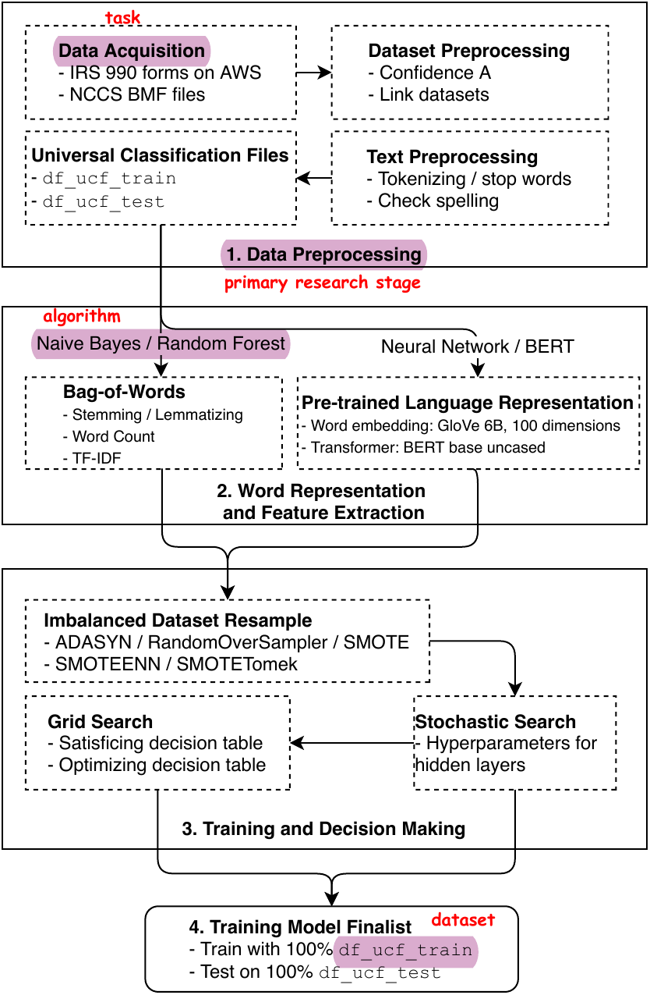
A real multi-stage workflow, published
§4.4
Automated classification of U.S. nonprofits: stages, task-level detail, and component types in one diagram.
Source: Ma (2021), Fig. 1, Nonprofit and Voluntary Sector Quarterly. © SAGE Publications. Included for instructional use.
Takeaway: Every stage names its inputs, tools, and outputs.
31 / 38
Notes:
This workflow, from the author's automated NTEE-classification study, shows the two-level principle at publication quality. Read it top to bottom: data preprocessing from IRS 990 forms through universal classification files, feature extraction splitting into bag-of-words and pretrained embeddings by algorithm family, training with resampling and hyperparameter search, and a model finalist trained on the full data. Notice the annotations distinguishing tasks, algorithms, and datasets, and stage labels beside file-level specifics like df_ucf_train. Students' Exercise 4.6 diagrams will be simpler, but the standard — a reader can retrace the study from the figure — is the same.

Slide 32
Exercise: your workflow
Exercise · §4.4
• Define your scope: keywords, journals, or subject headings
• Draw the workflow with a short narrative for each component
• Name and organize: 01_OpenAlexQuery.R, raw_data/, cleaned_data/, a README
• Add a promptbook if LLMs helped with coding or validation
You will need
• The retrieval and cleaning steps you actually performed in this chapter
• A diagramming tool
Deliverable
A workflow diagram with a short narrative per stage, plus the named and organized project directory it describes — the documentation later chapters assume you kept.
Ch. 4 · Gathering Literature · cssprimer.org
32 / 38
Notes:
The instruction to document what students actually did — not an idealized pipeline — is what gives this exercise teeth: gaps in the diagram reveal steps done ad hoc. Numbered scripts, folders mirroring the workflow, and a README follow Gentzkow and Shapiro's conventions; students using the Chapter 2 project structure put workflow documentation in memory/ and codebooks in kb/codebooks/. This deliverable closes the chapter's loop: source review, ERD, codebook, quality assessment, screening note, and now the workflow that binds them into one reproducible, documented dataset. Later chapters assume exactly this state of the project.

Slide 33
Five workflow habits (Gentzkow & Shapiro)
§4.4
• Make the directory runnable: one script rebuilds everything
• Make changes safe: version control; run the full pipeline before committing
• Let structure communicate: input, code, output; keyed, normalized tables
• Abstract repeated code; comment strategically, not extensively
• Track tasks outside email: owner, status, definition of done
Takeaway: Many “data problems” are workflow problems in disguise.
33 / 38
Notes:
Gentzkow and Shapiro's manuscript is short and worth assigning whole; these habits are its spine. The runnable-directory test is deliciously concrete: delete your intermediate outputs and rebuild without manual steps — most students discover they cannot. Version control replaces date-stamped filenames with one authoritative history, and the discipline that matters more than the tool is running the pipeline end to end before recording a version. On documentation, their caution is counterintuitive but right: extensive comments go stale and mislead, so comment the non-obvious and let names and structure carry the rest. The limiting resource in graduate research is careful thinking; workflows protect it.

Slide 34
Tools that carry the load
§4.4
• OpenRefine: bulk cleaning with a replayable operation history
• Spreadsheets: quick inspection — beware silent type conversions
• draw.io, dbdiagram.io, MySQL Workbench for ERDs; some generate the SQL
• GitHub and OSF for documentation, versioning, collaboration
↗ Data-management tools · cssprimer.org/tools/data
Takeaway: An updated tool list and repository catalog live at cssprimer.org/tools/data.
34 / 38
Notes:
A quick tour, not an endorsement list — tool choice depends on data size, team familiarity, and the research questions. OpenRefine's operation history deserves the highlight: every transformation is recorded and replayable, which makes cleaning itself reproducible in the spirit of this whole chapter. The spreadsheet warning is earned by generations of mangled data — auto-converted dates and stripped leading zeros. ERD tools that generate SQL keep diagram and database consistent. The printed book freezes; the companion page does not, so send students there rather than memorizing this slide.

Slide 35
Discussion
Reflective exercises
• What did inspecting OpenAlex change about how you now read the data section of published papers?
• How much structure was enough? Where did normalization serve your research, and where did it become engineering for its own sake?
• What did the agreement check reveal? Would you trust the same workflow on a corpus you could not hand-verify?
• Could a classmate reproduce your dataset from your documentation alone? Name your weakest-documented step.
Ch. 4 · Gathering Literature · cssprimer.org
35 / 38
Notes:
Drawn from the chapter's reflective exercises. The first prompt asks for a named coverage gap or bias in OpenAlex that could plausibly affect a study in the student's field — hold them to naming one. The second surfaces the social-scientist-not-engineer balance; answers that admit to over-engineering are the honest ones. The third generalizes beyond this corpus: the uncomfortable answer is usually no, which is the right instinct. The fourth ends the session with action — the chapter says strengthen the weakest step now, while the details are still in memory, so consider making that repair tonight's only homework.

Slide 36
Key concepts from Chapter 4
Entity relationship diagram: Visual blueprint of how tables link through keys in a relational database
Promptbook: Records the prompts, model settings, and audits behind LLM-built variables
Normalization: Restructuring tables to store each fact once, steered by the three normal forms
Agreement check: Blind hand-screening of a sample to estimate concordance with model labels
Three normal forms: Atomic values; whole-key dependency; no transitive dependencies
Rate limit: A cap on API requests that shapes retrieval time and design
Codebook: Defines how each variable is structured, coded, and interpreted
Version control: One authoritative history of what changed, when, and by whom
Ch. 4 · Gathering Literature · cssprimer.org
36 / 38
Notes:
Chapter 4 has no key-concepts table, so this recap collects the working vocabulary the exercises introduced; the glossary at the back of the book defines the starred terms formally. Self-test format again: cover the glosses, reconstruct from the terms. The pairs are what matter — ERD with codebook as structure plus meaning, screening with agreement check as delegation plus verification, normalization with the three forms as principle plus procedure. Students should also leave able to say, in one sentence each, what their six deliverables were and where each lives in the project directory.

Slide 37
Materials on the companion site
cssprimer.org
Chapter 4 hub cssprimer.org/ch04/
The exercise chapter's materials, prerequisites, and deliverable in one place
Data-management tools cssprimer.org/tools/data
OpenAlex, reference managers, and the rest of this chapter's toolkit
Getting started cssprimer.org/setup/
Where to send students whose environment breaks mid-exercise
Ch. 4 · Gathering Literature · cssprimer.org
37 / 38
Notes:
This chapter is where environments actually break, so the support pattern matters: the hub states the deliverable and prerequisites, the tools page carries current links, and the setup page handles the installation problems. Students who work from the hub rather than from memory of the lecture complete the corpus exercise with far less back-and-forth.

Slide 38
Where to go next
• Revisit: Chapter 3's 3S framework — your corpus is now a worked case of all three
• Browse: the chapter hub — retrieval notebook, prompt templates, tools catalog at cssprimer.org/ch04
• Next: Stage 2, concept representation — Chapters 5 and 6 turn this corpus into measures
All materials: cssprimer.org
Notes:
Close by naming what now exists: a source review, normalized tables with an ERD, a codebook, a quality assessment, a screened corpus with its provenance note, and a documented workflow — a real dataset, managed to the standard Chapter 3 argued for. The pipeline moves to stage two next: concept representation, where the corpus stops being rows of metadata and starts becoming measures of ideas. Students behind on any deliverable should catch up before then, since the Chapter 6 exercises read the codebook and screened corpus directly.

