Slide 1

Computational & AI-Assisted Methods for Social Sciences
A Research Design Primer
Chapter 5
From Concepts to Measures
Ji Ma
cssprimer.org
Instructor slides · free to adapt for course use
Notes:
This deck accompanies Chapter 5, the theory chapter for concept representation, stage two of the four-stage framework. Today's argument in one line: between a theoretical idea and a column of numbers lies a chain of decisions, and every one of them can quietly change what you end up measuring. We will work through worldviews, deductive and inductive measures, featurization, auxiliary instruments, validity, and the marginal-cases problem, and close with what AI can and cannot contribute to concept work.

Slide 2
Learning objectives
By the end of this chapter, you can:
• Identify the four research worldviews and how each shapes computational measurement
• Distinguish deductive, inductive, and integrative approaches to concept representation
• Explain featurization and auxiliary instruments as bridges from raw data to theory
• Evaluate computational measures against conceptual-goodness, validity, and reliability criteria
• Diagnose the marginal-cases problem and its ethical stakes
Ch. 5 · Concepts to Measures · cssprimer.org
2 / 42
Notes:
These objectives distill the chapter's arc. The second and third are the technical core: by the end, students should be able to take any published computational measure and reconstruct the chain from raw records through an auxiliary instrument to a feature. The first and last are the framing pair: worldviews open the chapter and the marginal-cases problem closes it, and both are about the same question, namely whose experience a measure can represent.

Slide 3
Stage 2: concept representation
Chapter 5
1. Data management
2. Concept representation
3. Data analysis
4. Scientific communication
Chapters 5 and 6 develop the second stage: turning abstract ideas into variables an analysis can use.
Takeaway: Every method in this chapter serves one job: linking concepts to data defensibly.
3 / 42
Notes:
Re-anchor students in the pipeline before descending into the chapter. Data management, from Chapters 3 and 4, produced organized and documented records; concept representation now decides what those records will be taken to mean. The book prefers this term over the traditional "operationalization" because it covers deductive measurement but also inductive and interpretive ways of linking concepts to data. Chapter 6 makes everything here hands-on with the OpenAlex corpus.

Slide 4
A measure is a chain of decisions, not a translation
Chapter 5
• A dictionary, a topic model, and a network position can all claim to measure “influence”
• Each commits you differently, sees different cases, fails differently
• Failures are not evenly distributed; the missed cases are often the ones you most want
• “Representation”: measures are partial, theory-informed stand-ins for the concept
Takeaway: AI can draft candidate measures; whether a measure is valid remains your judgment.
4 / 42
Notes:
Set the chapter's stakes with the influence example: three plausible measures of the same concept, three different commitments. Then explain the terminology choice. "Operationalization" is closely associated with postpositivist research; "representation" is more descriptive, less committed to one worldview, and keeps attention on the fact that the measure is never the concept itself. The last line previews the AI section: models can propose and critique, but validity evidence is the researcher's to produce.

Slide 5
“In computational research, epistemology is not a preamble to the method; it is embedded in the method.”
Chapter 5
Ch. 5 · Concepts to Measures · cssprimer.org
5 / 42
Notes:
Unpack the claim with the chapter's examples. A keyword dictionary wagers that a concept can be fixed in advance and matched against data; a topic model wagers that categories should emerge from the data instead. Deciding whose posts to collect and whose codes to trust settles whose experience the measure can represent at all. These are the postpositivist, constructivist, and transformative positions made in code rather than argued in a seminar. Students will commit to one in every exercise from Chapter 6 onward; the only question is whether they do it deliberately.

Slide 6
§5.1
Worldviews and purposes of social research
Four philosophical orientations, and the research goals each one serves.
Ch. 5 · Concepts to Measures · cssprimer.org
6 / 42

Slide 7
Postpositivism: approximating an external reality
§5.1
• Cause-and-effect emphasis; reductionistic focus on a few key variables
• Objective reality approached through systematic observation and measurement
• Theory-driven cycle: propose, test, refine, repeat
• CSS example: classify millions of posts, model what drives virality
Takeaway: Objectivity is the aspiration; absolute objectivity is acknowledged as impossible.
7 / 42
Notes:
Distinguish postpositivism from positivism first: it keeps the striving for objectivity while conceding that absolute objectivity is unreachable. The four emphases come from Creswell. Walk the misinformation example: collect posts, classify content into theoretical categories like emotional valence or source credibility, then model how those measures predict rapid transmission. Theory revision follows test results: if emotional valence explains less variance than hypothesized, you refine the category or propose a different angle. That loop is how a postpositivist theory evolves.

Slide 8
Constructivism: multiple realities, contextual meaning
§5.1
• Subjective, overlapping interpretations rather than a single truth
• Meaning emerges from historical, cultural, and social context
• Researcher reflexivity replaces claimed neutrality
• CSS example: topic-model a hashtag, then read, engage, and reflect
Takeaway: Theory is revised against participants' lived realities, not prediction error.
8 / 42
Notes:
The contrast case, typically associated with qualitative research. In the hashtag example, topic modeling only opens the inquiry: the researcher then reads the tweets, notes linguistic nuance and user context, possibly interviews users, and reflects on how personal assumptions shape interpretation. Stress the different standard of revision named in the takeaway: categories that fail to capture the complexity of people's experiences get refined or replaced, regardless of how well they predict. This is a fully legitimate home for computational tools, which surprises students who equate coding with hypothesis testing.

Slide 9
Transformative research: knowledge tied to social change
§5.1
• Centers marginalized groups; investigates power and inequity
• Action-oriented: findings feed advocacy, outreach, and policy proposals
• Participants co-design the research and share ownership
• CSS supports the work without leading it: networks map connections, topics surface demands
Takeaway: Revision follows the community's evolving priorities, decided jointly with participants.
9 / 42
Notes:
Transformative inquiry emerged because postpositivist and constructivist work did not adequately address power, justice, and social change. Its four philosophical commitments, from Mertens: an ethical focus on social justice, an ontology that asks which realities are privileged, an epistemology of cultural competence and authentic engagement, and a methodology that often mixes methods to address power imbalance. In the social media example, researchers partner with community leaders before collecting anything, and the analysis exists to amplify voices and design action steps. Flag that this worldview returns at the marginal-cases problem.

Slide 10
Pragmatism: what works, in context
§5.1
• Problem-centered inquiry; methodological freedom, mixed methods welcome
• The test of an idea: does it solve the concrete problem?
• CSS example on online bullying: NLP detection, network clusters, plus interviews
Takeaway: What works, demonstrably and in context, is the standard that drives revision.
10 / 42
Notes:
Pragmatism refuses the choice between the previous three stances. The bullying example shows the division of labor: NLP quantifies prevalence and trends, network analysis reveals the structures that facilitate or inhibit harassment, and interviews capture the lived impact that neither can reach. Solutions are then tailored and evaluated by whether they demonstrably reduce harm. Note the contrast with transformative work: both are impact-oriented, but pragmatism prioritizes solving the problem at hand over a specific ethical agenda. Ragin's seven goals of social inquiry map across all four worldviews.

Slide 11
Worldviews map to computational measures
§5.1
 | Postpositivism | Constructivism | Transformative | Pragmatism
Purpose | Test and refine theory; predict | Interpret phenomena; advance new theory | Explore diversity; give voice | Real-world practice oriented
Approach | Deductive measures | Inductive measures | Not bound to one approach | Not bound to one approach
Example method | Keyword-dictionary classification | Topic modeling | Social network analysis | New data source + ML classification
Example study | Golder & Macy (2011) | Hannigan et al. (2019) | Loutfi et al. (2020) | Asur & Huberman (2010)
Takeaway: Read the table as a design heuristic, not a rulebook.
11 / 42
Notes:
This is the chapter's central alignment table. Walk it column by column: diurnal mood measured with dictionaries for postpositivist theory testing; topic modeling for constructivist theory building in management research; network analysis of marginalized young women for transformative outreach; a new data source plus machine-learning classification for pragmatic box-office prediction. Emphasize the two "not bound" cells: transformative and pragmatic work select whatever serves the goal. Each worldview also has limitations; knowing yours helps you see what your approach oversimplifies or cannot generalize.

Slide 12
§5.2
Epistemological approaches to computational measures
Deductive, inductive, and integrative routes from concept to code.
Ch. 5 · Concepts to Measures · cssprimer.org
12 / 42

Slide 13
Deductive measures: categories defined before you look
§5.2
• Automated coding of raw data into predefined theoretical categories
• Word lists: “flowers” pleasant, “insects” unpleasant (Caliskan et al.)
• Machine learning extends the principle by learning from labeled examples
• Strengths: consistency and scalability on large datasets
Takeaway: Deductive coding wagers that the concept can be fixed in advance.
13 / 42
Notes:
The bucket metaphor helps: you carry themes in mind before examining the data, then sort documents into them. Use the transportation-policy example: predefined word sets for positive and negative feedback, applied automatically to tweets. Supervised classifiers generalize the same logic from word lists to learned patterns, as in protest-event detection and coding of political video. This approach fits established hypotheses about content you expect to find, which is exactly its postpositivist alignment from the table.

Slide 14
Inductive measures: letting structure emerge
§5.2
• A misconception: computational methods only serve postpositivist quantifiers
• The representational view: data represent the social world; insights emerge inductively
• Topic modeling within grounded theory, refined through manual reading
• Network analysis surfaces clusters and bridges you did not anticipate
Takeaway: Most valuable when understanding is still unfolding and categories would come too soon.
14 / 42
Notes:
Correct the misconception explicitly, because many students carry it in. Under a constructivist view, quantitative or qualitative data are representations of the social world from which researchers generate insights inductively. Topic modeling of interview transcripts inside grounded theory, per Baumer and Hannigan, blends automated pattern detection with human interpretation so unanticipated insights are not missed. Networks are the other exemplar, which the next slide shows in a published transformative-flavored study. Letting the data speak reveals themes that predefined categories would have hidden.

Slide 15
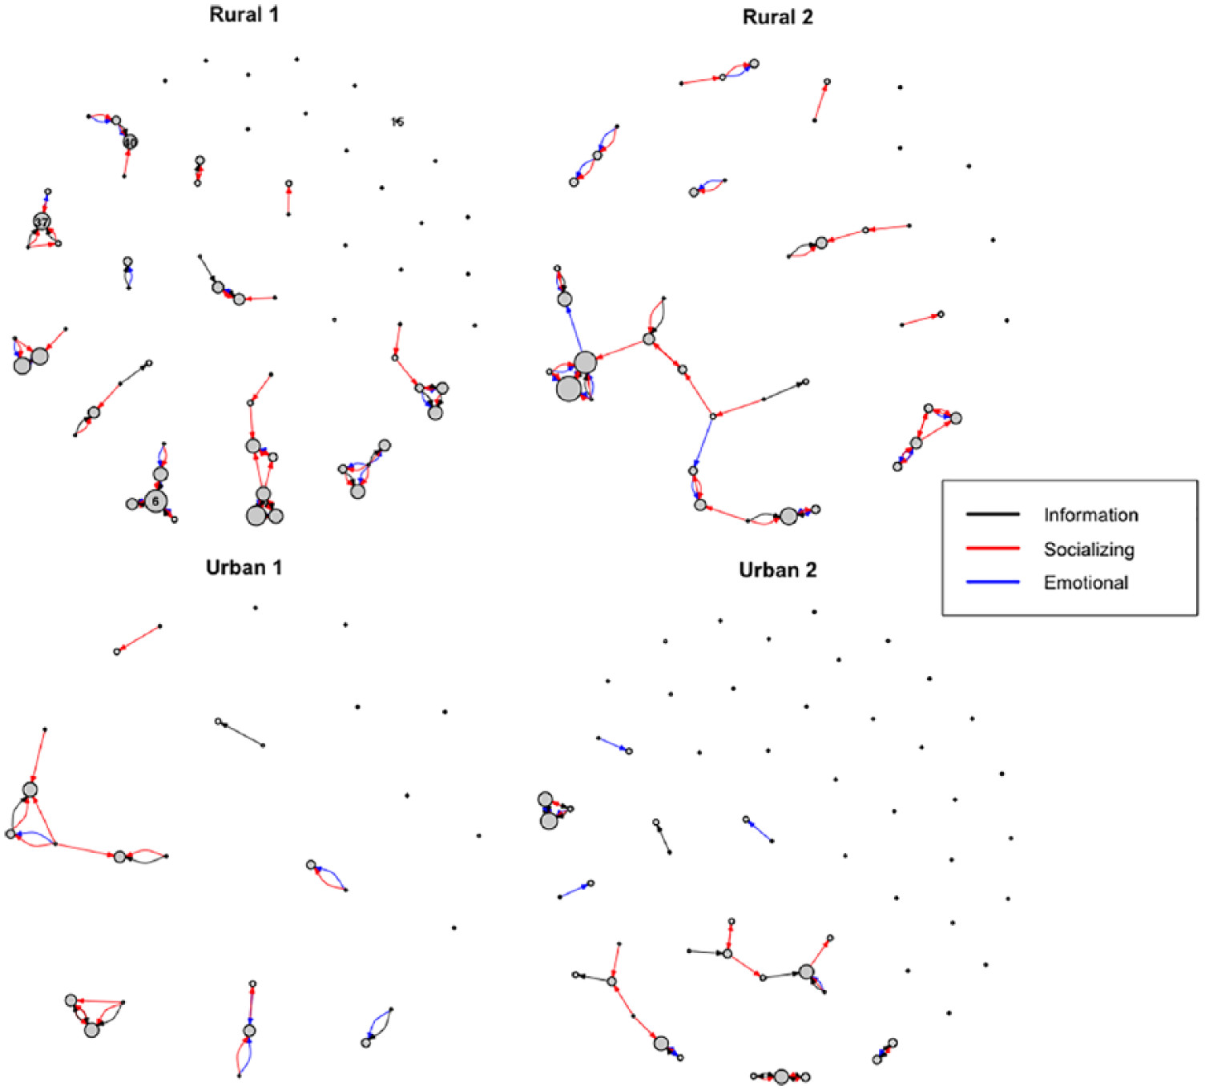
Networks reveal how marginalized communities connect
§5.2
Support networks of young women at high HIV risk in four Botswana communities. Node size: how often a participant was sought for support; tie color: information, socializing, or emotional support.
Source: Loutfi et al. (2020), Fig. 1, Global Health Promotion. © SAGE Publications. Included for instructional use.
Takeaway: Emergent structure, not a preset category scheme, guided more effective outreach.
15 / 42
Notes:
Loutfi and colleagues mapped the social ties of young women at high risk of HIV infection in Botswana and found that many relied heavily on family members and preferred face-to-face communication, insights that reshaped outreach strategy. Point out the sparse urban panels versus the denser rural ones. Connect to the broader point from Lubbers and colleagues: for marginalized communities, networks both build resilience and reproduce the inequalities people face, so their structure is worth mapping carefully. A companion example in the chapter is Cassidy and Barnes's money-exchange network of Botswana households.

Slide 16
Integrative measures and methodological bricolage
§5.2
• Start deductive (sentiment lexicon), then add inductive discovery (topic model)
• Keeps automated scalability while staying open to unanticipated patterns
• Bricolage: weaving multiple techniques into one workflow (Bonikowski)
• Abductive logic blurs the neat deduction-induction line
Takeaway: A deductive step finds a known concept; an inductive step explores what surrounds it.
16 / 42
Notes:
Like the transformative and pragmatic worldviews, integrative measurement is not bound to a single stance; it selects what the question needs. The typical pattern: a predefined lexicon sorts a large corpus, then topic modeling or clustering catches nuances the initial framework did not anticipate. Bonikowski's term "methodological bricolage" names this weaving-together, and its abductive logic is worth a beat: real projects cycle between imposing categories and discovering them. Chapter 6's triangulation exercise turns this slide into a full workflow.

Slide 17
Method choice as three explicit decisions
§5.3
• Methods carry no fixed epistemology; your worldview supplies the link to the concept
• Decide the unit of analysis and data source
• Decide deductive, inductive, or integrative representation
• Decide which checks can support validity for this use
Takeaway: Start from the concept and the claim you want to make, then work backward to the tool.
17 / 42
Notes:
This short section is the practical payoff of everything so far. The same tool can play different roles: an embedding can serve explanation, interpretation, equity, or intervention. What differs is the justification: transformative work integrates methods to make inequalities visible while centering marginalized perspectives; pragmatic work combines whatever evidence supports a concrete decision. The three-decision sequence turns method choice from taste into design, and it is the template students should apply in the Chapter 6 exercises.

Slide 18
§5.4
From raw data to socially meaningful variables
Featurization, and the auxiliary instruments that make measurement feasible.
Ch. 5 · Concepts to Measures · cssprimer.org
18 / 42

Slide 19
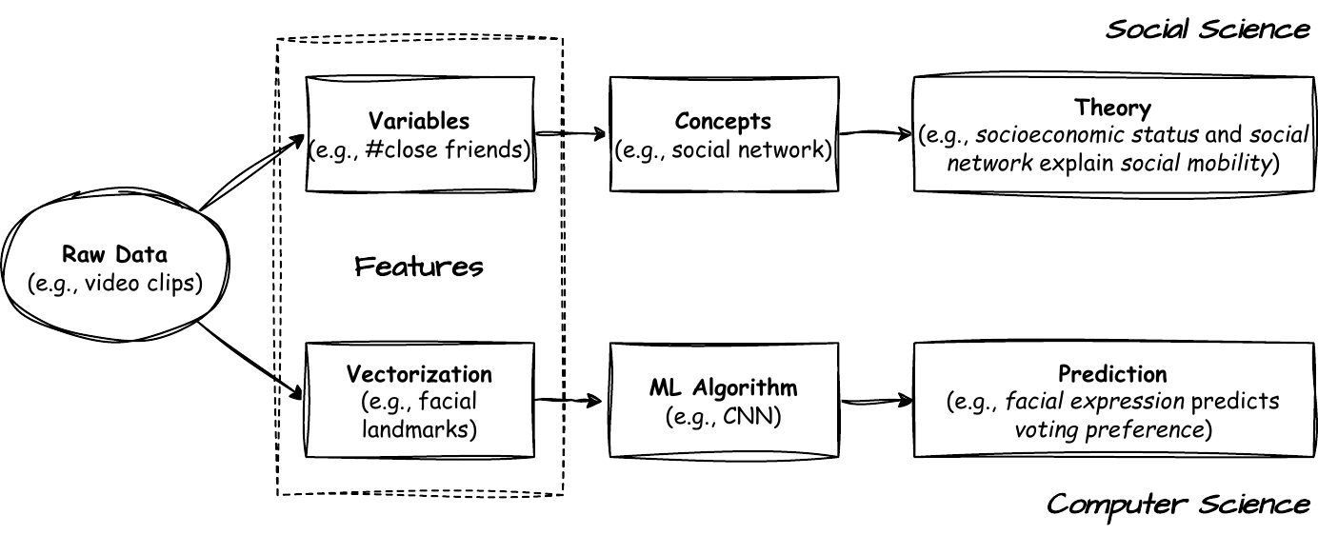
Featurization sits between raw data and latent structure
§5.4
“Features” in social and computer sciences: observable variables cluster into concepts, and concepts become building blocks of theory.
↗ Working with text data · cssprimer.org/primers/text-data
Takeaway: Featurization transforms raw data into socially meaningful variables.
19 / 42
Notes:
Walk the diagram: income, education, and occupation cluster into socioeconomic status; gathering frequency, close friends, and memberships combine into social network; both concepts then explain social mobility. That translation step is what many textbooks call operationalization and this book calls concept representation. Use the political-speech video example: computer vision extracts color histograms and facial landmarks, but the social scientist codes emotion, topic, and intended audience. Each coded category ties to a theoretically relevant construct rather than raw pixels.

Slide 20
Same word “feature,” two disciplinary meanings
§5.4
Computer science
Social science
• Any measurable attribute: pixel intensity, word frequency
• Extracted automatically, purely data-driven
• Aim: maximize predictive performance
• A variable imbued with conceptual and theoretical meaning
• Chosen or coded to reflect theory: trust, social capital, framing
• Aim: preserve conceptual relevance
Takeaway: Careful feature design keeps analyses able to speak to social theory, not only to accuracy.
20 / 42
Notes:
The terminological collision matters because interdisciplinary teams talk past each other here. A vector of frame-level values is a perfectly good feature for training a model and a poor feature for testing a theory of political emotion. The right-hand column is not a rejection of the left: social scientists still need the automated extraction, but they add a layer of interpretive commitment on top. Validating that layer, showing the coded feature really reflects the construct, is what the validity section later demands.

Slide 21
Auxiliary instruments: the bridge in the middle
§5.4
• Workflow: raw data → auxiliary instrument → measure (feature)
• “Instrument” means a practical measurement tool, not an instrumental variable
• Rarely the outcome of interest; it makes measurement feasible, reusable, transparent
• You can point to a concrete object: a network, a matrix
Takeaway: Measurement in CSS is multi-stage; the intermediates carry the key decisions.
21 / 42
Notes:
Many CSS measures are not computed directly from raw records: you first build an intermediate representation that organizes information so a concept can be quantified. Head off the causal-inference confusion immediately; this is not an instrumental variable. The pedagogical value of instruments is explainability: you can show a reader the network or the matrix rather than an opaque algorithmic output. The decisions that matter, what counts as a tie, what counts as a topic, which similarity function, live in the intermediate, which is why they must be documented and validated. Two examples follow.

Slide 22
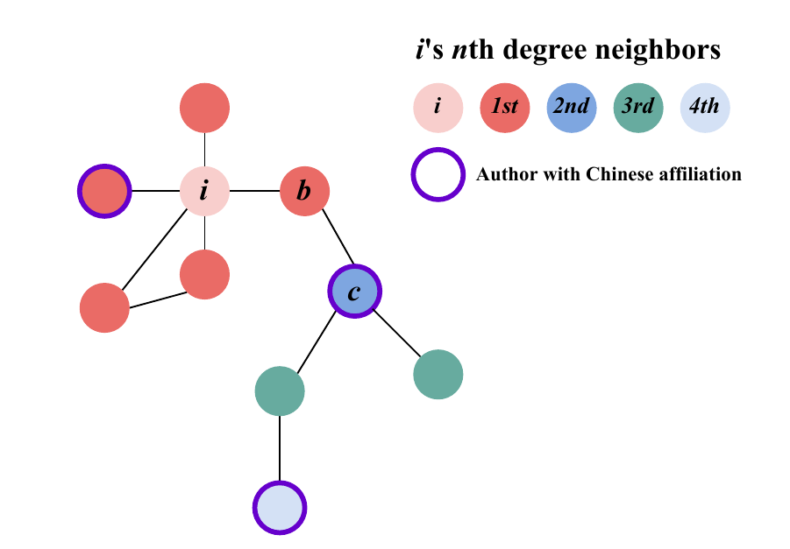
A coauthorship network measures closeness and connectedness
§5.4
Nodes are authors; an edge means at least one coauthored publication. Closeness becomes network distance (b is nearer to i than c); connectedness becomes degree (i has four ties, b has two). Adapted from Ma (2024), Fig. 1A.
Takeaway: The network is the instrument; the statistics computed on it are the measures.
22 / 42
Notes:
First worked example, from the author's own research. Once the coauthorship network is constructed, social closeness is representable as graph distance: b is a first-degree neighbor of i, c a second-degree neighbor reached through b, so b is closer. Connectedness becomes degree: i has four direct ties to b's two. Have students propose alternatives, such as weighting edges by number of joint papers, to feel how instrument design choices change the measure. Relational concepts generally want network instruments; that is the theoretical-utility criterion arriving early.

Slide 23
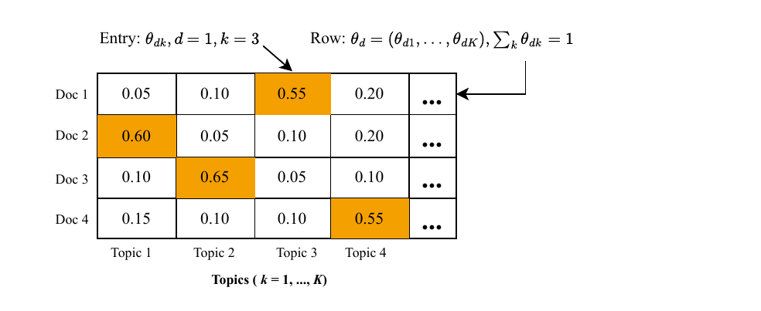
The document-topic matrix turns topics into measures
§5.4
Rows are documents, columns are topics, entries are topic proportions summing to 1 per row. Recreated illustrative excerpt after Heiberger et al. (2021).
Takeaway: One matrix yields focus, novelty, and even cross-language relevance measures.
23 / 42
Notes:
Second worked example. Heiberger and colleagues fit a structural topic model to dissertation abstracts; the resulting matrix supports theory-relevant measures of specialization: a Herfindahl-style concentration index over a row measures a dissertation's topical focus, and transformations of the same matrix yield novelty measures based on rare topic combinations. The logic extends from proportions to similarities: the author's cross-language document-topic similarity matrix scores how similar English-language articles are to topics built from Chinese-language articles, a direct instrument for cross-language thematic relevance. Same object, many measures.

Slide 24
§5.5
What makes computational measures unique?
New data meets new analytical capacity — and new points of failure.
Ch. 5 · Concepts to Measures · cssprimer.org
24 / 42

Slide 25
Found data: records produced for something else
§5.5
• Fine-grained, time-stamped behavioral traces at enormous scale
• Not simply more data: new kinds of data (who interacts with whom, when)
• Repurposing: reusing records collected for another purpose (Salganik)
• Risks: local conventions, shifting categories, undocumented provenance
Takeaway: Data availability is never a free lunch; provenance and missingness are substantive.
25 / 42
Notes:
Much of CSS measurement is driven by by-products of platforms, devices, and organizations. The advantage is direct measurement of relational concepts like exposure and brokerage that surveys reach only by self-report. Digitized administrative records count too: Paxton and colleagues could study emotional language in ninety thousand nonprofit mission statements only once IRS filings became machine-readable. Then give the warning from Twidale and colleagues: even closely related user communities misinterpret repurposed clinical fields, and seemingly stable variables shift when workflows change. Treat measurement error as part of the data-generating process.

Slide 26
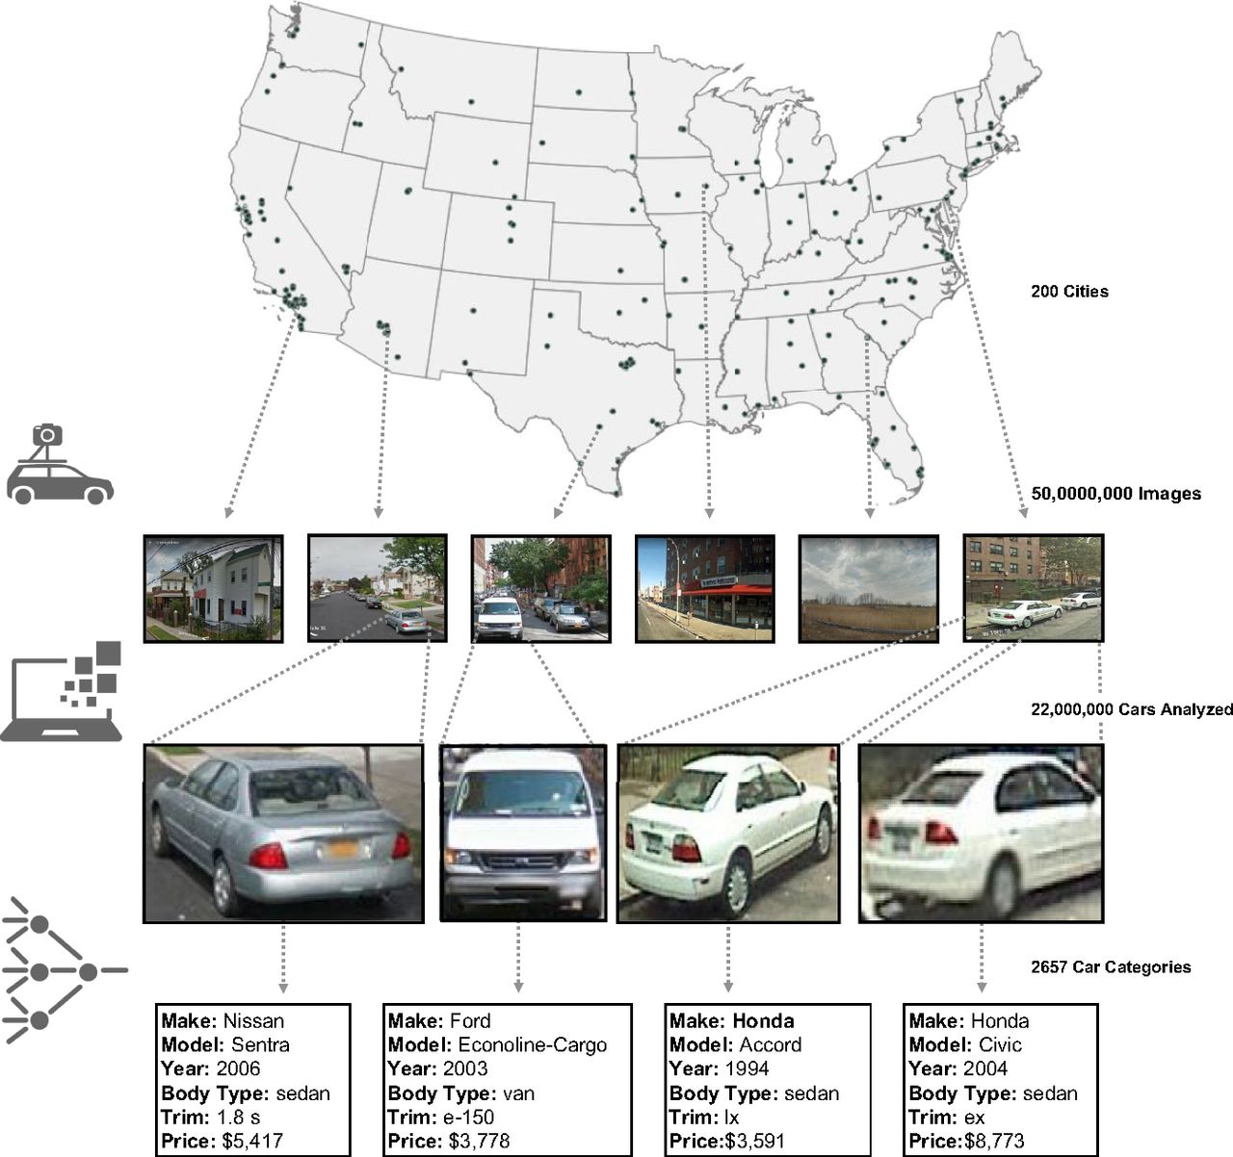
Street View repurposed: cars predict demographics
§5.5
50 million images across 200 U.S. cities; 22 million vehicles classified by make, model, and year. Aggregated vehicle features estimate income, race, education, and voting at ZIP-code and precinct level.
Source: Gebru et al. (2017), Fig. 1, PNAS. © National Academy of Sciences. Included for instructional use.
Takeaway: Repurposed traces support measures no survey could produce at this spatial resolution.
26 / 42
Notes:
The chapter's flagship repurposing example. Imagery designed for navigation becomes an auxiliary instrument for demographic inference: detect vehicles, classify each into a fine-grained make-model-year category, aggregate by geography, and predict census-style outcomes with fine spatial resolution. Ask students to trace the full chain on this slide: raw images, then a vehicle-feature instrument, then demographic measures. Then ask what could go wrong: when were images captured, whose streets are covered, and what do parked cars measure in dense transit cities? The repurposing risks from the previous slide all apply.

Slide 27
Analytical capacity, and its structural blind spot
§5.5
• Algorithms summarize high-dimensional records and amplify researcher coding
• Three forms this session: embeddings, transfer learning, generative measurement
• Abundant data teach majority patterns well and minority patterns poorly
• Social science often centers exactly those rare cases
Takeaway: The blind spot returns as the marginal-cases problem at the end of this session.
27 / 42
Notes:
Availability matters only if you can turn records into interpretable measures, so the second distinctive ingredient is analytical capacity: some tools extend familiar statistical logic like regularization and out-of-sample evaluation, others produce genuinely new representations of meaning. Plant the tension now: classifiers and embeddings learn where statistical signal is strong, which means majority phenomena. Protest events in a news archive or equity framing in a mainstream policy corpus receive weak signal. Keep this in reserve; the deck closes the loop two sections from now.

Slide 28
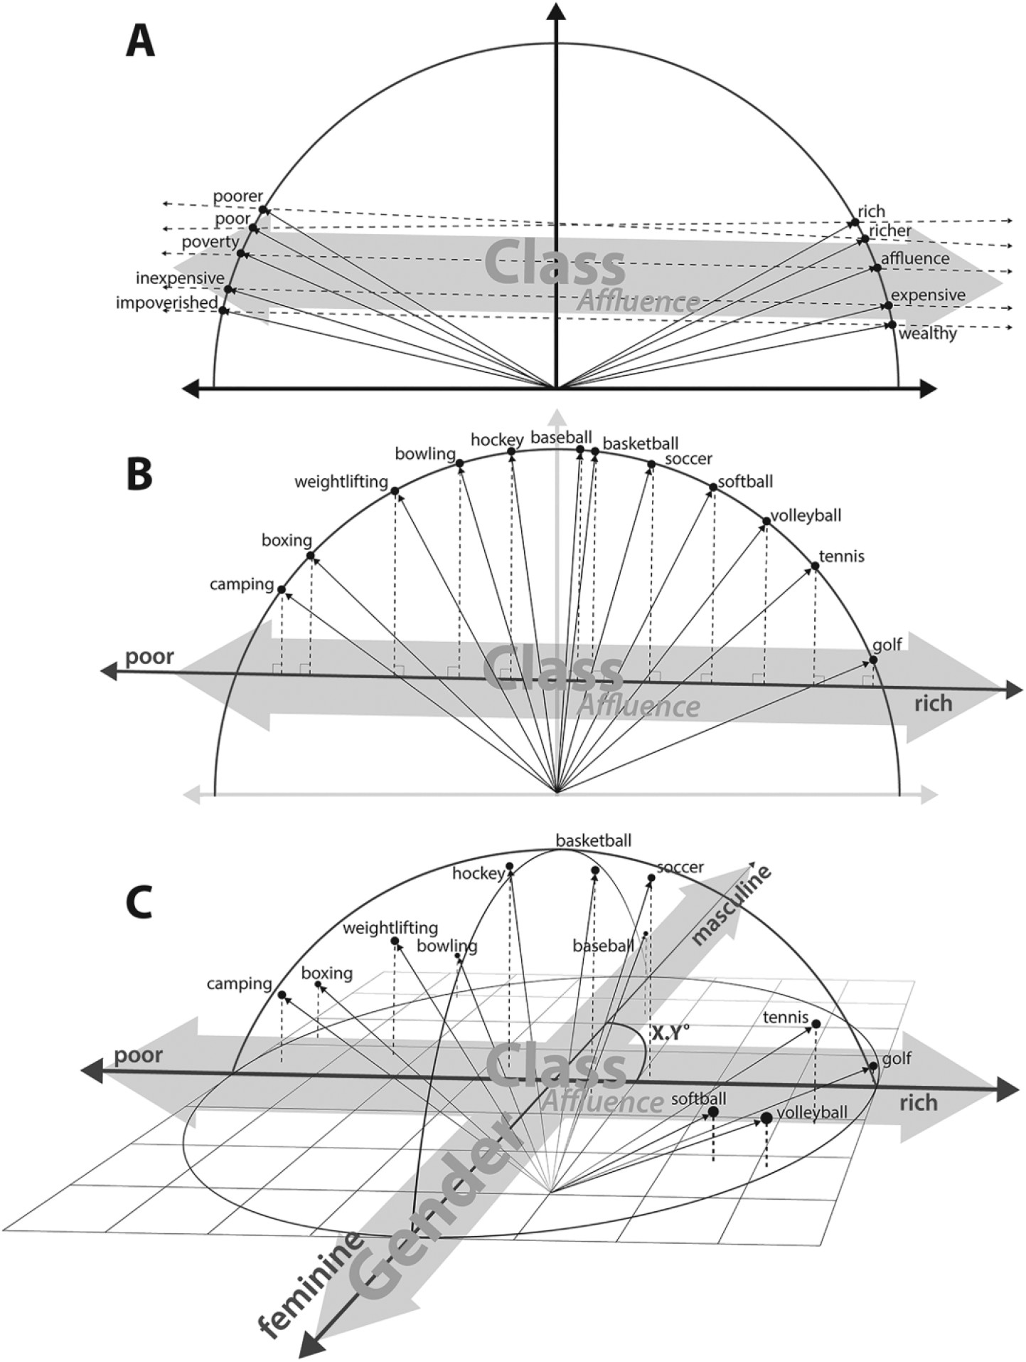
Word embeddings as dimensions of cultural meaning
§5.5
(A) Build an affluence dimension by averaging antonym pairs; (B) project words onto it — golf and tennis score affluent, boxing and camping poor; (C) angles between dimensions reveal how cultural axes entangle.
Source: Kozlowski et al. (2019), Fig. 2, American Sociological Review. © American Sociological Association. Included for instructional use.
Takeaway: Validation was uneven: correlation with surveys hit .53 for class, .76 for gender, only .27 for race.
28 / 42
Notes:
Kozlowski, Taddy, and Evans's three-step workflow is the canonical example of interpreting directions in embedding space as cultural meaning. Words appearing in similar contexts end up close together; averaging many antonym pairs like rich-poor and prosperous-bankrupt yields a class dimension; projections score individual words; near-right angles between dimensions mean unrelated axes. What this yields is relational meaning, not a keyword count. Dwell on the takeaway numbers: the race dimension correlated so weakly with survey judgments that the authors dropped it, a corpus property, not a method property. Validation is not optional garnish.

Slide 29
Transfer learning and prompt-based measurement
§5.5
• Transfer learning: repurpose a pretrained model where labels are scarce (Laurer et al.)
• Transparency burden rises with pretraining you did not control
• Promptbook: prompts documented like a codebook (Stuhler et al.)
• Accuracy is field-specific: age 0.99, but religion quietly imputed
↗ Prompting and its failure modes · cssprimer.org/primers/prompting
Takeaway: High average accuracy can hide non-random error that biases downstream analysis.
29 / 42
Notes:
Two more capacities. Fine-tuning BERT-family models helps precisely when training data are scarce or imbalanced, but readers must know what the model was pretrained on and how stable the measure is across contexts. Generative extraction makes the prompt itself part of the instrument: it encodes coding rules, output format, and ambiguity handling, hence the promptbook analogy. Stuhler's obituary study is the cautionary tale: near-perfect accuracy on formulaic fields, but the model inferred religious affiliation from names despite instructions, plausible but unjustified imputations that create non-random error. Chapter 6 has students build and stress-test their own promptbook.

Slide 30
Traditional and computational measures capture different facets
§5.5
Concept | Traditional measures | Computational measures
Protest mobilization | Surveys, interviews, ethnography, event catalogs: who participated and what it meant | Follower and message networks from Twitter traces: how information spread, who amplified it (González-Bailón et al.)
Scientific consensus | Expert panels and systematic reviews interpreting evidence and arguments | Dynamic citation networks: declining modularity marks closure and consensus (Shwed & Bearman)
Takeaway: Computational measures often trade conceptual depth for coverage; traditional benchmarks stay essential.
30 / 42
Notes:
The point is not that one column is better: they measure different facets of the same concept. For protest, traditional instruments capture offline participation and meaning; the Twitter reconstruction of the indignados protests captures diffusion dynamics and user types like broadcasters and hidden influentials. For consensus, expert reports interpret closure while modularity in citation networks tracks contestation over time. Traditional measures remain the benchmark for validation, the training labels for supervised learning, and the reality check when a pipeline produces surprising patterns.

Slide 31
§5.6
Validity and reliability of “good concepts”
Eight criteria for the concept, six strategies for the measure.
Ch. 5 · Concepts to Measures · cssprimer.org
31 / 42

Slide 32
Eight criteria of conceptual goodness (Gerring)
§5.6
Definition quality
Position among concepts
• Familiarity — stay close to established usage
• Resonance — the label rings true to readers
• Parsimony — few defining attributes, no kitchen sinks
• Coherence — attributes hang together logically
• Differentiation — influence must not be mere visibility
• Depth — scope conditions and facets specified
• Theoretical utility — instrument matches mechanism
• Field utility — leaves neighboring concepts their referents
Takeaway: Scale and sophistication do not guarantee conceptual adequacy.
32 / 42
Notes:
Good measures begin with good concepts, and concept formation is a trade-off across these eight criteria. Make them concrete with the chapter's CSS examples: a platform classifier score labeled "toxicity" strains familiarity; a retweet measure called "support" fails resonance until you handle sarcasm and criticism retweets; an "Engagement" score built from likes, replies, and clicks is unparsimonious; combining following, mentioning, and replying into one network strains coherence; and a hate-speech definition that swallows all offensive language destroys field utility. An underspecified concept lets a pipeline measure what is easy rather than what was intended.

Slide 33
Validity, reliability, and the evidence for each
§5.6
• Validity: does it capture what it claims? Reliability: is it stable?
• A measure can be reliable and consistently wrong
• Six strategies: face checks, benchmarks, outcome tests, theory tests, stability, error audits
• Multi-stage pipelines can introduce error at every stage
Takeaway: All quantitative models of language are wrong; validation must be extensive and problem-specific.
33 / 42
Notes:
The takeaway paraphrases Grimmer and Stewart's dictum for text analysis, and it generalizes. Walk one worked validation: Paxton and colleagues measured affect in nearly ninety thousand nonprofit mission statements with LIWC dictionaries, linked the scores to donations and volunteering, then added experiments and longitudinal analyses as converging evidence. Heiberger validated novelty and consistency measures against long-run career outcomes. Close with the bias point: embeddings encode gender and ethnic stereotypes, which is a measurement target when studying stereotypes and a measurement problem when embeddings feed decisions; either way, diagnose and document it.

Slide 34
§5.7
The marginal-cases problem
Rare in the data, central to the theory.
Ch. 5 · Concepts to Measures · cssprimer.org
34 / 42

Slide 35
Why algorithms struggle with rare but central cases
§5.7
• Protest events, equity framing, hate speech: small fractions of large corpora
• A 97% non-protest corpus teaches the majority pattern reliably, the minority poorly
• Topic models absorb rare themes; embeddings blur minority discourse
• Transfer learning helps with imbalance, but the asymmetry remains
Takeaway: The cases a pipeline most likely misses are the ones you most want to find.
35 / 42
Notes:
This is the chapter's most original argument, so give it room. Social science foregrounds phenomena that are numerically marginal but theoretically central, whether the goal is explaining contentious politics, documenting inequality, or giving voice. The real example is Zhang and Pan's CASM system: an impressive hundred thousand collective-action events detected in Chinese social media, yet the authors acknowledge relatively few events related to ethnic and religious conflict, exactly what a contentious-politics scholar most wants. Not a design flaw: there were too few training examples for the model to learn those patterns.

Slide 36
Too small and too noisy: how the errors compound
§5.7
• False negatives remove genuine minority cases: suppression
• False positives add majority-class impostors: dilution
• Both distort the minority category in the same direction
• 97% aggregate accuracy is achievable while learning nothing about the minority class
Takeaway: Only class-level precision and recall reveal whether the pipeline sees your cases.
36 / 42
Notes:
Work the two error types slowly. A protest article labeled non-protest is a case of theoretical interest the pipeline fails to find; a commentary using "march" in another sense, mislabeled as protest, pads the category with cases that do not belong. The net result: a reported 1.5 percent protest rate may simultaneously undercount genuine protests and include impostors. The distortion is invisible in aggregate accuracy, since predicting "majority" every time scores 97 percent on a 97-3 corpus. Add the ethical turn: research built on distorted minority categories risks reinforcing the marginalization it set out to document.

Slide 37
“CSS expands what we can measure, but it does not relax the basic obligations of measurement.”
Chapter 5
Ch. 5 · Concepts to Measures · cssprimer.org
37 / 42
Notes:
Let this land as the section's verdict. The practical translation: report precision and recall for each class, inspect whether false negatives concentrate the cases of central theoretical interest, and check whether false positives are majority-class cases that share surface features but differ conceptually. For transformative research these audits are an explicit ethical commitment; for everyone they are a validity requirement. Chapter 6 provides a worked confusion matrix and an actionable checklist, so students will run this audit on their own pipeline next session.

Slide 38
AI as concept-development partner, not judge
§5.8
• Brainstorming: candidate concepts, dimensions, indicators — a hypothesis list, not evidence
• Mainstream by construction: suggestions tilt toward well-studied populations
• Adversarial review: ask the model to attack your operationalization
• AI cannot settle validity; fluent agreement is its easiest output
Takeaway: The validation evidence remains yours to produce.
38 / 42
Notes:
Two legitimate uses, one hard limit. Prompted with a research question and data description, a model offers a fast tour of operationalizations the field has already tried, which is useful and dangerous for the same reason: it reproduces what is common, exactly the tilt the marginal-cases problem warns about, so push it with "whose experience does this indicator miss?" The reversal is often more valuable: hand it your definition, plan, and the eight goodness criteria, and have it argue against you. Each objection has force only after you judge that it bites. A model's approval is not a face-validity check.

Slide 39
Discussion
Reflective exercises
• Pick one concept from your research. How would a postpositivist represent it differently from a constructivist?
• Sketch a deductive and an inductive measure for that concept. What does each gain and lose?
• Would your project benefit from an auxiliary instrument, and which design choices would you need to justify?
• Which validation strategies are feasible for your project, and where are the largest threats?
Ch. 5 · Concepts to Measures · cssprimer.org
39 / 42
Notes:
Drawn from the chapter's Reflective Exercises. Run the first two together as a pair exercise on a single concept per student; answers usually reveal that the deductive sketch is easy and the inductive one uncomfortable, which is itself the lesson. For the third, push for specifics: tie definitions, similarity functions, number of topics. For the fourth, steer toward the feasible minimum of face checks plus one stability analysis, and preview that Chapter 6 makes exactly that audit a graded deliverable.

Slide 40
Key concepts from Chapter 5
Concept representation: Translating abstract ideas into measurable variables; broader than operationalization
Featurization: Transforming raw data into socially meaningful variables
Research worldviews: Postpositivism, constructivism, transformative, pragmatism; each shapes measurement
Auxiliary instrument: Intermediate representation — network, matrix, embedding — that makes a concept quantifiable
Deductive measures: Predefined theoretical categories applied to data: dictionaries, supervised classifiers
Conceptual goodness: Eight trade-off criteria, from familiarity to field utility (Gerring)
Inductive measures: Patterns emerge from the data: topic modeling, network clustering
Validity and reliability: Capturing what is claimed vs. yielding stable results; multi-stage pipelines multiply both risks
Integrative measures: Deductive and inductive combined; scalable yet open to emergent patterns
Marginal-cases problem: Majority patterns learned well, rare but central cases distorted by false negatives and positives
Ch. 5 · Concepts to Measures · cssprimer.org
40 / 42
Notes:
Quick self-test: cover the glosses and have students reconstruct them from the terms. The three items they must carry into Chapter 6 are the deductive-inductive-integrative distinction, the auxiliary-instrument idea, and the marginal-cases problem, because the exercises operationalize each one directly. The full key-concepts table in the chapter adds word embeddings, transfer learning, and AI-assisted concept development, and maps every concept to the specific Chapter 6 exercise where it is practiced.

Slide 41
Materials on the companion site
cssprimer.org
Studies filtered to concept representation cssprimer.org/ch05/
The Practice assignment's pre-filtered slice of the studies browser
Working with text data cssprimer.org/primers/text-data
The representation groundwork Chapter 6 assumes
CSS Empirical Studies Database cssprimer.org/studies/
The full database for comparisons across stages
Ch. 5 · Concepts to Measures · cssprimer.org
41 / 42
Notes:
The text-data primer is the bridge between this theory chapter and the next exercise chapter: featurization, tokens, and matrices with runnable examples. Students who read it before Chapter 6 move through the coding exercises noticeably faster. The Practice assignment again runs on the pre-filtered studies slice, one annotated bibliography per student.

Slide 42
Where to go next
• Read: Chapter 6, the automated-coding exercises that operationalize this chapter
• Practice: annotate two studies from the CSS Empirical Studies Database (worldview, measures, instruments, validity)
• Try: AI brainstorming and adversarial review on a concept from your own research
All materials: cssprimer.org
Notes:
The practice assignment comes from the chapter: a one-page annotated bibliography of two studies from the database filtered to concept representation, critiqued along worldview alignment, measurement approach, featurization, and validity evidence. Students should also bring their OpenAlex corpus from Chapter 4 to the next session, since every Chapter 6 exercise builds on it. The chapter hub at the link collects the database filter, the studies, and the exercise materials.

