Slide 1

Computational & AI-Assisted Methods for Social Sciences
A Research Design Primer
Chapter 7
Computational Analysis and Epistemic Purposes
Ji Ma
cssprimer.org
Instructor slides · free to adapt for course use
Notes:
This deck accompanies Chapter 7, the theory chapter for stage three of the research design pipeline: data analysis. Chapter 6 ended with a handoff package of validated measures; today we ask what you can claim once you analyze them. Three practical questions organize the session: what computational methods make possible, what challenges they create, and when they are most useful. We close with a newer question specific to AI: when a model's own outputs become part of the evidence, what kind of validity is being claimed?

Slide 2
Learning objectives
By the end of this chapter, you can:
• Explain the three computational capacities and where each appears across methods
• Recognize the three challenges those capacities create for inference
• Distinguish distribution from causality approaches to modeling social data
• Match methods and evaluation standards to the four epistemic purposes
• Evaluate the validity claims of AI-assisted methods and synthetic agents
Ch. 7 · Computational Analysis · cssprimer.org
2 / 39
Notes:
Five objectives, all traceable to the chapter's section structure. The capacities are iteration, non-linear modeling, and high-dimensional processing; the challenges are opacity, the semantics-to-application gap, and temporal dynamics; the purposes are descriptive, explanatory, predictive, and integrative. Stress at the outset that the fourth objective is the chapter's core skill: students should leave able to name the epistemic purpose of any computational paper and judge whether its evaluation matches that purpose.

Slide 3
Stage 3 of the pipeline: data analysis
Chapter 7
1. Data management
2. Concept representation
3. Data analysis
4. Scientific communication
Chapters 7 and 8 develop the third stage: what analysis can claim, and how to practice it.
Takeaway: Analysis inherits everything the first two stages got right — or wrong.
3 / 39
Notes:
Reorient students in the book's backbone. Data management gave us contextualized, documented data; concept representation turned them into validated measures; this stage extracts patterns and tests relationships. The handoff matters: every analytic claim in this chapter rests on the audit trail built in Chapters 3 through 6. Chapter 7 is the theory half, Chapter 8 the exercise half where each idea today gets a hands-on counterpart on students' own data.

Slide 4
§7.1
Computational capacities
Iterate, model non-linearity, process high dimensions — what writing code buys you.
Ch. 7 · Computational Analysis · cssprimer.org
4 / 39

Slide 5
Three capacities, one definition
§7.1
• Recall the test from Chapter 1: inference that requires writing and executing code
• What the code buys: iteration, non-linear prediction, high-dimensional processing
• Capacities, not tools — each cuts across many methods
Takeaway: These capacities explain why computational methods reach questions too slow, too complex, or too large to study otherwise.
5 / 39
Notes:
Reconnect to Chapter 1's working definition before adding anything new. Humphreys' framing is useful here: computational methods extend our native cognitive capacities, the way instruments extended our senses. The three capacities are deliberately not tied to particular tools; gradient descent, agent-based models, and Bayesian updating will all turn out to be faces of the same first capacity. Preview that the same power will generate the chapter's three challenges, so nothing in this section is free.

Slide 6
Iteration as optimization and search
§7.1.1
• Gradient descent: guess, compute error, follow the gradient downhill, repeat
• Like seasoning a dish: taste, adjust, taste again
• Dijkstra's algorithm searches million-node networks the same way
• Empirical feedback replaces hand-tuning — but the benchmark matters
Takeaway: Iteration improves fit to the data at hand, not automatically to the concept you care about.
6 / 39
Notes:
Walk the five gradient-descent steps with the cooking analogy: initialize parameters, compute error against actual values, find the direction of steepest error increase, move the opposite way, repeat until improvement is negligible. Then the caution: a dropout model trained on administrative records that miss students who quietly leave will reduce error against those records while misrepresenting the problem. Dijkstra shows the search face of iteration: repeatedly examining neighbors and updating distances is trivial for a machine and impossible by hand at scale.

Slide 7
Iteration as simulation: rule-based agents
§7.1.1
• Agents follow simple rules across discrete time steps
• Epidemic waves and residential segregation emerge from repeated interaction
• Rerun under different assumptions to compare interventions
• Useful where real experiments are costly, slow, or unethical
Takeaway: Without empirical grounding, iteration just repeats weak assumptions at scale.
7 / 39
Notes:
Here iteration is not a solver but the model itself: the repeated updates are the social process unfolding. Give both classics briefly, contagion with some infection probability producing waves, and households moving when neighborhood composition mismatches preferences producing segregation. The research value is counterfactual comparison, more vaccination versus less contact, where direct experimentation is infeasible. The takeaway sets up a recurring theme: rules, initial conditions, and validation targets need empirical grounding, or the computer just amplifies your assumptions.

Slide 8
Autonomous agents: LLMs as simulated actors
§7.1.1
• Generative agents remember, reflect, plan — and once organized a party from one prompt (Park et al. 2023)
• 1,052 interview-grounded agents beat demographic and persona baselines at predicting their humans' survey answers (Park et al. 2024)
• Realism comes from interview grounding — and inherits its omissions
Takeaway: The simulation is only as rich, and only as biased, as its source data.
8 / 39
Notes:
The newer variant replaces hand-coded rules with LLM-generated behavior. Park and colleagues' sandbox agents spread invitations and collectively organized a party from a single user prompt, social behavior emerging from repeated interaction. The 2024 follow-up grounded each agent in a two-hour qualitative interview with a real person; those agents predicted their counterparts' survey responses and personality traits better than persona-based baselines. Both faces of the finding matter: rich grounding is an empirical advantage, and it imports whatever the interviews missed. Students meet this again in the AI-validity section.

Slide 9
Iteration as statistical updating
§7.1.1
• Bayes: yesterday's posterior becomes today's prior; evidence accumulates
• Fits how social evidence arrives — poll after poll, wave after wave
• Google Flu Trends overestimated flu once search behavior and algorithms shifted
Takeaway: Updating works only while the signal stays valid and the data-generating process stays stable.
9 / 39
Notes:
Keep the formalism light: the posterior is proportional to likelihood times prior, and the cycle repeats as new data arrive, so uncertainty narrows cumulatively instead of being rebuilt from scratch. That matches the sequential texture of social evidence. Then the cautionary tale students met in Chapter 1 returns with a sharper lesson: Google Flu Trends did not fail because updating is wrong in principle; it failed because the search-query signal drifted when behavior and Google's own algorithms changed. Frequent updating is not the same as better knowledge.

Slide 10
A result can stabilize because the evidence is genuinely informative — or because the same bias enters the process again and again.
Chapter 7, on convergence and emergence
Ch. 7 · Computational Analysis · cssprimer.org
10 / 39
Notes:
This is the epistemic payoff of the whole iteration section. Some iterative processes converge, like a forecasting model settling on an estimate; others show emergence, tipping points, or fragmentation depending on tiny differences in starting conditions. The trap is reading convergence as truth. Cumulative learning and cumulative error look identical from inside the loop: once a weak proxy enters, repeated updating makes the result look more stable than it is. The question to train: what evidence drives each round, and does it remain valid?

Slide 11
Social life is not a straight line
§7.1.2
• Stress and performance: an inverted U, not a slope
• Thresholds: a protest gains momentum only past critical mass
• Diminishing returns: each additional study hour helps less
• Interactions: the effect of age depends on education
Takeaway: A model that assumes one constant effect can miss the pattern entirely.
11 / 39
Notes:
Start from the linear benchmark so the contrast lands: each additional year of education adding a constant five thousand dollars of income is what linear regression is built for. Then collect examples students recognize from their own fields; ask for one more from the room. The point is not that linear models are bad, it is that much of social life is curved, thresholded, or interactive, and a constant-effect assumption is a substantive claim, usually an unexamined one. Next slide: how code captures the curves.

Slide 12
How a neuron bends a line
§7.1.2
• A unit: weighted sum of inputs, then a nonlinear activation
• ReLU(income − 50): zero below $50k, rising above — a learned threshold
• Stacked layers combine such units into interactions
• Universal approximation guarantees existence, not discovery or generalization
Takeaway: Validation, not the theorem, decides whether the wiggle is signal.
12 / 39
Notes:
Sketch the two ingredients on the board: a linear combination of inputs plus a bias, then a nonlinear transformation. ReLU is just max of zero and the input, a switch that turns on when combined evidence is strong enough. The book's example: a unit computing ReLU of income minus fifty captures income mattering for voting only above fifty thousand dollars. Deeper layers learn interactions like "high income matters more for older voters." The universal approximation theorem says a wide-enough network exists for any continuous relationship; it says nothing about finding it or generalizing.

Slide 13
High dimensions: smart summarizers
§7.1.3
• Corpora, panels, and surveys can carry more variables than observations
• PCA and factor analysis have long compressed variables into indices
• Topic models and embeddings do the same for text
• A difference of degree, data type, and workflow — not of kind
Takeaway: The computational end adds automated representation learning for large, messy, unstructured data.
13 / 39
Notes:
Deflate any sense that high-dimensional analysis is a computational invention. Psychometrics has done dimension reduction for a century; PCA turning hundreds of census indicators into an economic-opportunity index is classical statistics. What the computational end adds is scale and input type: topic models summarizing thousands of bills into themes, embeddings placing words in learned spaces, neural representations for images and networks, usually fitted iteratively where hand inspection is impossible. Note the connection back to iteration: even PCA goes iterative once datasets get very large.

Slide 14
AI is not a fourth capacity
§7.1.4
• LLMs run on the same three capacities, at scale
• Role one: coding and labeling — your codebook, a million documents
• Role two: designing agents grounded in interviews or personas
• 2026 survey: 81% of quantitative social scientists tried chatbots; one in five uses coding agents
Takeaway: The catch is new: the instrument's outputs are themselves interpretations.
14 / 39
Notes:
This slide inoculates against treating AI as categorically new. An LLM coding text applies one instruction across a million documents, iteration at scale; its layers stack the linear-plus-nonlinear units just discussed; its representation of language is a high-dimensional embedding space. Seeing it as a combination of the three capacities helps you reason about when it works and how it fails. The Lyttelton survey shows rapid but shallow adoption. The closing bullet plants the section-four problem: when a model assigns a code or answers as a respondent, there is often no single correct answer to check against.

Slide 15
§7.2
Challenges of computational methods
The same power raises three problems: opacity, meaning, and timing.
Ch. 7 · Computational Analysis · cssprimer.org
15 / 39

Slide 16
Epistemic opacity: the uninspectable path
§7.2.1
• Too many steps, executed too fast, for any human to audit
• No transparent shortcut from inputs to outputs; stochastic paths never seen
• A child-welfare risk score no caseworker can explain to a family or judge
• Rudin: in high stakes, prefer interpretable models of comparable performance
Takeaway: Opacity decides whether a consequential decision can be contested at all.
16 / 39
Notes:
Humphreys' definition: a process is opaque when the researcher cannot know all its epistemically relevant elements, sometimes in principle because of ordinary cognitive limits. Give his three sources — step count and speed, computational irreducibility in connectionist models, and Monte Carlo trajectories that are never directly observed — then land on the child-welfare example. High accuracy is not the issue; contestability is. Families, social workers, and judges cannot scrutinize a prediction emerging from thousands of interacting features. Rudin's recommendation is a design principle, not a counsel of despair.

Slide 17
From semantics to application
§7.2.2
• A sentiment score has clear statistical meaning, ambiguous social meaning
• A detected 'community' is dense ties — not shared identity, norms, or action
• Mapping outputs back onto concepts takes theory, context, and judgment
Takeaway: The model cannot supply the meaning of its own output.
17 / 39
Notes:
The gap runs in both directions: translating social phenomena into computational representations, then translating outputs back into substantive concepts. The sentiment example is vivid — a classifier trained on product reviews labeling a political speech "negative" strips away rhetoric, audience, and strategic framing. The community-detection example returns in Chapter 8's exercises, where students will write a memo on exactly this question. Lazer and colleagues' point closes it: bridging the gap needs training and collaboration structures that let computational skill and social theory work together, plus validation.

Slide 18
Temporal dynamics: models run in time
§7.2.3
• Two clocks: the model runs in time, and represents a process in time
• Synchronous versus one-by-one updating can change segregation outcomes
• A weather model that takes a million years to run forecasts nothing
• Update order, time steps, and stopping rules are part of the model
Takeaway: Speed and update order have epistemic importance, not just engineering importance.
18 / 39
Notes:
Simulations are not timeless deductions; they unfold on concrete machines. The segregation example makes the point concrete: if every household reevaluates simultaneously, the city may split quickly; if households move one by one as openings appear, the same starting conditions can produce a slower, different pattern. So update order is a modeling decision to justify, report, and test — students do exactly that in Chapter 8. Humphreys' weather example extends it to prediction: a theoretically sound model too slow to run is useless for real-time decisions, which makes approximation choices epistemic ones.

Slide 19
§7.3
Epistemic purposes
Distribution versus causality — then four distinct research goals, not a ladder.
Ch. 7 · Computational Analysis · cssprimer.org
19 / 39

Slide 20
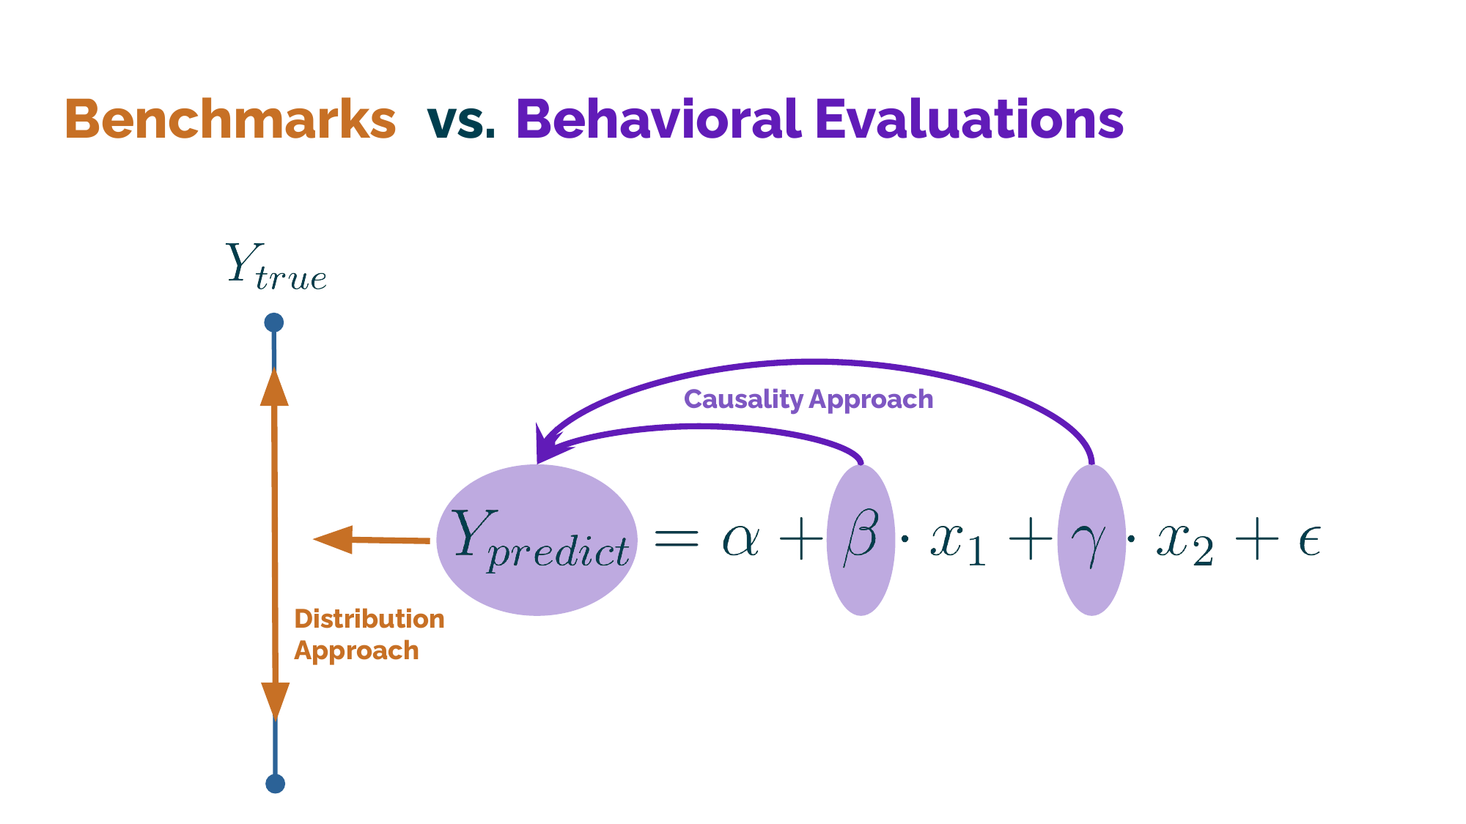
Two questions you can ask of a model
§7.3.1
The distribution approach asks whether predictions match observed outcomes; the causality approach asks what the coefficients mean under intervention.
Takeaway: The epistemic goal, not the algorithm, sets the standard of evaluation.
20 / 39
Notes:
Walk the figure's two orientations with the book's nonprofit example. Predicting which donors give again is distribution work: success is out-of-sample accuracy, and useful correlations need no mechanism. Asking whether a personalized reminder causes more giving is causality work: the focus shifts to identifying beta as an effect that survives the intervention changing the data distribution. The timely case is LLM evaluation: benchmarks like MMLU are distribution-style scores, and once models simulate human behavior, researchers need the explanatory orientation instead — observing agents in economic games, asking what shifts behavior and why.

Slide 21
Structural or agnostic: what can a model recover?
§7.3.1
• Structural: a true data-generating process exists; recover it faithfully
• Agnostic: for social text it rarely does — optimize interpretability instead
• When fit and interpretability diverge, the choice is a modeling commitment
Takeaway: Fit versus interpretability is a commitment to state, not an inconvenience to hide.
21 / 39
Notes:
This distinction from Grimmer, Roberts, and Stewart sits beneath the distribution-causality contrast: what do we assume a model can recover at all? For data as complex and high-dimensional as most social text, the agnostic position holds that the true process is rarely recoverable, so the goal shifts to models that maximize substantive insight. Bonikowski's application spells out the practical rule: when fit statistics and interpretability favor the same model, the choice is moot; when they diverge, weigh raw fit against theoretically meaningful, defensible patterns — and say so explicitly in the paper.

Slide 22
The Hofman 2×2: four epistemic purposes
§7.3.2
Purpose | Core question | Evaluated by
Descriptive | What does the social world look like? | Fidelity and usefulness of the map
Explanatory | What changes under intervention? | Identification of the causal effect
Predictive | How well do we forecast new cases? | Accuracy on held-out data
Integrative | Can we predict when the world itself changes? | Performance out of distribution
Takeaway: Distinct goals, not steps on a ladder from weak to strong research.
22 / 39
Notes:
Hofman and colleagues cross two questions: does the study focus on specific effects or on predicting outcomes, and is the model evaluated in a stable setting or one altered by interventions? Insist on the anti-ladder point — description is not failed causal inference, and prediction is not description done better. Each purpose is valuable matched to the right question, and each has its own evaluation standard. The next slides give one exemplary study per row; students apply the same rubric to a study of their choice in the practice assignment.

Slide 23
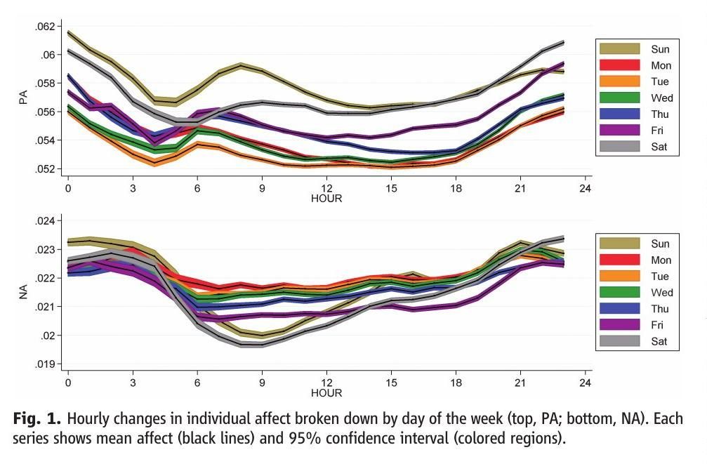
Descriptive modeling: mood rhythms in 509 million tweets
§7.3.2
Hourly positive affect (top) and negative affect (bottom) by weekday; weekends run higher and the morning peak arrives later.
Source: Golder & Macy (2011), Fig. 1, Science. © American Association for the Advancement of Science. Included for instructional use.
Takeaway: Description turns diffuse digital traces into stylized facts that demand explanation.
23 / 39
Notes:
Golder and Macy measured expressed positive and negative affect in 509 million tweets from 2.4 million users across 84 countries, documenting diurnal, weekly, and seasonal rhythms no survey could reach at this grain. Contrast with retrospective self-reports from small student samples: these measures were composed in real time by millions worldwide. Stress what the study does not do — it explains none of the rhythm. What description contributes is a clearer account of what needs explaining, and a firmer basis for later causal work. That is a distinct inferential goal, not a consolation prize.

Slide 24
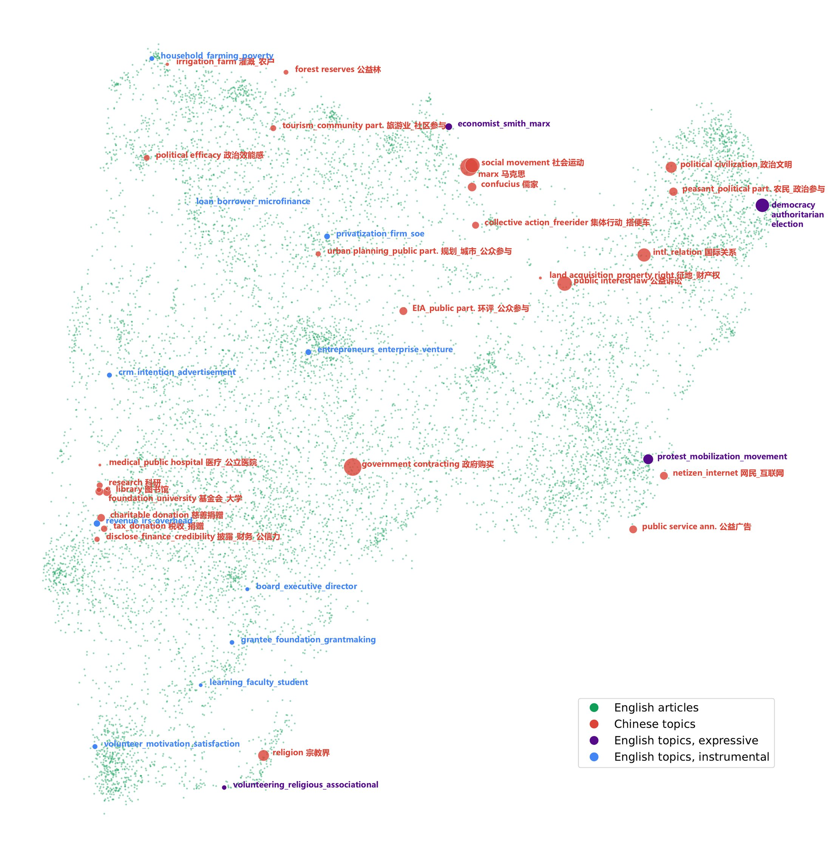
Descriptive modeling: mapping a bilingual knowledge space
§7.3.2
Cited English articles and English and Chinese research topics in one multilingual semantic space; distance means thematic similarity, node size means volume.
Source: Ma (2024), Fig. 5, Nonprofit and Voluntary Sector Quarterly. © SAGE Publications. Included for instructional use.
Takeaway: Description can map abstract intellectual spaces, not only concrete networks.
24 / 39
Notes:
The author's own study places English articles cited by Chinese scholarship and the major topics of both literatures in a shared multilingual embedding space. Reading the map: central topics cluster mid-space, marginal ones sit at the edges, and sparse regions between language communities mark thin cross-language exchange. Pair it with the protest-network study in the book — González-Bailón reconstructing the indignados Twitter network into influentials, hidden influentials, broadcasters, and common users. Both are description at their best: making visible a structure nobody could previously see, without claiming to explain it.

Slide 25
Explanatory modeling: the opposing-views bot
§7.3.2
• Paid frequent partisan Twitter users to follow an opposing-side bot for a month
• Republicans became more conservative; Democrats shifted little, not significantly
• The value is a causal estimate of one specific intervention
Takeaway: A clean causal estimate can still predict individual outcomes poorly.
25 / 39
Notes:
Bail and colleagues' field experiment is the chapter's exemplar of explanatory modeling: financial incentives to follow a bot retweeting elected officials and media from the other side, with attitudes measured before and after. The asymmetric result, a backfire among Republicans, matters less here than the epistemic form: what the study delivers is an identified effect of a defined intervention, not a forecast of who polarizes next year. Close with the built-in limit: social outcomes have many causes, so even a strong single-effect estimate explains a small share of total variation.

Slide 26
Predictive modeling: proxies that work
§7.3.2
• 50 million Street View images; 22 million vehicles detected and classified
• Neighborhood car patterns estimated income, race, education, and voting
• Early-warning systems rank cases for scarce interventions
• Correlations that forecast well can vanish when policy or behavior shifts
↗ Supervised learning, gently · cssprimer.org/primers/ml
Takeaway: Useful predictors do not have to be causal — until the world changes.
26 / 39
Notes:
Gebru and colleagues never claimed cars cause demography; visible street features are cheap, fast proxies for indicators that are otherwise slow and expensive to measure. That is the predictive purpose in pure form, judged on held-out accuracy. The institutional use case makes the stakes concrete: early-warning systems identifying students at risk of not graduating, tenants at risk of harassment, children at risk of lead exposure. Then the conditionality: when policy changes or behavior adapts, supporting correlations weaken — which is precisely the gap the integrative purpose exists to address.

Slide 27
Integrative modeling: predicting under change
§7.3.2
• Specify the change; capture the causal structure; test out of distribution
• Causal ML — double/debiased learning, causal forests — serves the middle requirement
• Moral Machine: prediction critiques the explanation; experiments test the revision
• Predictive failure is informative: it locates the incomplete causal account
Takeaway: Integration means making explanation and prediction discipline each other.
27 / 39
Notes:
The hardest question in the framework: forecasting a world the intervention itself changes. Neither a good causal estimate nor strong stable-world accuracy suffices alone. Give the three requirements slowly, then Brand and colleagues' education examples for the second: causal trees finding who gains most from college completion, debiased machine learning tracing heterogeneous earnings effects. The coordinate-ascent story is the memorable part — a neural network predicting moral judgments exposes what the simple cognitive account misses, and researchers return to experiments with better hypotheses. Failure becomes a research instrument.

Slide 28
Interpretability is not causality
§7.3.2
• Explanations help a decision-maker trust a score or choose how to intervene
• Mug-shot morphing yields hypotheses: 'well-groomed,' 'heavy-faced'
• That is hypothesis generation, not hypothesis testing
• Interpretability is logically independent of causal and predictive properties
Takeaway: Understanding a model is not the same as identifying an effect.
28 / 39
Notes:
A boundary students routinely blur. Amarasinghe's policy cases show explanation doing legitimate work that still is not causal: a lead-inspection team deciding whether to override a risk score, or a flagged student whose possible reasons — course difficulty, bullying, transportation, health, family — each imply a different response. Ludwig and Mullainathan's mug-shot study shows the other boundary: morphing images and describing recurring contrasts produces interpretable hypotheses about judges' detention decisions, and the authors themselves sketch the new experiments needed to test them. Keep the integrative question narrow: what must the model get right to stay useful when the world changes?

Slide 29
§7.4
The AI validity challenge
When the model's own outputs become part of the evidence.
Ch. 7 · Computational Analysis · cssprimer.org
29 / 39

Slide 30
Two AI roles that fail differently
§7.4
• Coding real data: the evidence is still about humans; coding quality is at issue
• Cross-prompt consistency can reflect shared training bias, not accuracy
• Generating data: model behavior is offered as evidence about human behavior
• The second claim is stronger — and fails in documented ways
Takeaway: Ask what kind of validity is being claimed, and what evidence would support it.
30 / 39
Notes:
Separate the roles from the AI-toolkit slide because their failure modes differ. When an LLM annotates, the validity question resembles intercoder reliability — except that for open-ended tasks like topic discovery there is often no single correct label, and Than and colleagues warn that agreement across prompts or models may just mean shared training bias, so human-involved validation stays essential. When an LLM stands in for respondents, the claim escalates: the model's own behavior becomes the evidence. The rest of the section takes that stronger claim apart.

Slide 31
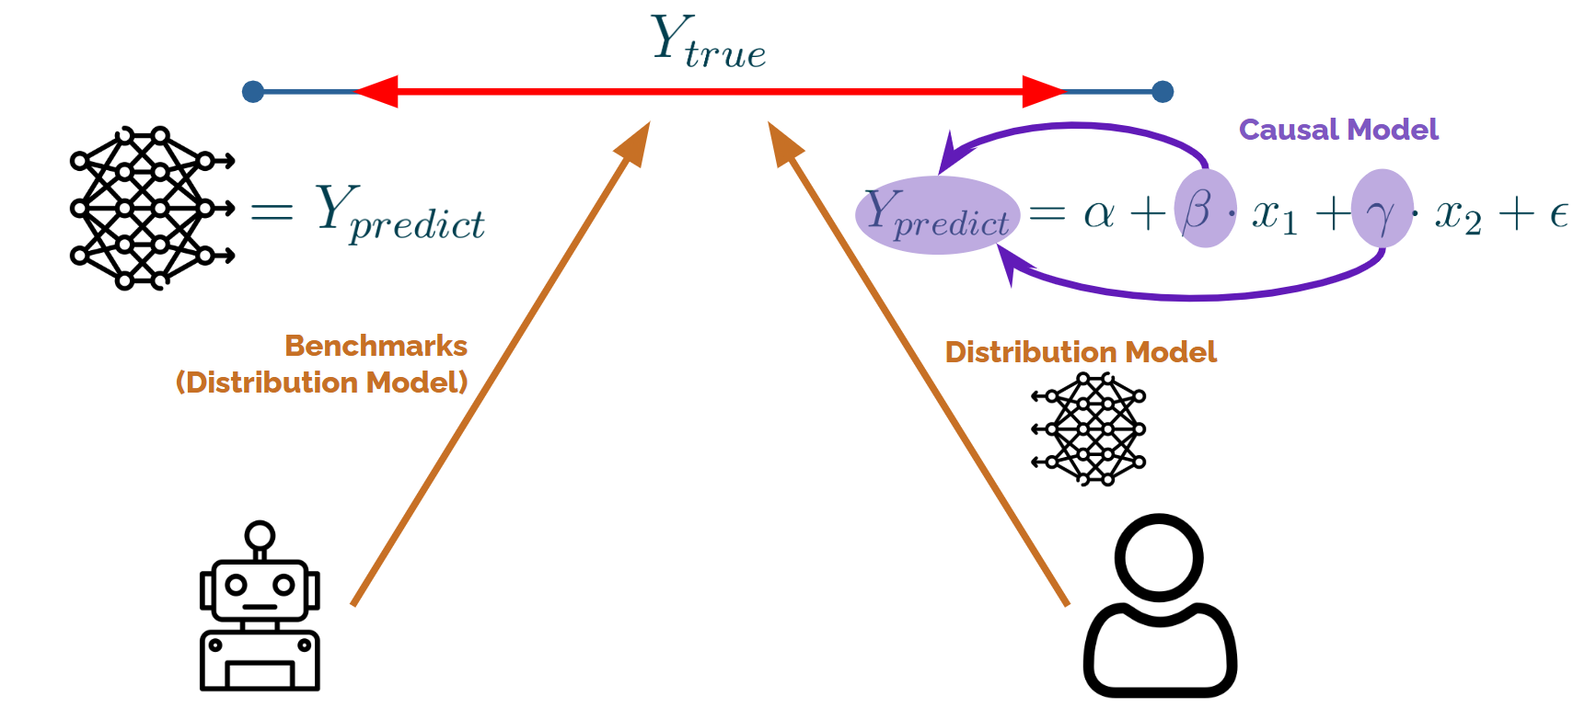
Two validation logics for AI-assisted studies
§7.4
Benchmark evaluation asks whether outputs match targets on a task; causal-model evaluation asks whether behaviorally relevant relationships hold up under change.
Takeaway: Benchmark success shows a pattern was reproduced, not that mechanisms were captured.
31 / 39
Notes:
The figure maps the terrain: human-subject studies on one side, LLM-agent studies on the other, crossed with two evaluation logics. Benchmark-oriented evaluation is the distribution-style criterion from earlier in the chapter — does predicted output match target output on held-out tasks. It can certify reproduction of an observed pattern while saying nothing about the mechanisms that matter for social-scientific inference. Once AI outputs serve as evidence about human behavior, that gap stops being a computer-science subtlety and becomes the central methodological question of the study.

Slide 32
Two validity claims, and neither implies the other
§7.4
• External sociological validity: does model behavior correspond to human subjects?
• Internal representational validity: are constructs meaningfully encoded and manipulable inside the model?
• A model can mimic aggregates on brittle internal shortcuts
• Clean internal encoding does not make a faithful model of humans
Takeaway: State which validity you claim; evidence for one is not evidence for the other.
32 / 39
Notes:
This distinction is from the author's own work. External sociological validity is the familiar correspondence question. Internal representational validity asks whether theoretically relevant constructs actually exist inside the model in a form that affects its computations — testable by probing activations and by activation engineering, manipulating the internal direction and watching behavior change. The independence runs both ways, which is what makes sloppy claims tempting: aggregate mimicry can hide brittle shortcuts, and a cleanly encoded construct proves nothing about human correspondence. Chapter 8's closing exercise has students draft their own validity statement.

Slide 33
Synthetic respondents: the variance collapse
§7.4
• ANES-based personas answering feeling thermometers matched human averages
• But: too little variation, coefficients differ, some reverse sign
• Results shift with small prompt changes and over time
• Picture two curves: same mean, far narrower synthetic spread
Takeaway: Agreement on averages masks failures that surface in variances and coefficients.
33 / 39
Notes:
Bisbee and colleagues prompted ChatGPT to adopt personas from the 2016 and 2020 ANES and rate 11 sociopolitical groups. First glance encouraging, second glance damning: the synthetic distribution shares the human mean but collapses the spread. Sketch the two curves on the board — the book renders exactly this figure — and trace the consequences: regression coefficients estimated on synthetic data diverge from ANES estimates, some flip sign, and everything wobbles with prompt wording and model updates. The lesson generalizes: surface agreement with a benchmark distribution is too weak a standard for sociological inference.

Slide 34
Mixed-subjects designs keep humans the gold standard
§7.4
• LLM predictions treated as informative but imperfect proxies
• Prediction-powered inference: efficiency gains without assuming predictions are correct
• Moral Machine reanalysis: silicon sampling alone was biased and overconfident
• 100,000 LLM predictions + 10,000 humans → effective sample ≈ 11,275
Takeaway: Validity is assessed empirically, not assumed from benchmark performance.
34 / 39
Notes:
Broska, Howes, and van Loon offer the constructive response: refuse interchangeability, keep human observations as the gold standard, and combine the two sources with prediction-powered inference. Their Moral Machine reanalysis shows both faces — the mixed design preserved valid causal estimates where pure silicon sampling was badly biased, and because GPT-4's predictions were only modestly interchangeable with humans, a hundred thousand of them bought an effective sample gain of about thirteen percent. Useful, honest, and a world away from "synthetic respondents can replace human subjects." That is the posture the book endorses.

Slide 35
Practice: audit a published computational study
§7.5
• Identify the study's primary epistemic purpose
• Name the computational capacities its method depends on
• Trace how it handles opacity, the semantics gap, and temporal dynamics
• Judge whether its validation matches its purpose
• State what you would change in a replication or extension
You will need
• The CSS Empirical Studies Database, filtered to computational analysis (cssprimer.org/ch07)
• One published study using network analysis, machine learning, embeddings, or another method from this chapter
Deliverable
A one-page analysis answering the five questions, saved to your project repository.
↗ Studies filtered to computational analysis · cssprimer.org/ch07/
Ch. 7 · Computational Analysis · cssprimer.org
35 / 39
Notes:
This is the chapter's concept-level assignment, distinct from Chapter 8's coding exercises. Encourage students to pick a study near their own substantive interests; the audit works on any of them. The third step usually needs a nudge: most papers never name these challenges explicitly, so students must infer how the authors handled them, which is itself the skill. Collect one finding per student next session — a mismatched validation standard is the most common and most instructive discovery.

Slide 36
Discussion
Reflective exercises
• Which epistemic purpose do your own analyses usually serve — and does your goal shift as a project moves along?
• Where do you expect the semantics-to-application gap to bite hardest in your work, and how would you bridge it?
• How would epistemic opacity show up in a model you might use, and which remedies would you trust?
• What would you need to make a causal claim from a descriptive or predictive result you admire?
Ch. 7 · Computational Analysis · cssprimer.org
36 / 39
Notes:
Adapted from the chapter's Reflective Exercises, which are written to be revisited after the Chapter 8 exercises; today, run them prospectively against students' own planned projects. The first prompt usually reveals that most students default to explanatory ambitions with descriptive designs — worth naming gently. On the fourth, push past "an experiment" toward the specific design elements: identification strategy, confounders addressed, and what the estimate would and would not license. Close by pointing at the key-concepts checklist, which doubles as the review sheet for the exercises ahead.

Slide 37
Key concepts from Chapter 7
Iteration: Repeated updating — optimization, simulation, statistical — that learns from empirical feedback at scale
Descriptive modeling: What does the social world look like? Mapping structure without causal claims
Non-linear modeling: Capturing thresholds, diminishing returns, and interactions via activation functions and layers
Explanatory modeling: What changes under intervention? Identifying and estimating causal effects
High-dimensional processing: PCA, embeddings, topic models compressing many variables into tractable representations
Predictive modeling: Forecasting new observations; useful predictors need not be causal
Epistemic opacity: Not being able to know how a model reached its output; limits contestability
Integrative modeling: Predicting under change; causal structure that survives distributional shifts
Semantics-to-application gap: Linking computational outputs to social concepts requires theory and judgment
AI validity: External sociological vs. internal representational; neither implies the other
Temporal dynamics: Update order, time steps, and stopping rules are part of the model
Ch. 7 · Computational Analysis · cssprimer.org
37 / 39
Notes:
Run this as a self-test against the chapter's own checklist table, which also maps every concept to the Chapter 8 exercise where students will practice it: iteration in the network and simulation exercises, opacity in the prediction exercise, the semantics gap in centrality and community detection, integration in the cross-domain evaluation. The two items to insist on before next session are the four purposes as distinct goals and the two AI validity claims — both will be graded implicitly in the exercise deliverables.

Slide 38
Materials on the companion site
cssprimer.org
Studies filtered to computational analysis cssprimer.org/ch07/
The Practice assignment's pre-filtered slice of the studies browser
Worked notebooks cssprimer.org/notebooks
The network-analysis notebook with sample data, for students whose corpus is not ready
Computational-analysis tools cssprimer.org/tools/analysis
The maintained tool list for networks, prediction, and simulation
Ch. 7 · Computational Analysis · cssprimer.org
38 / 39
Notes:
The network notebook is listed here as a preview on purpose: Chapter 8 uses it heavily, and students who skim it now arrive at the exercises oriented. The sample dataset matters for equity, because a student whose Chapter 4 corpus came out small or broken can still do every Chapter 8 exercise on the provided network.

Slide 39
Where to go next
• Read: Chapter 8 — every concept today has a hands-on exercise on your own data
• Do: the practice audit of one published study from the database
• Browse: the Chapter 7 hub for the studies database and worked examples
All materials: cssprimer.org
Notes:
Chapter 8 turns each idea from today into working code on the coauthor network and OpenAlex corpus students already built, so nothing next week presumes new data. The practice audit is due before the exercise session; it primes the rubric students will apply to their own analyses. Point them to the chapter hub for the filtered studies database and companion notebooks.

