Slide 1

Computational & AI-Assisted Methods for Social Sciences
A Research Design Primer
Chapter 9
Communicating Research
Ji Ma
cssprimer.org
Instructor slides · free to adapt for course use
Notes:
This deck accompanies Chapter 9, the theory chapter for the fourth and final stage of the research pipeline: scientific communication. The chapter's claim is that communication is not a postscript you attach after the analysis; it is a practice that runs through the entire pipeline, from study design to archival dissemination. Everything today hangs on three properties: making your pipeline inspectable, your results reproducible, and your findings interpretable. Chapter 10 then turns each property into hands-on exercises on the students' own cumulative project.

Slide 2
Learning objectives
By the end of this chapter, you can:
• Understand scientific communication as a practice spanning the entire research pipeline
• Evaluate transparency practices and apply them to computational projects
• Apply principles of visual perception and design to communicate high-dimensional results honestly
• Recognize CSS- and AI-specific communication challenges, from opacity to reproducibility
Ch. 9 · Communicating Research · cssprimer.org
2 / 41
Notes:
These come from the chapter's learning-objectives box. The first objective is the conceptual reframe: communication starts at study design, not at write-up. The second covers preregistration, open data, open code, and documentation. The third moves from transparency to visualization, grounded in perceptual psychology. The fourth names what is distinctive here: epistemic opacity, uncertainty visualization, workflow documentation, and the reproducibility of AI-assisted analyses. By the end, students should be able to audit any CSS paper against the three properties this chapter defines.

Slide 3
Stage 4: scientific communication
The four stages
1. Data management
2. Concept representation
3. Data analysis
4. Scientific communication
The last stage of the pipeline, and the one that makes the other three open to scrutiny.
Takeaway: Communication is where the whole pipeline becomes public and accountable.
3 / 41
Notes:
Place the chapter on the course map. Data management, concept representation, and data analysis produced the work; scientific communication is what turns that work into science others can evaluate. Remind students that a CSS finding is not just a coefficient: it includes the data pipeline, the measurement decisions, the modeling choices, and the interpretation framework. Each of those steps must be communicated for the work to be open to scrutiny, which is why this stage reaches backward into everything the earlier stages did.

Slide 4
§9.1
Scientific communication as a social process
From dissemination to a definition: inspectable, reproducible, interpretable.
Ch. 9 · Communicating Research · cssprimer.org
4 / 41

Slide 5
Communication was never just the final write-up
§9.1
• Three classical functions: archival preservation, accessibility, quality control through peer review
• Digital tools collapsed the informal-to-formal publication sequence
• A CSS “finding” includes the data pipeline, measurement, modeling, and interpretation
Takeaway: Every choice that affects the result must be communicated for scrutiny.
5 / 41
Notes:
Start from the history. Abelson's three functions already extended beyond the printed article; Garvey and Griffith's staged model, which ended in journal publication, was collapsing by 2000 as preprints and networked collaboration let researchers share findings, data, and code instantly. For CSS the expansion goes further: ask students what it takes to fully communicate a topic-model study. Not just the clusters, but how data were collected and cleaned, how concepts were operationalized, which algorithms ran with what parameters, and how outputs were mapped back to social science concepts. That inventory motivates the definition on the next slide.

Slide 6
Scientific communication makes the entire research pipeline inspectable, reproducible, and interpretable to diverse audiences.
The chapter's working definition
Ch. 9 · Communicating Research · cssprimer.org
6 / 41
Notes:
This is the sentence the rest of the deck unpacks, so give each keyword its meaning now. Inspectable: every step, from data collection through analysis to interpretation, is open to scrutiny. Reproducible: another researcher can obtain the same results with the same data and procedures. Interpretable: findings are presented in forms that specialists, policymakers, and the public can understand and evaluate. The three sections of the chapter develop these three properties in order, and Chapter 10's exercises practice them on the students' own projects.

Slide 7
Objectivity is a social achievement, not a personal virtue
§9.1
• Longino: communities are objective through structures for critical scrutiny
• Inspectability is the precondition for that scrutiny
• Reproducibility is the mechanism for verification
• Interpretability widens the circle beyond specialists
Takeaway: Anything that makes scrutiny harder undermines objectivity, however careful the work.
7 / 41
Notes:
This is the philosophical anchor: on Longino's account, what makes science objective is not unbiased scientists but communities that maintain public forums, shared standards, peer criticism, and responsiveness to it. Objectivity is maintained through communication. Then draw the practical consequence for CSS: opaque algorithms, undocumented transformations, and unreproducible AI-assisted coding are not just inconveniences; they undermine the objectivity of the research itself. Conversely, sharing code, documenting prompts, and preregistering plans are part of what makes the research scientific, not optional extras.

Slide 8
Open data made the disagreement adjudicable
§9.1
• Tumasjan et al. (2010): tweet shares tracked German vote shares, 1.65% error
• Jungherr et al. (2012): add back the excluded Pirate Party and error tops nine points
• A meta-analysis: Twitter's predictive power “somewhat exaggerated”
Takeaway: The public API let the community see the pipeline, rerun it, and correct the record.
8 / 41
Notes:
Walk the story slowly; it dramatizes Longino's point. Tumasjan and colleagues analyzed 104,003 tweets before the 2009 German election and concluded tweet counts plausibly reflect vote shares. Because the tweets came from Twitter's public API, Jungherr and colleagues could interrogate the claim directly: the result turned on arbitrarily excluding the Pirate Party, which was strong on Twitter but won about two percent of the vote. Gayo-Avello's meta-analysis sealed the verdict. The open pipeline did not make the first study right; it made the disagreement adjudicable. Closed data would have allowed none of that.

Slide 9
The post-truth environment raises the stakes
§9.1
• Misinformation spreads more easily than corrections
• Computational results are easy to misread: dramatic layouts, confident predictions, authoritative AI output
• CSS studies the very platforms that drive misinformation
Takeaway: Rigorous communication is the honest trail that good-faith actors can follow.
9 / 41
Notes:
Iyengar and Massey argue the problem is less that scientists communicate poorly and more that misleading information is readily available in the media environment. For computational social scientists this creates a dual responsibility: our outputs are unusually easy to misinterpret, and we study the platforms driving the dynamics, so our own practices face scrutiny from the communities we study. Be clear about what rigor buys: it will not stop bad-faith misrepresentation, but it gives journalists, policymakers, and other researchers an inspectable, reproducible, interpretable trail to evaluate and build on.

Slide 10
§9.2
Making the pipeline inspectable
Declare intentions in advance, share what you actually did, document the AI-assisted steps.
Ch. 9 · Communicating Research · cssprimer.org
10 / 41

Slide 11
Preregistration separates prediction from postdiction
§9.2
• Declare hypotheses, methods, and analysis plans before seeing results
• Platforms: OSF for full project management, AsPredicted for a focused template
• Registered reports: peer review before data collection; publication regardless of outcome
Takeaway: Registered reports remove the incentive to publish only positive or surprising results.
11 / 41
Notes:
The logic is simple: specifying in advance what you expect and how you will test it makes it harder to run many analyses and report only the ones that worked, to selectively exclude observations, or to reframe exploratory findings as predicted all along; Nosek and colleagues call these the practices that inflate false-positive rates. Distinguish the two platforms briefly, then dwell on registered reports: because the journal commits before results exist, the publication decision rests on the question and the design, which eliminates publication bias at the source.

Slide 12
Preregistration is not all or nothing
§9.2
• Register what you can: data source, exclusion criteria, outcome, validation strategy
• Document what you cannot: the decision procedure, not the decision
• Distinguish confirmatory from exploratory analyses, and label both
Takeaway: Even a fully exploratory study can lock its pipeline before seeing results.
12 / 41
Notes:
CSS complicates preregistration: much work is exploratory, secondary data may already be in hand, and iterative tuning does not fit predict-then-test. The three-part answer keeps it useful rather than performative. For data-dependent choices, register the procedure: we will select the number of topics by coherence on a held-out sample. Give the retention-study example: Bukow and Rachinger stated plainly that the study was exploratory, then locked the feature-extraction script, the exclusion rules, and a nested cross-validation protocol. The registration fixed how the analysis would proceed without pretending to predict what it would find.

Slide 13
Open code: the script is part of the argument
§9.2
• Missing-data handling, exclusions, feature engineering: methodological decisions living in code
• The 2014–2017 baseline: ~1% shared scripts, ~7% shared data, none preregistered
• Shared code compounds: the NTEE classifier was reused for a question it never asked
Takeaway: Sharing thoughtfully beats not sharing: anonymize, aggregate, document restrictions.
13 / 41
Notes:
Push past the compliance framing. In CSS the analysis script is not peripheral to the scientific argument; it is part of the argument, because the consequential choices live in code. Hardwicke and colleagues' audit gives the sobering baseline, which also means even partial sharing places students above the field median. Then tell the reuse story: the author released the NTEE nonprofit classifier with all data and code on GitHub, and Ovalle and Ott later applied it to IRS 990 e-files to find environmental nonprofits the standard taxonomy missed. Open code became infrastructure for a question the original project never asked.

Slide 14
Documenting AI-assisted work: three layers, three artifacts
§9.2
Layer | What it holds | Documentation artifact
Rules | How the tool is used: model ID and version, generation parameters, validation protocol | Project rules file
Knowledge | Stable material the project relies on: full prompts, few-shot examples, output format | Promptbook
Memory | Where the project stands and how it got there: prompt iterations, rationale, validation results | Promptlog and run notes
↗ Chapter 2 templates · cssprimer.org/ch02/
Takeaway: Treat AI-assisted steps with the same documentation rigor as any regression.
14 / 41
Notes:
When an LLM codes text or generates features, sharing data and code is no longer enough; the AI-assisted steps need their own record, and the Chapter 2 framework already supplies the structure. Rules fix the tool's behavior, since model behavior changes between versions even when the public name stays the same. The promptbook operationalizes the task the way a codebook does for a human coder; sharing only a paraphrase is like sharing a description of a survey instrument instead of the instrument. The promptlog is what lets a reader judge whether the prompt was refined toward validity or tuned to convenient examples.

Slide 15
§9.3
Making results reproducible
The community must be able to verify, not just see, what you did.
Ch. 9 · Communicating Research · cssprimer.org
15 / 41

Slide 16
The reproducibility crisis, in three distinct terms
§9.3
• Nature 2016: over 70% failed to reproduce another's experiment; over half failed on their own
• Reproducibility: same data, same procedures, same results
• Replicability: new data, same hypothesis, same conclusion
• Repeatability: the original researcher repeats the analysis
Takeaway: These standards fail for different reasons; diagnose which failure you face.
16 / 41
Notes:
Baker's survey of 1,576 researchers found no immune field. Then insist on the vocabulary, because the terms are routinely conflated: a study can be reproducible in the narrow sense, the code runs and produces the same numbers, and still not be replicable, the finding does not hold in a new sample. Most of what gets measured in the crisis literature is replicability; reported success rates range from roughly thirty percent in the strictest psychology projects to nearly ninety in economics, and replications involving original authors confirm more often, which underlines why community scrutiny, not self-verification, is the standard.

Slide 17
Freese and Peterson's four forms of replication
§9.3
 | Similar analysis | Different analysis
Original data | Verifiability: same data, same analysis, same results? | Robustness: do reasonable alternative choices yield the same conclusions?
New data | Repeatability: does a similar design on new data repeat the findings? | Generalizability: do findings extend to new populations and contexts?
Takeaway: This chapter targets the original-data column: verifiability and robustness.
17 / 41
Notes:
The framework crosses data source with analytical approach and clarifies what any reproducibility discussion is actually about. Walk the four cells, then scope the chapter: verifiability and robustness, the original-data cells, are what communication practices can secure; repeatability and generalizability belong to replication studies. Note the paired distinction the same authors draw between production transparency, documenting how data were collected and prepared, and analytic transparency, documenting how findings are derived, which map onto this chapter's inspectability and reproducibility properties. Students will apply this table to a published study in the practice assignment.

Slide 18
“Same numbers” is only the minimum standard
§9.3
• Outcome reproducible: identical numerical outputs
• Analysis reproducible: minor numeric drift, same interpretation
• Interpretation reproducible: different analysis, same conclusion
• Documentation depth runs R1 (description only) to R4 (description + code + data)
Takeaway: The consequential question is whether the conclusion is robust, not just repeated.
18 / 41
Notes:
Gundersen's degrees keep students from treating reproducibility as binary. Floating-point differences across hardware can break outcome reproducibility without threatening the interpretation; conversely, a result that reproduces exactly but collapses under reasonable alternative specifications passes verifiability while failing robustness, which is false reassurance. The R1 to R4 scale ties reproducibility to what authors actually share: a methods section alone supports only the weakest verification; the full package of description, code, and data supports the strongest. Chapter 10 asks students to place their own projects on this scale and name the smallest change that moves them up a rung.

Slide 19
Four reproducibility challenges specific to CSS
§9.3
• Stochastic algorithms: the same code can produce different results without recorded seeds
• API-dependent data: Twitter's 2023 deprecation opened the “post-API age”
• Environment dependencies: package versions and hardware change results
• Prompt sensitivity: outputs shift with wording, model version, temperature
Takeaway: None of these make CSS less scientific; all demand specific technical practices.
19 / 41
Notes:
Ground each challenge. Clustering initialization, cross-validation splits, and stochastic gradient descent all involve randomness. The Twitter API deprecation rendered an entire category of research irreproducible overnight; Schoch and colleagues call the aftermath the post-API age, in which routine collection is simply no longer possible. A topic model can converge on fifteen topics on one machine and twelve on another if floating-point arithmetic differs. And LLM-based steps depend on the exact prompt, the model version, and the temperature setting; minor changes in any can produce substantially different outputs. The next slides give the countermeasures.

Slide 20
Freeze the environment, the seeds, and the data
§9.3
• Pin dependency versions in lock files: `scikit-learn==1.3.0`, never `>=`
• Isolate each project in a virtual environment
• Containerize when feasible; document hardware when not
• Set, record, and vary random seeds; report sensitivity
• Archive volatile API data at collection, read-only
• Tag the Git commit that produced published results
Takeaway: Together these freeze the execution context so the same inputs give the same results.
20 / 41
Notes:
This is the practical core of the section, and every item lands in Chapter 10's freeze exercise. Emphasize why sharing code alone is insufficient: a script on Python 3.8 with an older scikit-learn can produce different results on newer versions because defaults and internals change, and CSS pipelines chain many packages. The raw-data directory convention from Chapter 2 is exactly where archived API snapshots belong: stored as received, never modified. Journals are institutionalizing these practices through availability statements, reproducibility packages, and open science badges, which measurably increased data sharing where adopted.

Slide 21
Sharing alone does not guarantee reproducing
§9.3
• Even with materials nominally available, political science reproducibility averages below 50%
• Some journals appoint data editors who verify before publication
• Tiered access preserves verification when full openness is impossible
• Human barrier: self-taught programming without software-engineering habits
Takeaway: Robustness checks belong in the workflow before publication, not after.
21 / 41
Notes:
Brodeur and colleagues' number surprises students: availability is not reproducibility. Data editors, adopted by five of twenty-eight leading political science journals, verify computational reproducibility as a condition of publication. The tiered model matters for sensitive CSS data: the original team verifies its own pipeline, trusted third parties get access under data-use agreements, and nonrestrictive materials go to everyone. Close on the pairing from the Freese table: computational reproducibility answers whether someone can get the same numbers; robustness analysis answers whether the numbers hold up under the garden of forking paths. Both questions need answers.

Slide 22
AI-assisted analyses: shift the reproducibility boundary
§9.3
• LLM APIs cannot be pinned: versions deprecate, behavior drifts, temperature zero is not determinism
• Bisbee et al.: after a silent model update, “exactly replicating synthetic data was impossible”
• Archive complete prompt-output pairs; reproduce downstream analyses from the cache
• State in publications where the boundary lies
Takeaway: When the model cannot be frozen, freeze its outputs instead.
22 / 41
Notes:
The freezing practices fail here because the dependency is external: a perfectly containerized local environment still produces different results if the remote model changed. Tell the Bisbee story: ChatGPT personas built from ANES respondents answered differently after OpenAI's June 2023 update, reverting toward the average, and dropping political characteristics from the prompt dramatically inflated error for the most politically salient groups. The remedy is a boundary shift: cached prompt-output pairs become the reproducibility checkpoint, stored in Knowledge, with the model version and parameters recorded in Memory and the archival protocol stated as a Rule.

Slide 23
§9.4
Making findings interpretable
Design, perception, and honesty for outputs that are high-dimensional, relational, and probabilistic.
Ch. 9 · Communicating Research · cssprimer.org
23 / 41

Slide 24
CSS outputs are fabricated representations
§9.4
• Network layouts, embedding projections, and topic distributions have no material pre-existence
• They are fabricated through computational and design choices, not inscribed like a photograph
• The artifact problem: mistaking products of the visualization for features of the data
Takeaway: Every layout, projection, and color scale is an interpretive decision, not a neutral recording.
24 / 41
Notes:
Pauwels's distinction does real work here. Traditional figures often depict observable phenomena or simple data summaries; CSS outputs are non-visual constructs rendered visual, so every design choice interprets. Fabrication is not an accusation, all visualization constructs, but it creates the artifact problem: a force-directed layout can fabricate apparent community structure where the graph has none. Preview the four recurring challenges that organize the rest of the section: layout dependence in networks, latent-structure summarization in text outputs, multi-level communication in predictive models, and interactivity and maintenance in dashboards.

Slide 25
The design mindset: decisions before plotting code
§9.4
• Kirk's hidden thinking: formulate the brief, work with the data, establish editorial thinking
• Then the design solution: encode, lay out, iterate with the audience
• Three guiding principles: trustworthy, accessible, elegant
Takeaway: CSS researchers default to making; spend more time thinking before plotting.
25 / 41
Notes:
Kirk's four-stage process makes visualization a design discipline rather than a menu of chart types. The brief is decisive in CSS: a network figure meant to show community structure needs different choices than one showing brokerage or temporal change. Editorial thinking is where the honest simplification happens: what to include, what to leave out, what context a fair reading requires. Name Kirk's three working modes, thinking, doing, making, and the occupational hazard: programmers jump straight from data to code to chart. Documenting design decisions extends inspectability to the figures themselves.

Slide 26
The visual encoding hierarchy is measured, not aesthetic
§9.4
• Accuracy ranking: position, then length, angle, area, color intensity
• Viewers misread circle areas as diameters, shifting ratios by an order of magnitude
• Practical rule: give your most important variable position; reserve color for secondary distinctions
Takeaway: Topic prevalence over time reads better as lines than as stacked areas.
26 / 41
Notes:
This hierarchy comes from experimental perceptual psychology: when viewers estimate the ratio between two values, average error grows as the encoding moves down the ranking. That makes chart choice an empirical question, not taste. Apply it to CSS immediately: in networks, position is consumed by the layout algorithm, so size, color, and labels carry your substantive variables; in topic models, a line chart of prevalence over time uses position while a stacked area chart makes the same data harder to read. Making the choice consciously, instead of accepting the plotting library's default, is the first step of effective visualization.

Slide 27
Honest and accessible by design
§9.4
• Truncated y-axes nearly double the contrast viewers perceive
• Remedy: document the choices, show the same data under alternatives
• Accessibility: colorblind-safe palettes, grayscale-legible figures, alt text
• AI-drafted captions: an accessibility gain only if human-verified
Takeaway: A figure that mystifies part of your audience has failed the people who needed it most.
27 / 41
Notes:
The Franconeri result gives teeth to the truncated-axis complaint: viewers read the ratio of bar heights, not the axis labels, so the distortion is perceptual, not pedantic. Computational outputs add unintentional traps: aggressive edge bundling makes sparse networks look dense; t-SNE produces apparent clusters that do not exist in the original space. The remedy is documentation, not abstinence. On accessibility, red-green distinctions fail a meaningful share of any audience. For AI-drafted alt text: a multimodal model's first draft beats an empty field, but a caption asserts what the figure shows, so verify every claim against the figure; unverified, it is a fabrication risk.

Slide 28
Three kinds of uncertainty, six visual strategies
§9.4
• Statistical (sampling), model (specification), algorithmic (seed-to-seed instability)
• Strategies: error bars, icon arrays, hypothetical outcome plots, ensembles, sensitivity tables, opacity
• LLM confidence is not calibrated probability; report empirical accuracy against human coding
Takeaway: A point estimate without its uncertainty makes a precision claim the data may not support.
28 / 41
Notes:
Distinguish the three sources first; most CSS results carry more than one. Then match strategies to audiences: error bars are the technical default but widely misread as data ranges; icon arrays communicate risk more accurately to non-specialists because a count of shaded figures is readable at a glance; hypothetical outcome plots animate draws so viewers watch the estimate jitter; ensembles and sensitivity tables expose seed and specification dependence. Close with the AI caveat: a model asserting 95 percent probability is not right 95 percent of the time unless calibrated, so the human-coded benchmark, not self-reported confidence, is the standard. The next two figures show honesty done and not done.

Slide 29
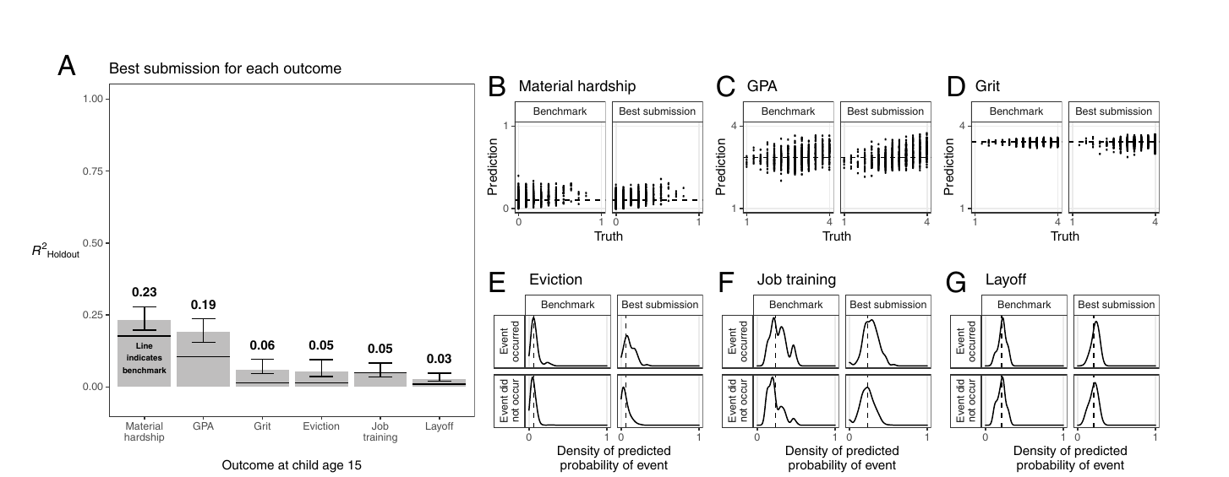
The Fragile Families Challenge made imprecision the finding
§9.4
160 teams, six life outcomes: the best hold-out R² reaches only ~0.23, with 95% intervals shown.
Source: Salganik et al. (2020), Fig. 3, Proceedings of the National Academy of Sciences. © National Academy of Sciences. Included for instructional use.
Takeaway: Showing the confidence intervals, not hiding them, is the figure's central act of honesty.
29 / 41
Notes:
Walk panel A first: 160 teams predicted six life outcomes for roughly 4,000 families from thousands of variables, and the most predictable outcome, material hardship, reaches an R-squared of about 0.23 while several sit near 0.05. The horizontal lines are a four-variable benchmark that the elaborate models barely beat. Panels B through G show predictions clustering near the training average instead of the diagonal. The authors drew the policy implication directly: predictive models in criminal justice and child-protective services deserve concern given how weakly these outcomes could be predicted. Uncertainty here is the finding, not a footnote.

Slide 30
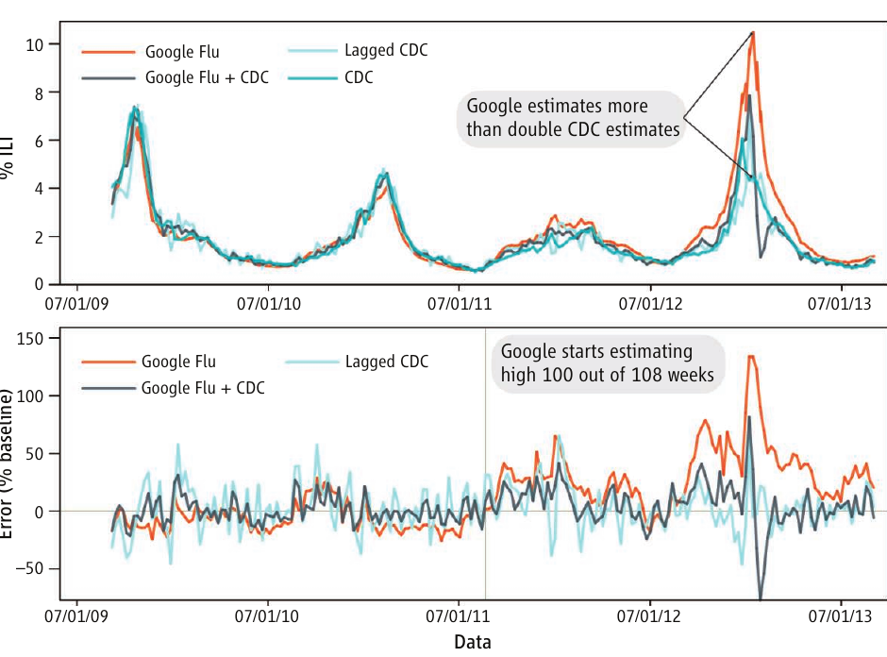
Google Flu Trends: uncertainty that never traveled with the numbers
§9.4
GFT overestimated flu prevalence 100 of 108 weeks after August 2011, doubling CDC's 2013 peak estimate.
Source: Lazer et al. (2014), figure p. 1204, Science. © AAAS. Included for instructional use.
Takeaway: Undocumented algorithms and search terms meant no one could anticipate or audit the drift.
30 / 41
Notes:
Students met Google Flu Trends in Chapter 1 as a prediction success; this is the other half of the parable. The top panel shows GFT overshooting CDC surveillance season after season; the bottom panel shows its error running persistently positive after August 2011. Because the search algorithm and the 45 terms behind the model were never documented, users could neither anticipate the drift nor audit it afterward. The constructive fix is in the same figure: combining the search signal with lagged CDC data pulls the error back toward zero. Set beside Salganik: the same numbers are trustworthy or misleading depending on whether their uncertainty travels with them.

Slide 31
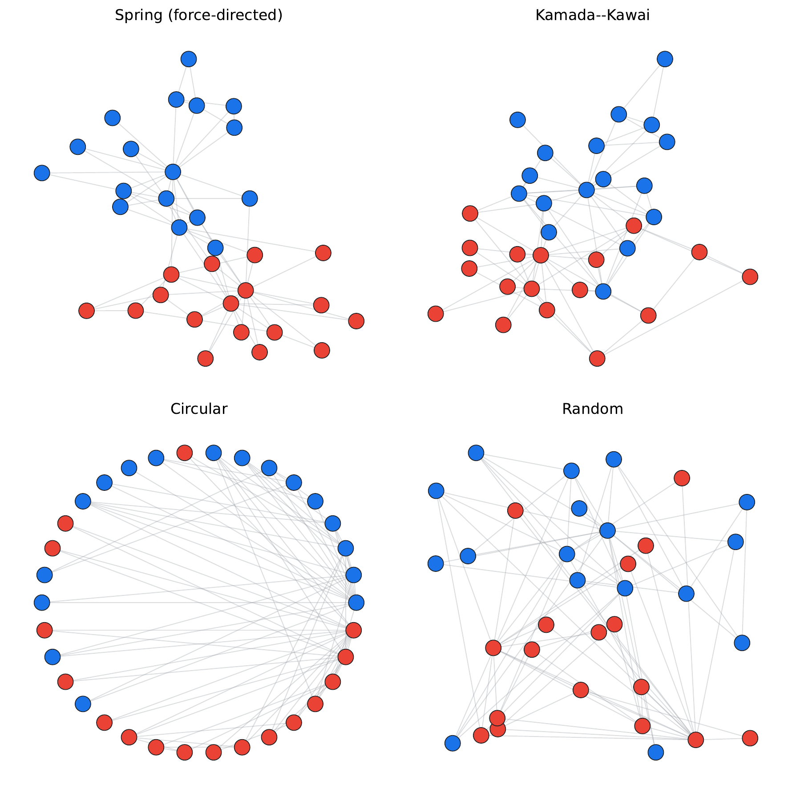
Four layouts, one graph: layout is not data
§9.4
Zachary's karate club under spring, Kamada–Kawai, circular, and random layouts; only the algorithm changes.
Takeaway: A reader shown only the spring panel would overestimate the community structure.
31 / 41
Notes:
The edge set, faction colors, and node sizes are identical in all four panels. The spring layout pulls the two factions apart and makes the split look like a sociological fact; Kamada-Kawai reaches a similar separation with a fuzzier boundary; the circular layout keeps some structure on the ring but buries it under crossing edges; random is incoherent. None is more true than the others; each emphasizes a different feature of the same graph. The design lesson: state the brief, pick the layout that serves it, report the algorithm and parameters, and acknowledge that the visual form is a computational artifact, not a picture of the social world.

Slide 32
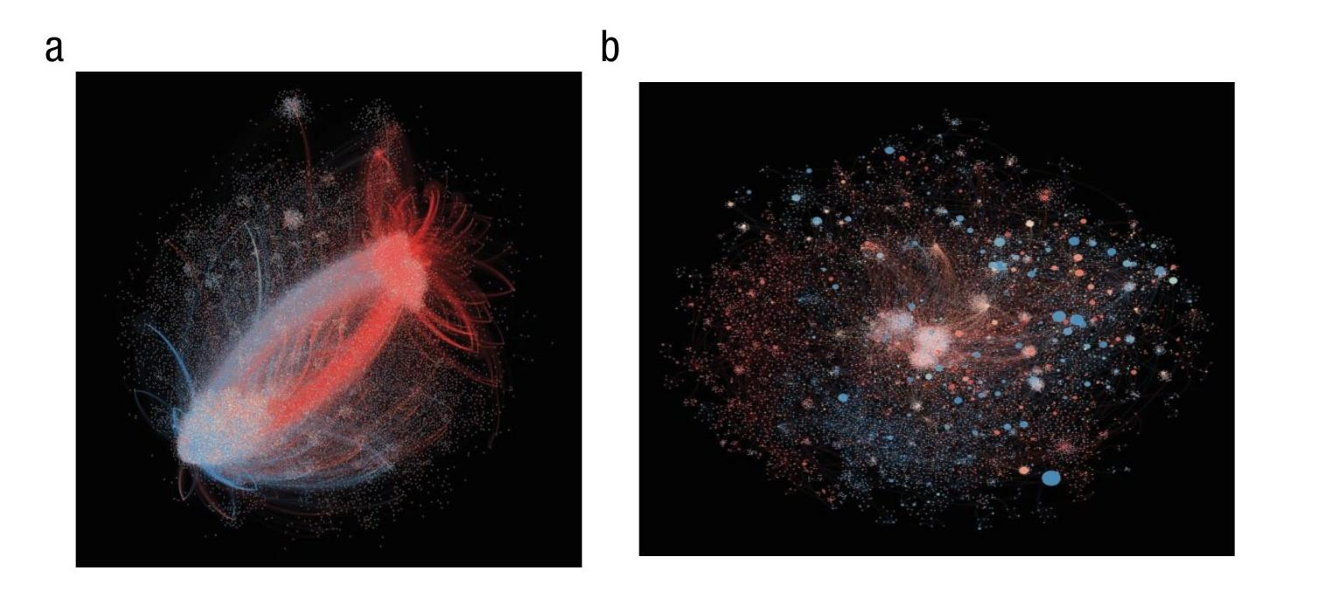
The same layout dependence in a published finding
§9.4
Retweet networks: the 2012 election splits into ideological lobes; the 2014 Super Bowl does not.
Source: Barberá et al. (2015), Fig. 3, Psychological Science. © SAGE Publications. Included for instructional use.
Takeaway: Pairing a political with a nonpolitical event is good editorial thinking; the unnamed layout is the honesty gap.
32 / 41
Notes:
Barberá and colleagues estimated ideology for 3.8 million Twitter users and drew these retweet networks with a force-directed layout. The election network separates into conservative and liberal lobes; the Super Bowl dissolves into small heterogeneous clusters, which stops a reader from concluding that all online interaction is polarized. Then the instructive limits: the paper names only "a force-directed layout algorithm," no variant or parameters, and never shows an alternative layout, so a reader cannot tell how much separation is structure and how much is the algorithm pushing weakly connected nodes apart. What the study does supply is deposited data and code, so anyone can redraw the graph and check.

Slide 33
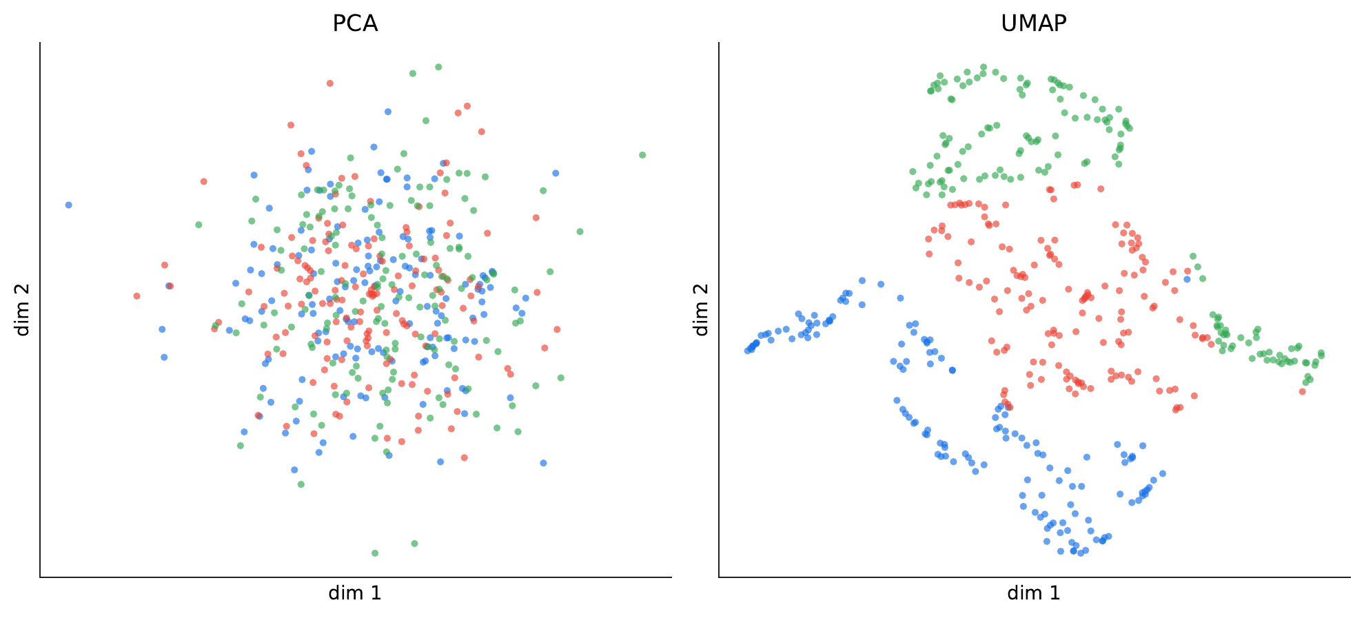
Same data, two projections, opposite answers
§9.4
A 64-dimensional dataset whose class signal lives on one low-variance axis: PCA shows one blob, UMAP three groups.
Takeaway: The projection algorithm decides what structure your audience gets to see.
33 / 41
Notes:
The dataset is built so a single dimension carries the class signal while two others carry high-variance noise. PCA's objective rewards variance, so it locks onto the noise and projects the three classes into one mixed blob. UMAP preserves local neighborhoods; the small signal keeps same-class points slightly closer together, and UMAP recovers three visibly distinct groups ordered along the signal axis. Neither picture is wrong: each answers a different question about the data. The honesty requirement follows: name the algorithm and parameters, warn that on-page distances are not similarities, and support substantive claims with quantitative measures computed in the full-dimensional space.

Slide 34
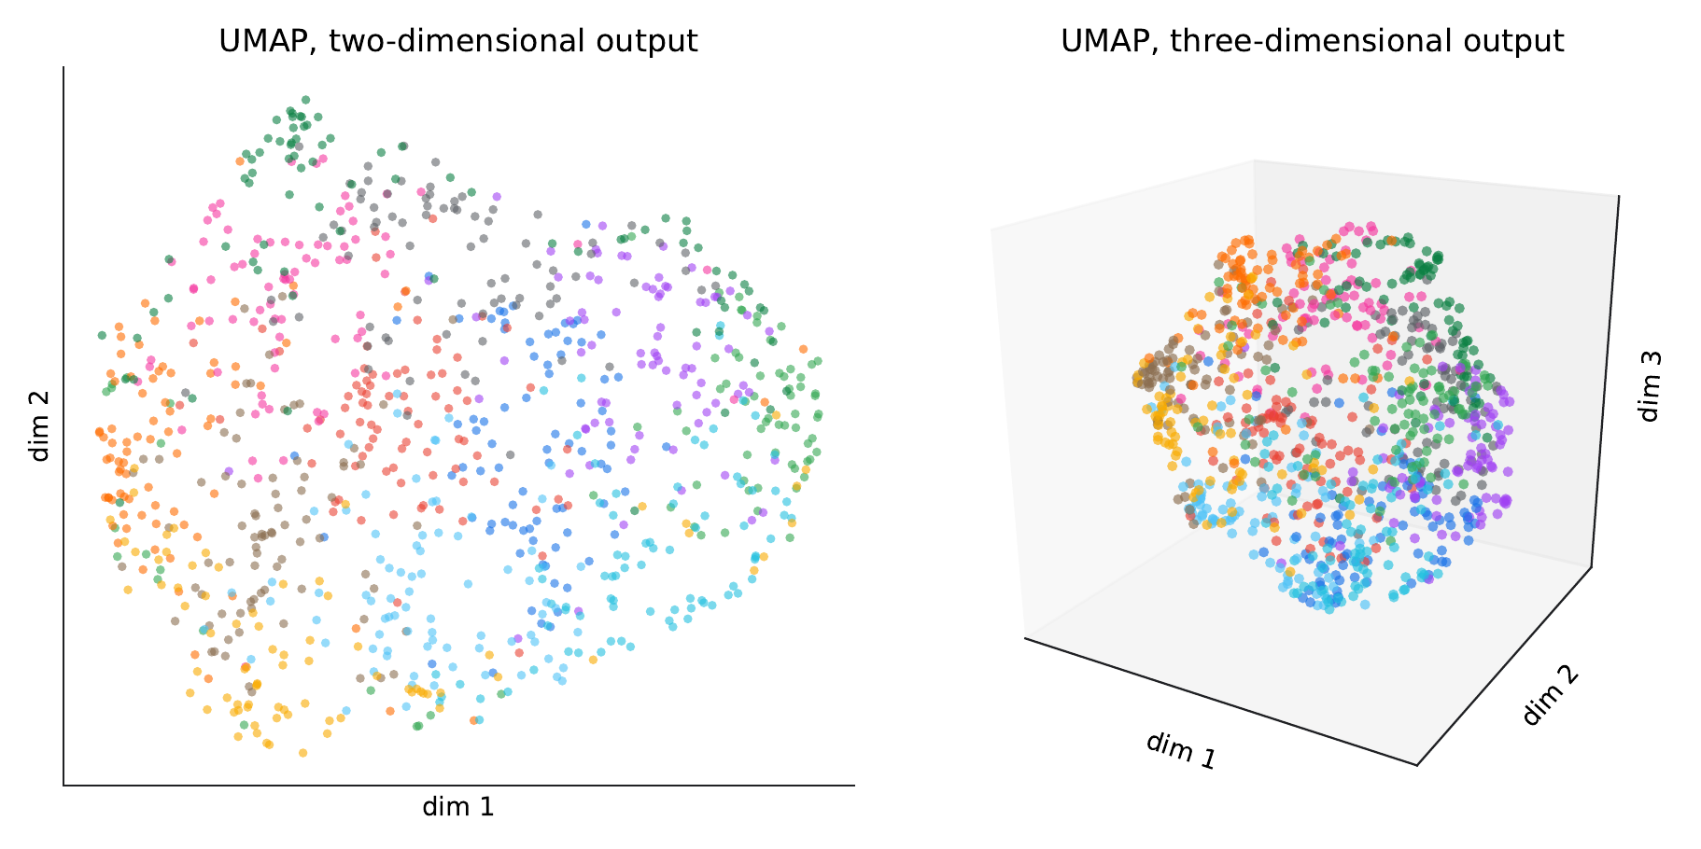
Same data, same algorithm, different output dimensionality
§9.4
Twelve clusters on a sphere: 3D UMAP recovers the shell; 2D compresses it into an unreadable disk.
Takeaway: You cannot flatten a sphere onto a plane without distortion; neither can UMAP.
34 / 41
Notes:
Here the twelve cluster centers sit at the vertices of an icosahedron, evenly spaced on a sphere. UMAP with three output dimensions settles the groups onto a spherical shell and the arrangement is visible. UMAP with two output dimensions faces the map-maker's problem: flattening a sphere requires stretching or seams, so neighboring regions press into one another in the middle of a disk and a reader sees one multi-colored blob. Same data, same algorithm, one changed setting. Add the topic-model corollary from the chapter: stochastic methods add seed-to-seed fragility on top of projection distortion, so ensemble plots or sensitivity tables communicate stability more honestly than one run's output.

Slide 35
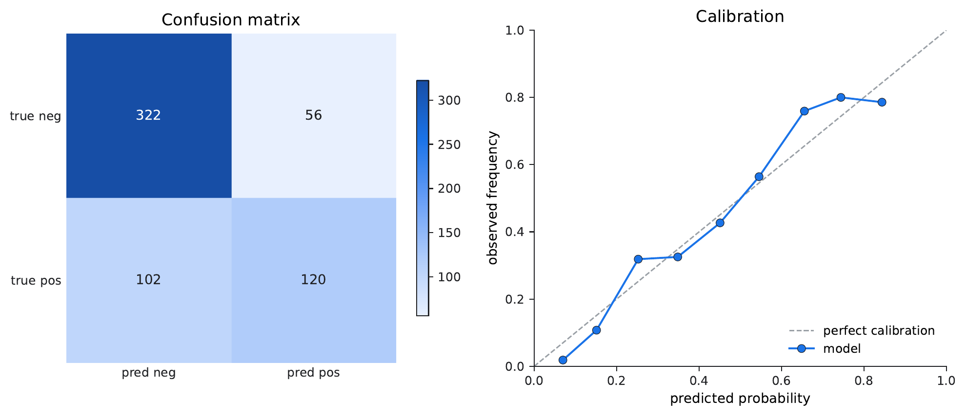
Diagnostics for the methods-oriented reader
§9.4
Confusion matrix: 56 false positives, 102 false negatives. Calibration: at a stated 0.65, the actual rate is 0.76.
Takeaway: A single accuracy number would hide both the error asymmetry and the calibration drift.
35 / 41
Notes:
A predictive model must be communicated at two levels; this figure serves the reviewer. The confusion matrix sorts 600 held-out cases by truth versus prediction: the model misses positives almost twice as often as it cries wolf, and in a benefits-eligibility tool those errors have opposite human costs. The calibration plot asks whether stated probabilities mean what they say: the curve sits above the diagonal through the middle and upper range, so when the model says 0.65 the actual rate is nearer 0.76; the model is too cautious about its own positives. Overall accuracy is about 0.74, and neither pattern is visible in that number.

Slide 36
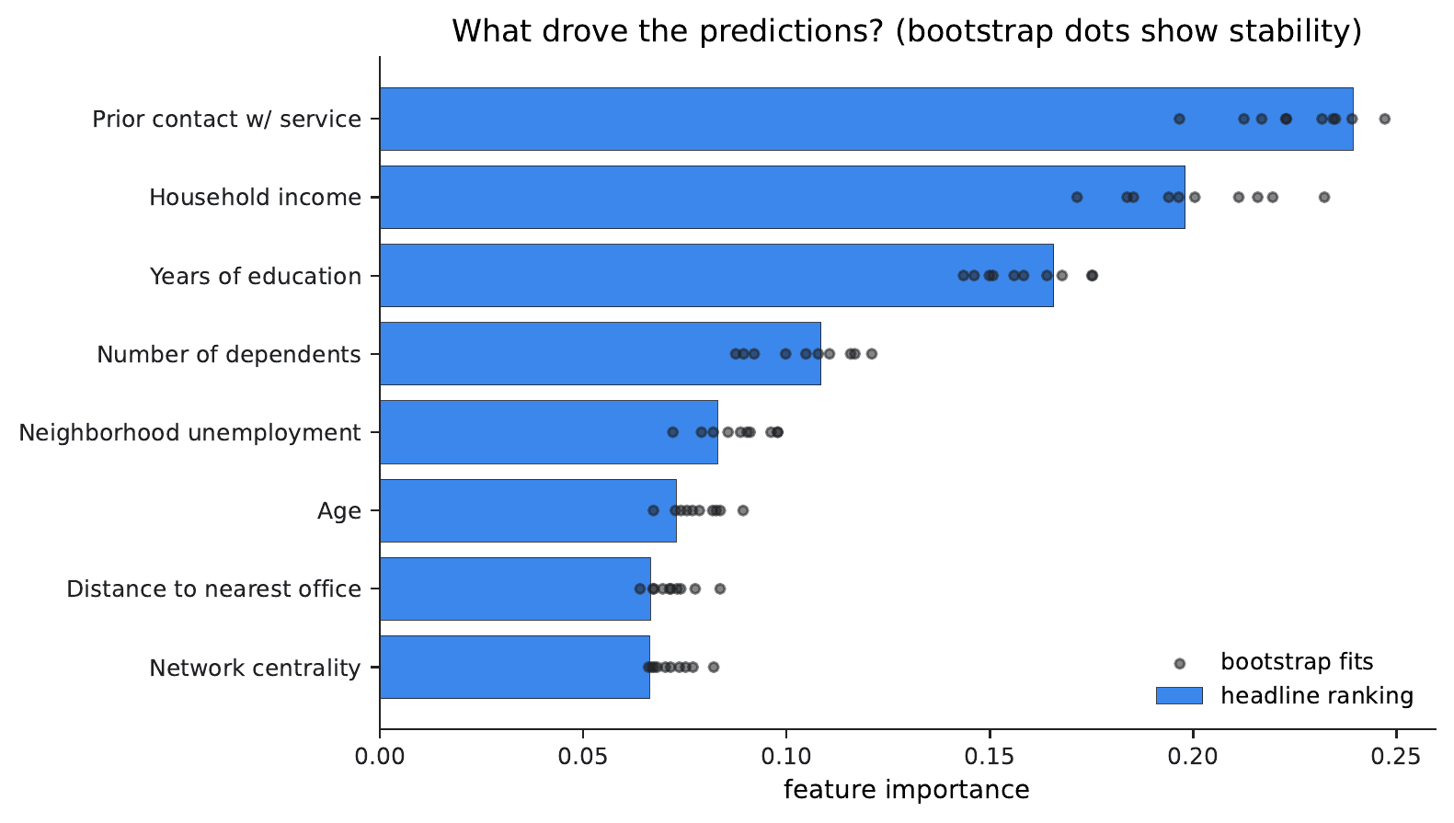
The same model, translated for the policymaker
§9.4
Feature importance as ranked bars; dots from ten bootstrap refits show how much each value moves.
Takeaway: The three tiers are stable across refits; the ranks within tiers are not.
36 / 41
Notes:
Same random forest, same data, different window. Each bar shows how much the model relied on a feature; length on a common axis sits at the top of the encoding hierarchy, so a non-technical reader decodes it reliably. The black dots are the honesty layer: ten refits on bootstrap-resampled training data reveal that the broad three-tier ordering, prior contact, income, and education on top, is stable, while the bars for age, distance, and network centrality are close enough that their order flips between refits. A sentence claiming age matters more than centrality would reach beyond what the figure supports. When the model is opaque, these visualizations are the audience's only window into it.

Slide 37
Dashboards are living systems, not static figures
§9.4
• Interactivity lets non-specialists ask their own questions of the data
• Honesty: document the aggregation, filters, and exclusions behind the surface
• Accessibility: static fallbacks, screen readers, keyboard navigation
• Longevity: a 2024 Shiny app may not run in 2030
↗ Communication tools · cssprimer.org/tools/communication
Takeaway: Prioritize principles over tools; grammar of graphics outlasts any platform.
37 / 41
Notes:
Dashboards close the four challenges. Their strength is audience agency: policymakers, community organizations, and journalists can filter and drill rather than accept the researcher's chosen view. Their risks are symmetrical: a polished interface can hide the analytical pipeline, so the underlying analysis still needs reproducible code and a documented manuscript; and they decay, since data sources, APIs, and hosting platforms all change. Editorial thinking decides which filters exist at all, which determines what the audience can and cannot discover. Chapter 10's integrative-artifact exercise has students build one and write its maintenance memo.

Slide 38
Discussion
Reflective exercises
• Could another researcher see every step of one of your earlier analyses? What is hidden?
• Where does your work fall on the R1–R4 scale, and what is the smallest change that moves it up a rung?
• If your research is exploratory, what can you lock down in advance without being performative?
• Which forms of uncertainty are present in your own work, and which visual strategy fits your audience?
Ch. 9 · Communicating Research · cssprimer.org
38 / 41
Notes:
Drawn from the chapter's Reflective Exercises. Have students answer about a concrete analysis they built in Chapters 4 through 8, not in the abstract. The first prompt usually surfaces undocumented preprocessing and prompt histories; push students to treat preregistration, open data, open code, and AI documentation as separate layers. The second gets specific fast: most sit at R2 or R3, and the missing rung is usually archived data or a pinned environment. For the last prompt, expect error bars by default; press for whether an icon array or ensemble plot would serve their actual audience better.

Slide 39
Key concepts from Chapter 9
Scientific communication: Making the entire pipeline inspectable, reproducible, and interpretable to diverse audiences
Open data / open code: Sharing data and scripts, with privacy protections, so others can verify and build
Preregistration: Declaring hypotheses, methods, and plans before seeing results
AI workflow documentation: Promptbook (Knowledge), promptlog (Memory), model and validation discipline (Rules)
Registered report: Peer review before data collection; publication regardless of outcome
Design mindset: Kirk's four-stage process guided by trustworthy, accessible, elegant
Reproducibility: Same data and procedures yield the same results for another researcher
Visual encoding: Position beats length beats angle beats area beats color intensity
Computational reproducibility: Pinned versions, recorded seeds, archived data, frozen environments
Uncertainty communication: Conveying precision and stability: icon arrays, ensembles, sensitivity tables
Ch. 9 · Communicating Research · cssprimer.org
39 / 41
Notes:
Run this as a self-test against the chapter's key-concepts table: cover the glosses and have students supply them from the terms. The three-property definition and the Rules/Memory/Knowledge mapping for AI documentation are the two items they must carry into Chapter 10, where every one of these concepts becomes a deliverable: a preregistration, a frozen environment, a documentation package, a designed figure, and an uncertainty layer. The full table in the chapter cross-references each concept to its exercise number.

Slide 40
Materials on the companion site
cssprimer.org
Studies filtered to scientific communication cssprimer.org/ch09/
The Practice assignment's pre-filtered slice of the studies browser
Communication tools cssprimer.org/tools/communication
Preregistration, environment freezing, visualization, and dashboard tools
CSS Empirical Studies Database cssprimer.org/studies/
The full database; the communication lens has the fewest annotations, which is itself discussable
Ch. 9 · Communicating Research · cssprimer.org
40 / 41
Notes:
Two of this chapter's themes continue on the site: the tools page carries the preregistration and environment-freezing options Chapter 10 will use, and the studies database's thin coverage under the communication lens is a ready-made discussion prompt. Why would the stage that makes work inspectable be the least annotated? Students' answers usually reach the chapter's own argument.

Slide 41
Where to go next
• Read: Chapter 10, where each property becomes a hands-on exercise on your own project
• Practice: audit one published study with the inspectable–reproducible–interpretable framework
• Browse: the CSS Empirical Studies Database, filtered to scientific communication
All materials: cssprimer.org
Notes:
The practice assignment is the chapter's own: pick one computational study from the database at the companion site, and write a one-page analysis working through inspectability, reproducibility with the Freese framework, one visualization under Kirk's process, and uncertainty communication. Students should arrive at the next session with that audit done and their own cumulative project ready, because Chapter 10 runs the OpenAlex corpus, the coded records, and the network and prediction outputs through every practice introduced today.

