Slide 1
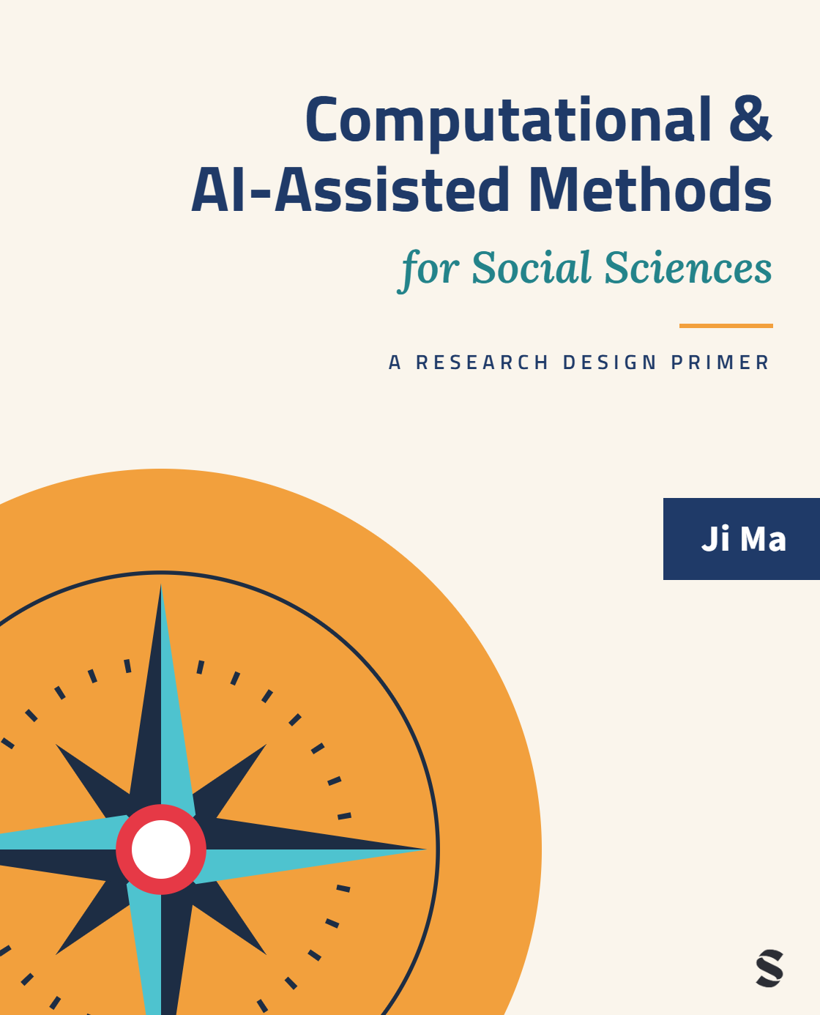
Computational & AI-Assisted Methods for Social Sciences
A Research Design Primer
Chapter 11
Ethical Concerns in Computational and AI-Assisted Research
Ji Ma
cssprimer.org
Instructor slides · free to adapt for course use
Notes:
This deck accompanies Chapter 11. Everything the course has built, the four-stage framework, the AI infrastructure, the validity habits, returns today with an ethical question attached to each piece. The chapter's structure is the course's structure: we walk the four design stages and the AI layer one at a time, asking at each what the ethically interesting thing about that stage actually is, then step back to ask why the inherited ethics framework keeps misfiring, and close with practices a project can adopt now. No checklists; vocabulary and judgment.

Slide 2
Learning objectives
By the end of this chapter, you can:
• Identify the ethical concerns at each design stage, and at the AI infrastructure layer cutting across them
• Recognize why the biomedical framework behind IRB review fits CSS poorly, and what an embedded alternative looks like
• Apply safeguards for born-digital data — contextual integrity, consent, tiered access — and for AI workflows: disclosure, traceability, oversight
• Develop a project-level ethical practice integrated with your workflow, audits, and reproducibility commitments
Ch. 11 · Ethics · cssprimer.org
2 / 41
Notes:
Straight from the chapter's learning-objectives box. Set expectations early: this is not a compliance session, and students hoping for a checklist that absolves them of judgment will not get one. The aim is a vocabulary and a set of orientations for exercising judgment well at each design choice. The fourth objective is the integrative one: by the end, students should see their own pipeline from the exercise chapters as this chapter's case material, which is exactly how the reflective exercises treat it.

Slide 3
Ethics in CSS is a property of how a project is designed, not an addendum applied at the end.
Ch. 11 · Ethics · cssprimer.org
3 / 41
Notes:
This is the chapter's thesis and the reason for its structure. Every methodological choice made earlier in the course carries ethical weight: which data sources you draw on, which concepts you measure and how, which claims you make from opaque models, how you communicate the pipeline, and how you structure the AI infrastructure touching all of the others. If ethics is a property of design, then the ethics chapter must be organized by design stages, and the person responsible is the person making the design choices, not a committee downstream.

Slide 4
Every stage raises its own ethical question
Chapter 11
1. Data management
2. Concept representation
3. Data analysis
4. Scientific communication
Whose context? Whose errors? Who can contest? What is hidden? — and an AI layer cutting across all four.
Takeaway: The ethics chapter is organized by the same four stages as the course.
4 / 41
Notes:
Reintroduce the backbone diagram with the ethical question each stage carries. Data management asks whose context the data travels out of. Concept representation asks whose cases the measurement errors fall on. Data analysis asks who can contest a decision made through an opaque model. Communication asks what the presentation hides. And the AI layer asks who is answerable for what an opaque tool produces in your name. Students who can recite these five questions have the chapter's skeleton before any detail arrives.

Slide 5
§11.1
Data management: privacy as contextual integrity
Stop thinking of privacy as a property of a file; start thinking of it as a property of how data circulate.
Ch. 11 · Ethics · cssprimer.org
5 / 41

Slide 6
The technical framing of privacy is part of the problem
§11.1
• The standard move: anonymize, encrypt, add calibrated noise
• Technically compliant research can still be ethically tone-deaf
• A “de-identified” release of teens' mental-health messages can pass every checkbox
Takeaway: Privacy becomes something a software library does, not something people negotiate.
6 / 41
Notes:
Start with the framing critique from Boenig-Liptsin and colleagues: when ethics is conceived as technical knowledge applied to technical problems, values get pulled out of the human relationships where they carry weight. The mental-health example does the work: no names, no IP addresses, differentially private aggregates, and still a violation of what the senders expected to happen with what they wrote. That gap between compliance and expectation is what the technical framing cannot see, and it is where this section lives.

Slide 7
Contextual integrity: what did the author intend?
§11.1
• Working rule: data should travel no further than its intended context and audience (Hoser & Nitschke 2010)
• A public tweet is loud talk in a coffee shop, not a press release
• Platform settings mark the upper bound on visibility, not intended audience
Takeaway: Users cannot defend a boundary they do not know is being crossed; the judgment falls on you.
7 / 41
Notes:
The replacement framing is contextual integrity: ask what the data subject expected, not what the platform permits. Work the grief-support example: a post in a public Facebook group is technically visible to anyone, but the audience is fellow grievers, not journalists or researchers studying mental-health language. Raise the stakes with communities whose safety depends on not being collected, organizers in repressive contexts, stigmatized minorities online, where scrapeability is the worst possible proxy for consent. The burden of judgment falls on the researcher because subjects cannot see the crossing.

Slide 8
Context collapse and the inferred-attribute problem
§11.1
• Imagined audience vs. “whole actual audiences” (Williams et al. 2017)
• ~80% of surveyed Twitter users expect to be asked before publication; >90% want anonymity
• Platforms infer ideology, ethnicity, orientation the user never volunteered
• Publishing an inferred attribute discloses what was never shared
Takeaway: Reproducing a post in a paper collapses audiences the speaker never anticipated.
8 / 41
Notes:
Two escalating problems. First, context collapse: people post for an imagined audience, and quoting them in a paper, dataset, or slide merges imagined and actual audiences into one the speaker never anticipated; the survey numbers show how far current practice sits from users' own expectations. Second, the harder problem: when researchers consume platform inferences or generate their own classifiers, a paper can publish a researcher-made sensitive attribute about a named person. Cambridge Analytica is the famous case; identifiable tweets beside demographic inferences are the everyday one.

Slide 9
Consent for subjects who never agreed to be subjects
§11.1
• Most CSS data was generated before the researcher arrived
• The modal move — “it was public” — asserts that scrapeable means usable
• Compensations: minimize collection, aggregate reporting, consult the affected community (Salganik 2017)
Takeaway: Human subjects are now data subjects; the protections must be reworked, not waived.
9 / 41
Notes:
The biomedical model takes prospective informed consent as the default; CSS rarely can. The honest stance is to acknowledge that consent will often be impossible, partial, or post-hoc, and to ask what compensating practices the design provides. Salganik's four principles, Respect for Persons, Beneficence, Justice, Respect for Law and Public Interest, adapt Belmont and Menlo for the digital age, and Respect for Persons is the one the consent gap presses hardest. The slogan worth writing down: human subjects are now data subjects.

Slide 10
Re-identification is a risk profile, not a status
§11.1
• Zip code, birth date, and gender can single a person out
• CSS data are large, sparse, longitudinal: behavior over months is a fingerprint
• Model plausible attacks; hold sensitive joins in controlled environments; release aggregates or synthetic products
Takeaway: Anonymization is a probability of disclosure under attack, not a property of the dataset.
10 / 41
Notes:
Two decades of data releases teach one lesson: anonymized is not a state a dataset is in, it is a probability of disclosure under plausible attacks, usually via joins to auxiliary sources. CSS data are unusually exposed because longitudinal behavior survives the removal of names. The status mindset produces predictable mistakes, stripping obvious identifiers and assuming scale provides cover; the risk-profile mindset produces the practices on the slide. Mention ethnoarrays from computational ethnography as one design that lets others verify analyses without full de-anonymization.

Slide 11
Workflow is the enforcement mechanism
§11.1
• Weak: the PI tells the team to drop identifiers
• Stronger: a documented workflow step names the columns to remove
• Strongest: an automated step selects only approved columns; deviations show up in version control
Takeaway: A privacy commitment that lives only in the IRB protocol is a commitment in name only.
11 / 41
Notes:
Same commitment, three enforcement designs, very different robustness to ordinary error. Only the third is auditable by an outsider and resistant to the drift long projects produce. This is the ethical case for the workflow standardization of Chapter 3: reproducibility is also the ability of another person, your future self, an auditor, a community partner, to verify that what was promised was done. The Memory dimension of Chapter 2 serves the same function for AI-assisted steps; without the record, claims about what the model did not do cannot be checked.

Slide 12
Three layered controls, each catching what the next cannot
§11.1
• Minimum-necessary collection: the unshared attribute is the uncollected one
• Tiered access: raw (controlled) → analytic (fewer identifiers) → public (aggregated or synthetic)
• Output-side review: could anything published re-identify a hidden record?
Takeaway: Only collection limits survive a leak; only tiers restrain an analyst; only review catches the quote.
12 / 41
Notes:
Walk the complementarity, because it is the argument for having all three. Minimum-necessary collection is the only protection against a future leak of the raw store. Tiered access is the only protection against an authorized analyst doing more than the protocol allowed. Output-side review, applied to supplementary materials and replication archives as well as the paper, is the only protection against an excerpt that, combined with the dataset, identifies its speaker. Have students map their own exercise pipeline onto the three layers; most discover they have none formalized.

Slide 13
§11.2
Concept representation: the geography of measurement error
Where errors concentrate, who they harm, and how the categories were constructed.
Ch. 11 · Ethics · cssprimer.org
13 / 41

Slide 14
Data is never innocent
§11.2
• Numbers always advance someone's way of seeing the world (Shugars & Meyer 2024)
• U.S. Census race categories changed with political commitments, not populations
• Tokenization, stopword lists, and corpus composition are value-laden choices
Takeaway: Critical CSS does not reject computation; it persistently asks what is measured and why.
14 / 41
Notes:
Set the section's premise: data is the product of a particular time, place, and way of conceptualizing the world, never a fixed unbiased reflection of it. The Census example makes it concrete, the categories moved because the commitments behind them moved. Then bring it inside the pipeline: which language a model handles first, which words count as stopwords, what the training corpus contains, all encode decisions. The point is not that the choices are wrong but that they are choices, and a chosen thing can be examined, defended, or revised.

Slide 15
Word embeddings transmit stereotype with high fidelity
§11.2
• GloVe reproduces Implicit Association Test results: career–male, family–female (Caliskan et al. 2017)
• Occupations' gender association tracks actual workforce composition at r = 0.90
• “Man is to programmer as woman is to homemaker” (Bolukbasi et al. 2016)
Takeaway: The embedding does not introduce the stereotype; it faithfully transmits the corpus, which transmits the world.
15 / 41
Notes:
The chapter's worked example, chosen because bias enters through ostensibly neutral computation. Explain the mechanism first: embeddings learn from co-occurrence, so words used in similar contexts land close together, including the stereotyped contexts. The r = 0.90 result is the striking one, the learned gender direction of occupation words mirrors the real workforce almost perfectly. Sketch the gender axis on the board: homemaker and nurse toward one pole, lawyer, engineer, programmer toward the other. Faithful transmission is precisely the problem, not a malfunction.

Slide 16
Two implications no technical fix dissolves
§11.2
• Downstream measures inherit the structure: “professional language” built on embeddings prefers male-coded language, by construction
• Deployed systems amplify: resume search ranks the historical pattern higher
• Using such systems is a choice about participating in that amplification
Takeaway: Aggregate accuracy cannot decide a question about amplification.
16 / 41
Notes:
Draw out why this is an ethics slide, not just a validity slide. First, silent propagation: a researcher who never wrote a rule about gender has nonetheless built one into any measure that consumes the embedding. Second, amplification: in resume search or ad targeting, the system does not just record existing inequality, it ranks people who match the historical pattern above those who do not. Caliskan's own summary: any system that learns enough language to use it will also acquire historical cultural associations. Choosing the tool is choosing a relationship to that fact.

Slide 17
Errors have a geography; audit it by group
§11.2
• High overall accuracy often concentrates errors at category boundaries and rare cases
• Boundary cases are not random: minorities, underrepresented discourse styles, lives off the template
• Disaggregated error audit: ask “for whom is this measure worst?” as routine
↗ CSS Empirical Studies Database · cssprimer.org/studies/
Takeaway: The technical problem and the equity problem are the same problem.
17 / 41
Notes:
Connect to the marginal-cases problem from Chapter 5: sarcasm and African American English misread by sentiment classifiers, transliterated names failed by matchers, small cohesive discourses scattered into noise topics. The machinery of the audit is nothing new, precision and recall by group, calibration by group; what is new is the commitment to report disaggregated results as part of the headline finding rather than an appendix footnote. Then the sobering baseline: in a content analysis of 132 published studies using public online data, 64 percent discussed no ethical issues at all.

Slide 18
§11.3
Data analysis: opacity and algorithmic accountability
In consequential settings, opacity is the breakdown of the accountability chain itself.
Ch. 11 · Ethics · cssprimer.org
18 / 41

Slide 19
Opacity becomes an accountability problem
§11.3
• Child welfare, recidivism, credit, hiring: high stakes, routine deployment
• Held-out accuracy justifies the model to developers, not to the people it scores
• Thick trust needs explanation and accountability; opaque tools permit only reliance (Koskinen 2024)
Takeaway: The trust must come from the human structures around the model.
19 / 41
Notes:
The formalism of prediction is neutral; the trouble is the conjunction of epistemic opacity with settings where individuals bear the consequences. Recall the child-welfare example from Chapter 7: benchmark performance cannot explain to a caseworker, a parent, or a judge why this family was flagged. Then re-import Chapter 2's distinction: we can rely on a model, but thick trust requires an agent that can explain and be held accountable, so the trust has to be built around the model, rules of use, audit procedures, channels for the scored to contest. When those are absent, opacity is the accountability breakdown.

Slide 20
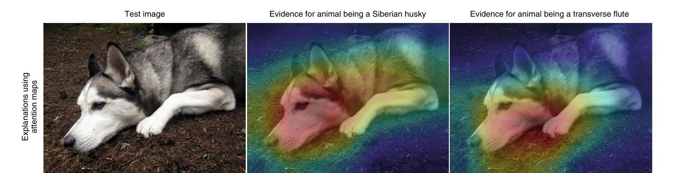
Saliency tells you where the network looked, not whether it had a reason
§11.3
Near-identical saliency maps “explain” the same image as a Siberian husky and as a transverse flute.
Source: Rudin (2019), Fig. 2, Nature Machine Intelligence. © Springer Nature. Included for instructional use.
Takeaway: An explanation that fits both labels explains neither.
20 / 41
Notes:
Give the image time; it is the most memorable evidence in the chapter. The network classifies the same photo as a husky and as a flute, and the saliency maps for the two labels are visually almost identical. The maps show where the gradients point, and both labels' gradients point at the animal. So the most common form of post-hoc explanation reports attention, not reasons, and looks equally reassuring when the judgment is absurd. Rudin's original credits the image to Chaofen Chen at Duke. Ask: if this dashboard sat in a courtroom, what would it legitimate?

Slide 21
COMPAS and the false hope of explainability
§11.3
• COMPAS: proprietary recidivism score used in U.S. bail and parole decisions
• ProPublica's audit fitted its own linear mimic — an explanation in name only (Rudin 2019)
• A mimic agreeing 90% of the time misdescribes one decision in ten
• 130+ intake items: typos alone have flipped bail outcomes
Takeaway: Affected people need a justification they can contest, not a description of model behavior.
21 / 41
Notes:
Rudin's argument is double-edged and worth stating carefully: the famous 2016 audit of COMPAS relied on a separate approximation, and a model fitted to mimic a black box can match its predictions while using entirely different features. When each case is a bail hearing, the ten percent residual is not a rounding error. Add the intake-form pattern: complexity plus bolted-on explanation amplifies human error rather than reducing it. The conclusion the book draws: prefer inherently interpretable models in high-stakes settings when comparable performance is achievable; the legibility must sit where the decision sits.

Slide 22
Semantic gaps and domain drift
§11.3
• A label's social meaning changes across populations even when the statistics hold
• Sentiment trained on product reviews means something else on political speech
• Drift shifts the burden of false positives onto people never validated for
Takeaway: Validate where you intend to deploy; until then, the model is not ready to be used there.
22 / 41
Notes:
The second ethical risk in analysis is quieter than opacity: the semantics-to-application gap from Chapter 7. A classifier can be statistically valid in its training context while its outputs mean something different where it is applied, and over time domain drift does the same thing along the time axis, degrading a recidivism model on cohorts it never saw. Stress that more data does not fix this; it takes a design discipline, validate at the deployment site, and a matching ethical discipline, refuse deployment where validation has not happened.

Slide 23
Technologies are moral mediators
§11.3
• Research technologies reinforce some values at the expense of others (Carusi 2012)
• Caseworkers come to ask first what the model says; departures need justifying
• Risk scores redefine the normal case and the flag
Takeaway: The researcher who builds the system is part of the chain that produces its effects.
23 / 41
Notes:
Close the analysis section with the deepest claim: predictive systems do not merely measure social phenomena, they shape them. Danaher's point is that technologies modulate the costs of acting on different values and gradually shift how the values themselves are interpreted. In a welfare office the model becomes the default any other reasoning must override, and over years the system reshapes what counts as normal. The implication for your students: the builder and the evaluator are not external observers of these effects, so the chain has to be visible all the way through. This thread returns in the chapter's closing argument.

Slide 24
§11.4
Scientific communication: disclosure, uncertainty, inspectability
Communication is the practice that makes scrutiny possible at every step.
Ch. 11 · Ethics · cssprimer.org
24 / 41

Slide 25
Disclosure as ethical commitment
§11.4
• Four layouts of the same network tell four visual stories (Ch. 9's karate club)
• Document what the visual does not show: missing data, exclusions, seeds, parameters
• For AI-assisted steps: prompts and outputs, with traceability and human oversight (Ivanov et al. 2025)
Takeaway: Treating pipeline choices as private craft hides them from the people who would catch the mistakes.
25 / 41
Notes:
The karate-club example carries the point: a reader who sees only the most dramatic layout cannot recover the soberer ones, so disclosure means documenting enough of the pipeline that another reader can see how the result was produced. For AI-assisted work the promptbook and promptlog from Chapter 2 are the concrete vehicles, and their absence in published work is increasingly itself a finding about the work. The framing to insist on: undisclosed complications still happened; hiding them makes the work less honest, not less complicated.

Slide 26
Honest communication of uncertainty
§11.4
• Four kinds: statistical, model, measurement, algorithmic
• The worst failure is tight confidence intervals over unmodeled systematic error
• Headline accuracy with a 95% CI erases the group the model fails
Takeaway: This is “confidently wrong” translated into a published claim.
26 / 41
Notes:
A confidence interval is a statement about sampling noise around an estimator; it says nothing about whether the construct measured is the one intended. So a classifier whose worst errors fall on a minority group, summarized as a single accuracy number with a tight interval, offers precision the data does not support, and the readers most affected are exactly the ones the number erases. Remedies come from Chapter 9: show uncertainty visually, put subgroup performance in the headline result, report the sensitivity analyses where small pipeline changes moved conclusions, and let interpretive language match the strength of evidence.

Slide 27
Open science within real constraints
§11.4
• Tiered access and platform terms pull against openness; law constrains further
• Practical rule: share what you can, restrict what you must, explain both
• Full pipeline code, schema, summary statistics, and synthetic samples meet most replication needs
Takeaway: The boundary between shared and withheld should itself be part of the inspectable record.
27 / 41
Notes:
Students often experience the privacy commitments of section one and the openness commitments of Chapter 9 as contradictory; this slide is the reconciliation. The environment is genuinely mixed, some data paywalled or unobtainable, commercial incentives pulling against public-interest access, so the ethical work is drawing the line deliberately and documenting where it was drawn and why. A replication archive without the raw records can still carry the full code, the analytic schema, and synthetic or held-out samples. Aim for security and openness coordinating, not competing.

Slide 28
§11.5
The AI layer: a transformed research environment
Not a new method but a changed environment — including who produces the data.
Ch. 11 · Ethics · cssprimer.org
28 / 41

Slide 29
Three roles of generative AI; the third is genuinely new
§11.5
• Measurement tool and simulation tool: validity questions from earlier chapters
• Research-environment transformer: participants, coders, and institutions use AI too
• Human findings on unverifiable human provenance are claims you cannot defend
Takeaway: The literature absorbs unverifiable claims as if they were verified.
29 / 41
Notes:
Recall Davidson's triad from Chapter 1 and sort the problems it generates. As measurement and simulation tools, generative AI raises validity questions the earlier chapters equipped students to handle. The transformer role is different in kind: when respondents draft answers with AI and coders quietly delegate to it, the data-generating process itself has changed, and a researcher reporting human findings cannot verify the humanity of the data. The field-level consequence in the takeaway is the reason this section exists: unverifiable claims, once published, are cited like verified ones.

Slide 30
Synthetic respondents are not human respondents
§11.5
• Synthetic ANES responses match averages but invert higher-order relationships (Bisbee et al. 2024)
• Machine bias: strong but socially random skews; near-identical answers across personas (Boelaert et al. 2025)
• Dictator Game: a human persona does not produce human behavior (Ma 2026)
Takeaway: They do not stand in the same epistemic relation to social phenomena as human respondents.
30 / 41
Notes:
Three independent lines of evidence, deliberately stacked. Bisbee shows the averages are a trap: regression relationships invert and results shift with small prompt changes. Boelaert's machine bias has two parts, topic-level skews that track no real social group, and low adaptability, the model answering almost identically whatever sociodemographic persona it is given. The author's own behavioral experiments show persona assignment failing to produce human-like allocation decisions, and the follow-up work locates personas in internal representations, showing how superficial unaltered outputs' human likeness is. Publishing them as human findings is the ethical failure.

Slide 31
Mixed-origin data and model collapse
§11.5
• LLM respondents pass standard attention checks at near-perfect rates
• Nontrivial fractions of crowdworkers admit to being LLMs
• Model collapse: synthetic content contaminates future training data, compounding bias
Takeaway: Treat unsupervised online responses as potentially mixed-origin, and validate accordingly.
31 / 41
Notes:
The transformer problem now reaches data researchers believed was human. Chapter 1 reported the numbers: synthetic respondents passing attention checks almost always, and nontrivial fractions of an MTurk sample answering yes when asked if they were an LLM. Once coherence stops signaling humanity, validation has to be designed into collection rather than bolted on afterward. Model collapse adds the field-level spiral: synthetic content enters training corpora, so errors reinforce across model generations, disproportionately affecting populations the original data underrepresented. Mixed-origin is the term to keep.

Slide 32
Disclosure is not accountability
§11.5
• “We used an LLM; prompts in the appendix” is visibility, not answerability
• A human RA who miscoded could explain and be replaced; the model offers no handle
• What survives: procedural accountability — bounded use, recorded use, exposed use
Takeaway: Disclosure on top of Rules–Memory–Knowledge is verifiable; without them it is an assertion of good faith.
32 / 41
Notes:
Disclosure is now widely promoted, is necessary, and does less than people assume. The paper that discloses its prompts is more transparent, but the published claim still rides on output from a tool whose error structure the author cannot fully characterize, so visibility has not settled who is answerable. The asymmetry with the human research assistant is the sharpest way to see it. What remains available is procedural: commit in advance to bounded uses, record what was done, expose both to scrutiny. That is exactly what the Chapter 2 architecture was built to provide.

Slide 33
Ethics is institutionally grounded practice
§11.5
• Technical functions are only necessary conditions of unethical practice (Jeon et al. 2025)
• The same AI use: exploitative in one institution, empowering in another
• Deliberation at field, university, and department scales — checklists complement, never substitute
Takeaway: A field that skips the deliberation adopts its model providers' values by default.
33 / 41
Notes:
Jeon and colleagues' finding deflates the universal-checklist project: one researcher described an AI use as exploitative because it undermined a community's collective capacity to write and code; another described the same use as empowering because it gave marginal scholars access to advice they lacked. The valence came from the institutional arrangement, not the function. Your project's rules and promptbooks are how it participates in those deliberations legibly. Close with the longer arc from the moral-mediators slide: technologies chosen without visible ethical infrastructure choose the field's future values silently.

Slide 34
§11.6–11.7
Why CSS demands its own ethics
The inherited framework misidentifies, at every stage, what CSS has at stake.
Ch. 11 · Ethics · cssprimer.org
34 / 41
Notes:
Before the next slide, name the pattern the stage-by-stage walk revealed. At each stage the inherited research-ethics framework either does not address the issue or misidentifies the stakes: privacy read as a file property, no language for grouped measurement error, opacity treated as a technical inconvenience, disclosure as an end-of-paper acknowledgment, and on the AI layer no settled position at all. Five appearances of one mismatch point to a structural gap in the framework itself, not five independent problems to patch — which is why the answer is a different kind of ethics, not a longer checklist.

Slide 35
Ethics creep, and boards ruling outside their depth
§11.7
• Regulation spreads outward and tightens simultaneously (Haggerty 2004)
• A journalist scrapes freely; a university researcher waits months for approval
• IRB administrators: 93.1% see unique online-data issues; 55.2% call their board well versed; 5.3% think scraping needs consent (Vitak et al. 2017)
Takeaway: “The Common Rule itself does not provide appropriate guidance for research with online data.”
35 / 41
Notes:
The regulatory architecture descends from mid-century biomedical scandals and assumes bounded experiments, identifiable subjects, prospective consent. CSS rarely fits, and the Vitak survey shows the boards know it: near-consensus that the issues are unique, bare-majority confidence in technical competence, and near-zero agreement on the framework's own default answer about scraping. Add Haggerty's distributional point: the burden lands on the researchers most committed to public-interest scrutiny while market researchers face none. For exploratory work, prior consent logic fails before the field is even entered. The takeaway quotes Vitak and colleagues.

Slide 36
Ethics as embedded, covenantal practice
§11.7
• Principles are reminders of considerations, not premises for deriving judgments (Hammersley 2015)
• The covenantal view: obligations created by the relationship, not calculations of harm (May 1980)
• Learned like other judgment: emulation, deliberation with peers, accumulated cases
Takeaway: Ask not what the regulation requires, but what you owe the people on the other side of this data.
36 / 41
Notes:
If ethics cannot be a checklist, what is it? The chapter's answer: a practice embedded in research design and sustained through scholarly communities, where values partly constitute what it means to inquire well. The covenantal framing is the usable core: a team scraping a forum on gender violence stands in some relation to its members whether or not any committee requires acknowledging it. The question in the takeaway is harder than the regulatory question, and it is the question every section today has circled back to. Let students sit with it before the practices slide.

Slide 37
Practices you can adopt now
§11.8
• Treat data source as ethical context — document origin, intent, audience
• Build privacy into the pipeline: minimum collection, tiers, output review
• Audit measurement error by group, in the headline result
• Prefer interpretable models in high-stakes settings
• Record AI-assisted steps in promptbooks and promptlogs
• Share what you can; restrict what you must; explain both
Takeaway: Reminders that make the right considerations harder to forget — not a substitute for judgment.
37 / 41
Notes:
Every line traces to a section of today's lecture, so use the slide as a recap in disguise. Add the seventh practice verbally: communicate uncertainty honestly, subgroup performance included. And add the missing actor: the community studied. Chapter 5's transformative worldview and the co-productionist framework both put affected publics inside the norm-setting, because the contextual-integrity question, would the speaker have shared this here, is best answered by asking. End on Hammersley's caution: specification to a case cannot eliminate conflicting judgments; the list disciplines deliberation, never replaces it.

Slide 38
Discussion
Reflective exercises
• Your OpenAlex corpus holds records about identifiable researchers who never agreed to be subjects. Which uses preserve contextual integrity, and which breach it?
• Whose cases did your pipeline's errors fall on? Is the geography of your measurement error ethically neutral for your question?
• Draft the AI-disclosure paragraph for your pipeline. Does it make a verifiable record visible, or assert good faith?
• When an AI-coded variable turns out wrong, where does accountability sit: the prompt, the model, the audit sample, or you?
Ch. 11 · Ethics · cssprimer.org
38 / 41
Notes:
From the chapter's Reflective Exercises, which deliberately use the students' own exercise pipeline as case material. The first prompt lands when someone notices OpenAlex authors are colleagues they might meet. The second should send students back to their marginal-cases audit from Chapter 6; the honest answer is usually that errors concentrated somewhere meaningful. For the fourth, push past the instinct to say the model: good answers describe the Rules-Memory-Knowledge trail that would let someone else reconstruct the allocation of responsibility, and notice that without the trail the question has no answer at all.

Slide 39
Key concepts from Chapter 11
Contextual integrity: Data should travel no further than the context and audience its author intended
Disaggregated error audit: Reporting where errors concentrate, by group, alongside aggregate accuracy
Context collapse: Content made for an imagined audience reaches whole actual audiences
Post-hoc explanation: LIME, SHAP, saliency: shows where a model attended, not whether it had a reason
Re-identification: Recovering identities from “anonymized” data; a risk profile, not a status
Mixed-origin data: Responses that may come from humans, LLMs, or both; validate accordingly
Tiered access: Raw data controlled; analytic data restricted; public release aggregated or synthetic
Ethics creep: Review apparatus spreading and tightening without producing better protection
Ch. 11 · Ethics · cssprimer.org
39 / 41
Notes:
Self-test format: cover the glosses, have students reconstruct them. The pairing worth rehearsing once more is contextual integrity with context collapse, the lens and the phenomenon it corrects for; and post-hoc explanation with the husky-flute image, since that picture is what students will remember at their first review request. Covenantal ethics belongs on the list too if you extend it: the obligations created by the relationship between researcher and the people the research touches. All terms appear in the book's glossary with fuller definitions.

Slide 40
Materials on the companion site
cssprimer.org
CSS Empirical Studies Database cssprimer.org/studies/
Audit published studies with this chapter's stage-by-stage ethical questions
Materials by chapter cssprimer.org/chapters/
Return to any stage's materials when an ethics question points back to practice
Ch. 11 · Ethics · cssprimer.org
40 / 41
Notes:
A strong seminar exercise: have each student pick one study from the database and run this chapter's four stage questions against it. Whose context was collapsed, whose errors were audited, who could contest the finding, what was hidden. The database's annotations make the audit concrete rather than hypothetical, and the chapter hubs are there when the audit sends someone back to a method.

Slide 41
Where to go next
• Read: Chapter 12, the conclusion — a century of methods controversies and what they teach
• Revisit: your exercise pipeline with the practices list; formalize one layer of privacy enforcement
• Draft: the AI-disclosure paragraph for your project, and test it against today's standard
All materials: cssprimer.org
Notes:
The homework operationalizes the discussion: each student picks one practice from the list and implements it in their actual pipeline before next session, the most common choices being an output-side review pass and a first promptlog entry. The disclosure draft feeds directly into the final project's methods section. Next week is the last session: the conclusion chapter reads the current computational transition against a century of methodological paradigm shifts, and it is deliberately a history lecture, the payoff for everything built this term.

