Slide 1
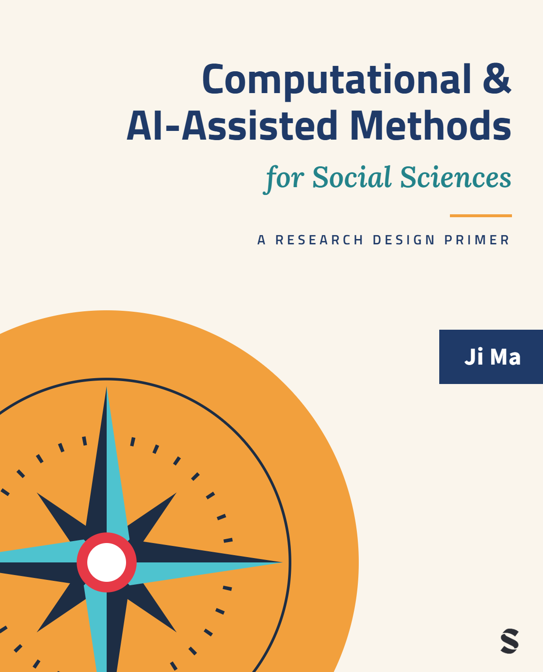
Computational & AI-Assisted Methods for Social Sciences
A Research Design Primer
Chapter 12
Conclusion
Ji Ma
cssprimer.org
Instructor slides · free to adapt for course use
Notes:
Final session. The chapter, and this deck, do two things: distill what the book has argued, not chapter by chapter but as a thematic synthesis, and then look backward rather than forward, reading the current computational transition against a century of methodological paradigm shifts. The wager is that the 1920s case-study wars and the mixed methods movement tell us more about the next decade than any technology forecast could. Students should leave with three patterns they can apply to whatever arrives after this course's tools are obsolete.

Slide 2
Learning objectives
By the end of this chapter, you can:
• Synthesize the book's central argument: CSS is a methodology organized by research design, not a toolbox
• Trace the recurring arc of methodological paradigm shifts and locate the computational expansion on it
• Explain why computational/traditional and quant/qual are choices about observation, not properties of phenomena
• Apply the historical lessons — question first, integration over replacement — to your own research plans
Ch. 12 · Conclusion · cssprimer.org
2 / 37
Notes:
Chapter 12 has no learning-objectives box, so these four are drafted for the lecture from the chapter's own aims. The first is retrospective, the middle two carry the chapter's historical argument, and the fourth is where the course hands off to the students' own work. Announce the session's shape up front: first a synthesis pass back through the four stages, then three historical episodes, then the three patterns that recur across them. Nothing new is introduced today; everything is consolidated.

Slide 3
Computational social science is a methodology, not a toolbox.
Ch. 12 · Conclusion · cssprimer.org
3 / 37
Notes:
The book's opening claim, returning as its conclusion. In week one this was a promise; today it should be a summary of lived experience, because every exercise the students completed organized techniques around design questions rather than algorithms. Ask the room what the sentence means now that it did not mean in week one. Good answers mention that the four stages gave every method a location, and that validity questions, not tool features, decided what counted as good work.

Slide 4
§12.1
What this book has argued
A thematic synthesis, not a chapter-by-chapter recap.
Ch. 12 · Conclusion · cssprimer.org
4 / 37

Slide 5
What makes a researcher computational
§12.1
• Computational methods: inference requiring written, executed code — defined by what specification buys
• Not someone who happens to use Python or machine learning
• Someone who designs research integrating computational capacity with social science validity standards
Takeaway: The definition determines what kind of researcher the field produces.
5 / 37
Notes:
Recall the working definition from Chapter 1 and draw out its consequence. The definition was never about the presence of a computer; it was about the capacities that writing the procedure yourself buys, iteration, non-linearity, high dimensionality. By the same logic, the identity of a computational social scientist is a design identity, not a tool identity. This matters for how students present themselves on the job market: the claim they can now defend is not that they know particular libraries but that they can design research those libraries serve.

Slide 6
The tools do not dictate the worldview
§12.1
• Embeddings, networks, and topic models serve postpositivist hypothesis testing…
• …constructivist exploration, transformative action research, pragmatist problem-solving
• Research design decides; the algorithm is agnostic
Takeaway: Integration operates across philosophical worldviews, not just across methods.
6 / 37
Notes:
This synthesis point comes from Chapter 5 and deserves restating because students often arrive believing computational methods belong to one epistemology. The same topic model can test a hypothesis derived from theory, open an inductive exploration, or center marginalized voices in a community-designed study; nothing in the mathematics chooses among these. What chooses is the design: the purpose, the validity standards, the relationship to the people studied. That neutrality is what makes the integration argument of this chapter possible at all.

Slide 7
Structured environments for AI-assisted research
§12.1
• Rules configure; memory preserves; knowledge grounds
• Poor agent performance usually reflects environmental disorganization, not model weakness
• Thick trust vs. reliance, translated into a practical architecture
↗ Chapter 2 templates · cssprimer.org/ch02/
Takeaway: The argument was epistemological, not organizational.
7 / 37
Notes:
Chapter 2's framework in one slide, with the emphasis on why it exists. Because large language models are essentially opaque, no amount of expertise lets anyone trust them the way we trust human collaborators; what remains available is structuring the environment so AI contributions are constrained, traceable, and grounded in project-specific materials. By now students have a term of experience with the architecture: their promptlogs, decision records, and knowledge bases are the evidence. Ask who caught a real error through their own memory files; someone always has.

Slide 8
The backbone, one last time
§12.1
1. Data management
2. Concept representation
3. Data analysis
4. Scientific communication
Four stages, each pairing a theory chapter with an exercise chapter; ethics and AI infrastructure across them all.
Takeaway: Any computational method you meet after this course still slots into one of these stages.
8 / 37
Notes:
The diagram from week one, now fully inhabited. Walk it as a retrospective: each stage got a theory chapter and an exercise chapter, ethics attached to every stage, and the AI framework sat underneath as infrastructure. The portable skill is the slotting: when a method arrives in 2030 that this book never named, the first question is which stage it serves, and the second is what validity standard that stage imposes. The next four slides revisit each stage in a single claim.

Slide 9
Stage 1 revisited — data management (Chs. 3–4)
§12.1
• Born-digital data carries the goals and biases of the platforms that made it
• “Cheap data, costly validation”: ease of collection obscures the work of knowing what it measures
• Decisions here propagate through every later analysis
Takeaway: Source, structure, and standardization; the validation bill always comes due.
9 / 37
Notes:
One claim per stage, starting here: the digital explosion made data cheaper to acquire but not cheaper to validate. Have students recall their own OpenAlex exercise: the corpus arrived in minutes; the codebook, the source evaluation, and the validation of a random sample took the actual work, and that asymmetry is the principle in miniature. The propagation point sets up the retrospective logic: every later stage inherited the choices made at this one, which is why the book put data management first.

Slide 10
Stage 2 revisited — concept representation (Chs. 5–6)
§12.1
• Deductive, inductive, or integrative — the same validity questions apply
• Does the measure capture the concept? Where does it fail, and for whom?
• Marginal cases: strong on majority patterns, weak on rare, theoretically important ones
Takeaway: This is where research design meets epistemology most directly.
10 / 37
Notes:
The stage's enduring lesson is the question set, not any technique: whether the instrument is a dictionary, a supervised classifier, or a topic model, the same three questions decide its worth. The marginal-cases problem is worth one more repetition because it connects validity to ethics: computational measures distribute their error unevenly, and the rare cases they miss are often the theoretically central ones. Students met this as a confusion matrix in Chapter 6 and as the geography of error in Chapter 11; today it is one idea.

Slide 11
Stage 3 revisited — data analysis (Chs. 7–8)
§12.1
• Three capacities: iteration, non-linearity, high-dimensional data
• The cost: epistemic opacity — better fit to data is not better fit to concepts
• Four epistemic purposes: descriptive, explanatory, predictive, integrative
Takeaway: Decide what kind of knowledge the analysis aims to produce; interpretation obligations follow.
11 / 37
Notes:
The capacities and the cost arrived together, and the four purposes are the discipline that keeps them honest. Rehearse the purpose logic one last time: describing structure, identifying causal effects, forecasting new observations, and integrating explanation with prediction are different kinds of questions, not rungs on a ladder, and each imposes its own standard of evidence. The opacity cost bridges backward to Chapter 2's trust argument and forward to Chapter 11's accountability argument; by now students should hear all three as one thread.

Slide 12
Stage 4 revisited — scientific communication (Chs. 9–10)
§12.1
• Objectivity is a social achievement, maintained through structures that enable scrutiny
• Three properties: inspectable, reproducible, interpretable
• For AI-assisted work: document the AI interactions, not just the analysis
Takeaway: Communication is woven through the pipeline, not appended to it.
12 / 37
Notes:
The philosophical claim deserves its last airing: objectivity is not a property of individual rigor but of communication structures that let a community scrutinize and correct. The three properties operationalize it, and the AI-specific implication is the one this cohort will carry into a changed field: replicating an AI-assisted study means replicating the interactions that shaped it, which is precisely what promptbooks and cached prompt-output pairs make possible. Communication practices are also where a hiring committee will read this training most clearly.

Slide 13
Ethics as embedded practice (Ch. 11)
§12.1
• Not a separate checklist; a dimension of every design decision
• Privacy, fairness, accountability, and disclosure arise at each stage
• Existing frameworks were built for experimental and survey research
Takeaway: CSS as methodology and CSS as ethical practice are one project, not two.
13 / 37
Notes:
Last week compressed to a slide. The structural point to repeat: ethical work in CSS happens at the same sites where methodological work happens, which is why the ethics chapter was organized by the four stages rather than as an appendix of principles. Developing CSS-specific guidelines is collaborative work among researchers, policymakers, and affected communities, and your students' generation will do much of it. This slide completes the synthesis pass; what remains is the shared core beneath all of it.

Slide 14
The shared core: research design and social questions
§12.1
• Research design integrates the four stages into a coherent whole
• Social questions decide which methods fit and which results matter
• Tools change; the shared core survives
Takeaway: Methods integrate when design holds them together; methods endure when they answer questions that matter.
14 / 37
Notes:
The synthesis lands on two anchors. Research design is the practice that makes the four stages one inquiry rather than a sequence of disconnected techniques; social questions, the puzzles that brought each student into the field, decide which methods are appropriate and which validity standards apply. The takeaway sentence previews the entire second half of today: integration and answering questions are the two themes the historical episodes will develop. If the course succeeded, this slide reads as obvious; in week one it would not have.

Slide 15
§12.2
Paradigm shifts in social science methods
Not a forecast — a century of history, and the arc that keeps repeating.
Ch. 12 · Conclusion · cssprimer.org
15 / 37

Slide 16
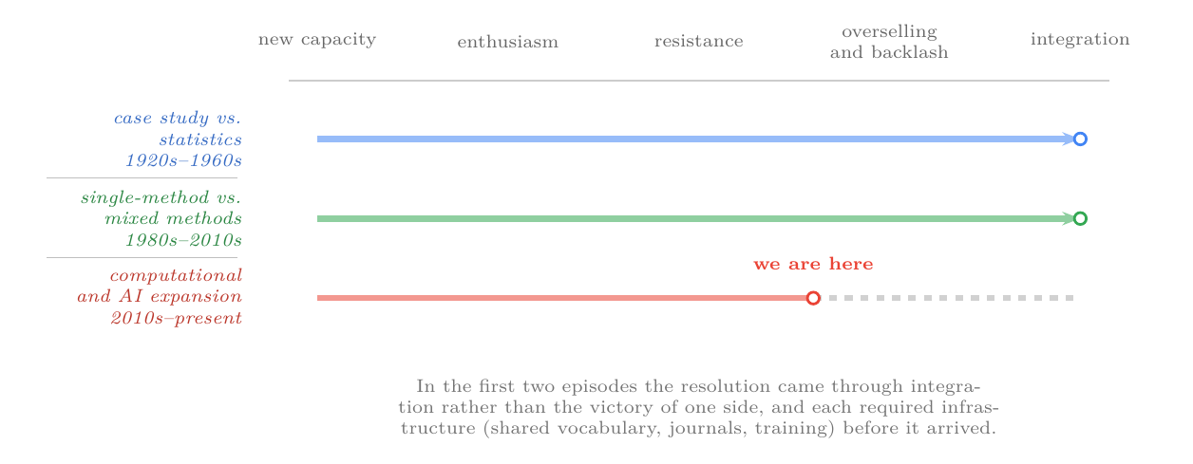
One arc, three episodes
§12.2
Each transition follows the same sequence; the two completed episodes resolved through integration, and the computational expansion sits partway along.
Ch. 12 · Conclusion · cssprimer.org
16 / 37
Notes:
This is the book's own Figure 12.1. The recurring sequence is the lecture's spine: new capacity, enthusiasm, resistance, overselling and backlash, then integration. Both completed episodes resolved through integration rather than one camp defeating the other, and both required infrastructure, shared vocabulary, journals, training, before resolution arrived. The third row's position is the point: adoption is real, contestation is active, and the shared standards are unfinished, which is why the arguments around the students still feel unsettled. History as orientation, not prophecy.

Slide 17
Case study vs. statistics: mostly myth
§12.2
• Chicago = case study, Columbia = statistics — “largely mythological” (Bulmer 1981)
• 1920s Chicago ran a thriving quantitative tradition: Ogburn, Burgess, Thurstone
• Mitchell, 1925: the two analyses “will cooperate … as peacefully in economics as they do in chemistry”
Takeaway: The controversy persisted because it served institutional purposes, not methodological ones.
17 / 37
Notes:
The first episode's surprise is that the war was retrospective myth-making. Burgess himself held that both methods deserved equal recognition and that their interaction was certain to prove fruitful; Lundberg's retrospective calls the whole controversy a misunderstanding, recognized as such by the sophisticated in both camps. Yet it ran for decades, because it served disciplinary identity needs beyond the questions it claimed to address. Invite students to spot the same dynamic in current computational-versus-qualitative skirmishes; the parallel is rarely lost on them.

Slide 18
Resolution came through infrastructure, not philosophy
§12.2
• WWII: massive Army Research Branch datasets; Stouffer, Lazarsfeld, Guttman
• Wartime work “set forward by several decades” quantitative sociology (Lundberg 1960)
• Postwar dominance came from institutes, funding, and computing — not settled debate
Takeaway: Methodological transitions are decided by material conditions more than by arguments.
18 / 37
Notes:
The philosophical debate was never settled; it was overtaken. War generated data at a scale no academic project could, the scale-construction revolution followed, and postwar research institutes, government funding, and computing equipment made large-scale quantitative work newly feasible. The lesson to carry to the present: watch the infrastructure, shared corpora, computing access, review standards, training programs, because that is where the computational transition will actually be decided. It also explains why this book invests so heavily in workflow and documentation: those are infrastructure.

Slide 19
Mixed methods: the transmission, not the engine
§12.2
• Combining methods is at least eighty years older than the term (Pelto 2015)
• The “horseless carriage” stage: engine bolted onto a carriage (Fetters & Molina-Azorin 2016)
• The real innovation: integration procedures — joint displays, triangulation, data transformation
Takeaway: A methodology coheres when combination becomes designed integration.
19 / 37
Notes:
Episode two's lesson is about what actually changed in the 1980s and 1990s: not the fact of combining evidence, which anthropologists had done for generations, but systematic integration procedures with shared vocabulary and explicit design typologies. The automobile analogy organizes it: early mixed methods placed components side by side; the transmission connected them into something neither could produce alone. And again infrastructure: a journal in 2007, professional organizations, training programs. Hold the analogy in mind; it returns as the chapter's forecast for computational integration.

Slide 20
The computational expansion is additive, not substitutive
§12.2
• Not a shift from theory-driven to data-driven research
• Machine learning still requires theory: estimands and credible assumptions (Lundberg et al. 2022)
• The methods draw on techniques that long predate them (Grimmer et al. 2021)
Takeaway: New computational tools join the repertoire; they do not replace it.
20 / 37
Notes:
Now episode three, ours. The central question, in An's phrase, is how to handle the relationship between theory and computing, maintaining theoretical grounding while exploiting new capacities. Abundant data enables more inductive work, discovery, pattern recognition, custom measurement at scale, but the researcher must still establish why an estimand matters and whether the assumptions behind it are credible; no model does that. The additive framing is the chapter's position in the live debate, and it is an empirical reading of the two completed episodes, not a preference.

Slide 21
The newest stage: AI-assisted research itself
§12.2
• LLMs now support annotation and much of the research workflow
• Generative agents simulate respondents on GSS items and economic games (Park et al. 2024)
• Validity concerns are live: synthetic responses from models whose properties remain unknown (Bisbee et al. 2024)
Takeaway: Chapter 2's framework was designed for exactly this terrain.
21 / 37
Notes:
Within the computational expansion, the frontier has moved again: from machine learning as method to AI as assistant and as object of study. Generative agents answering the General Social Survey are simultaneously a tool and a research subject, and the validity worries students met in Chapters 7 and 11 are the resistance phase of the arc playing out in real time. Note what the framework was built not to do: it does not dissolve essential opacity; it creates conditions for responsible reliance on tools we cannot inspect. That distinction is this book's bet about how the episode resolves.

Slide 22
§12.3
Quantitative is a verb, not a property
The recurring category error: treating a choice about observation as a property of phenomena.
Ch. 12 · Conclusion · cssprimer.org
22 / 37

Slide 23
The semantic error that keeps returning
§12.3
• “Inherently quantitative” phenomena vs. “inherently qualitative” ones — a “simple semantic error” (Lundberg 1960)
• Attitudes, prejudice, and status all became measurable once instruments existed
• The distinction was in the available tools, not the phenomena
Takeaway: What looks like a boundary in the world is usually a limit of current instruments.
23 / 37
Notes:
The chapter's sharpest historical lesson. Demography was once defined as the study of the quantitative aspects of population, as if aspects came sorted; then Thurstone measured attitudes, and a supposedly qualitative phenomenon changed sides without changing at all. Lazarsfeld's history pushes the point to the seventeenth century: Petty's causal arithmetic and Conring's descriptive categories were two responses to the same challenge, so quantification was never one thing. Even the quant/qual divide itself is largely a twentieth-century construct, imposed retroactively by the paradigm debates.

Slide 24
The same category error, in current dress
§12.3
• “LLMs cannot understand qualitative meaning” — computation as categorically unsuited
• “AI makes qualitative coding obsolete” — computation as categorically superior
• The real question: does this procedure capture this concept with sufficient validity?
Takeaway: That is an empirical question, answerable by validation — not a categorical one.
24 / 37
Notes:
Both contemporary camps commit the error identified over sixty years ago. The critic treats computational methods as categorically barred from meaning; the enthusiast treats them as categorically superior; both locate in the phenomena a boundary that actually lives in the instruments and their validation. The book's resolution is deflationary and practical: the question is the same one asked of any measurement instrument, and the course has spent a term building exactly the validation strategies that answer it. This slide is the students' inoculation against the next decade of hot takes.

Slide 25
§12.4
Methods survive by answering questions
Technical impressiveness gains attention; answered questions earn survival.
Ch. 12 · Conclusion · cssprimer.org
25 / 37

Slide 26
The quantitative history cautionary tale
§12.4
• 1970s prediction: quantitative methods would dominate history by the 1980s (Floud 1984)
• It did not happen — the methods were promoted as superior, not as useful
• The turn: “further knowledge about specific questions,” no longer “revolutionize the discipline” (Jarausch 1978)
Takeaway: Methods endured where they served genuine research needs, and faded where promoted for their own sake.
26 / 37
Notes:
The counterexample that proves the rule. The methods were not technically flawed: quantitative techniques thrived in demographic history, economic structure, and social mobility, exactly where they answered historians' questions, and faded everywhere they were advanced as inherently superior. Jarausch marks the turning point precisely: once proponents claimed less, the opposition began engaging the products instead of the pretensions. Ask students which current computational applications feel question-driven and which feel novelty-driven; their instincts, after a term of this course, are usually well calibrated.

Slide 27
Put the question before the method
§12.4
• Grimmer et al. organize machine learning by task: discovery, measurement, causal inference, prediction
• This book organizes methods by design stage for the same reason
• Ask “what question can I now answer?”, not “what can this tool do?”
↗ CSS Empirical Studies Database · cssprimer.org/studies/
Takeaway: Question-first organization is why both frameworks work.
27 / 37
Notes:
The positive version of the lesson. Grimmer, Roberts, and Stewart's framework succeeds because each task is a kind of question, and the choice of method follows from it; the book's four stages apply the same logic to the whole pipeline, and the four epistemic purposes of Chapter 7 apply it within analysis. Predict the near future with the historical pattern: text analysis at scale, network detection, and high-dimensional discovery look durable because the questions they answer are real; some current excitement will fade when novelty stops substituting for demonstrated value.

Slide 28
§12.5
Integration, not replacement
Every methods war ended in complementarity; this one will too.
Ch. 12 · Conclusion · cssprimer.org
28 / 37

Slide 29
Replacement framing provokes resistance; complements integrate quietly
§12.5
• The quantitative-history “revolution” never materialized; the complementary toolkit did
• Marienthal's postscript pointed to the quant–qual marriage in 1933 — systematization took fifty years
• Integration needs shared vocabulary, design principles, evaluation standards
Takeaway: Expect the computational integration to run on a similarly extended timeline.
29 / 37
Notes:
The pattern in one contrast: methods promoted as replacements provoke resistance, and the same methods offered as complements become normal practice without displacing anything. The Marienthal detail gives the timeline its scale: the vision of integration preceded its systematic realization by half a century, not because tools were lacking but because shared vocabulary and standards take that long to mature. Applied to now: we are in the horseless-carriage stage, bolting computational tools onto traditional designs, and this book's framework is an attempt at the transmission.

Slide 30
Source criticism: history's contribution to CSS
§12.5
• “If there is a characteristic historical methodology, it involves evaluating and criticizing sources” (Alter 1981)
• Digital traces were not created for research, any more than census records were
• Platform goals intrude on our analyses as administrators' goals intruded on theirs
Takeaway: Understanding how data was produced is a core analytical competence, not a preliminary step.
30 / 37
Notes:
One aspect of integration deserves its own slide because it closes a loop with Chapter 3. Historians' distinctive gift to quantitative social science was source criticism, the disciplined evaluation of how and why data came to exist, and the reviewer quoted predicted it might become history's major methodological contribution to social science generally. Digital trace data renews the case exactly: platform incentives shape what is recorded and what is missing, as nineteenth-century administrators' purposes shaped the census. Students have practiced this all term under the name data-source evaluation.

Slide 31
§12.6
Looking forward
History does not predict the future, but it identifies the dynamics that will shape it.
Ch. 12 · Conclusion · cssprimer.org
31 / 37

Slide 32
The use-and-validate habit outlasts the tools
§12.6
• AI moved from autocompleting sentences to executing multi-step analyses between drafts of this book
• The durable discipline: specify what the tool may do, ground it, record it, validate before output becomes evidence
• Deliberately independent of any model or vendor
Takeaway: It is the part of AI-assisted research that is methodology rather than technology.
32 / 37
Notes:
The chapter's only forward-looking passage, and its restraint is the message. Capabilities will keep shifting under any description the book could give; what will not shift is the discipline attached to every AI use, the same four moves students have practiced all term. Name them slowly, specify, ground, record, validate, because this is the last time you say them and the first day of the rest of their use. This habit is why the material belongs in a research design primer and why it will outlast the tools that prompted it.

Slide 33
The future belongs to researchers who refuse false dichotomies
§12.6
• Case studies and statistics were never enemies; neither are computation and theory
• Hold the tensions productively; build bridges between traditions
• Stay focused on the questions that brought you to social science
Takeaway: Tools change; the questions, and the design discipline that serves them, endure.
33 / 37
Notes:
The book's closing paragraph, nearly verbatim, and a fitting last content slide for the course. Every paradigm shift surveyed today was moved by researchers who saw complementarity where their fields saw combat. Send students out with the personal version: the methods they learned this term will age, some quickly; the four-stage lens, the validation habits, and the questions that brought them here will not. Then open the floor, the discussion prompts ask them to apply the historical patterns to their own subfields and plans.

Slide 34
Discussion
Synthesis
• Restate the course's central claim — methodology, not toolbox — with one example from your own field.
• Where on the paradigm-shift arc is your subfield's reception of computational methods, and what evidence places it there?
• Which method from this course answers a question you could not answer before? Which felt like technique for its own sake?
• What would the “transmission” — genuine integration procedures for computational and traditional methods — look like in your discipline?
Ch. 12 · Conclusion · cssprimer.org
34 / 37
Notes:
Chapter 12 has no reflective-exercise section, so these prompts are built from its synthesis themes. The second works best: students place their subfield at enthusiasm, resistance, or backlash and must defend the placement with observable evidence, review practices, hiring patterns, what gets published. The third is the honest one; let students name a course method that felt like technique for its own sake, and connect their verdicts to the survival-by-answering-questions pattern. Close the discussion, and the course, by returning to whatever question each student named in week one.

Slide 35
Key concepts from Chapter 12
Case study/statistics controversy: 1920s–1960s dispute, largely mythologized; dissolved by wartime data and infrastructure
Quantitative history: Movement whose replacement rhetoric provoked backlash; survived where it answered questions
Mixed methods integration: Systematic procedures — joint displays, triangulation — linking qualitative and quantitative evidence
Source criticism: Evaluating how and why data was created — history's contribution to CSS
Horseless carriage analogy: Bolting new tools onto old designs precedes genuine integration — the “transmission”
Additive expansion: New computational tools join the methodological repertoire rather than replacing it
Political arithmetic: Seventeenth-century demonstration that social phenomena admit quantitative analysis
Use-and-validate habit: Specify, ground, record, validate — the model-independent discipline of AI-assisted research
Ch. 12 · Conclusion · cssprimer.org
35 / 37
Notes:
A lighter recap than usual since nothing here is examinable technique; treat it as the course's parting vocabulary. The three historical terms matter because students will encounter the myths, the Chicago-versus-Columbia story most often, and should know the record behind them. The last two terms are the ones to internalize permanently: additive expansion names the stance to take in methods debates, and the use-and-validate habit names the practice that survives every model generation. The glossary in the book's back matter covers the rest.

Slide 36
Materials on the companion site
cssprimer.org
CSS Empirical Studies Database cssprimer.org/studies/
The corpus for final-presentation comparisons and future reading
Materials by chapter cssprimer.org/chapters/
Every stage's materials, for students returning to a method after the course
Errata and suggestions cssprimer.org/errata/
Where students and instructors report issues or propose studies for the database
Ch. 12 · Conclusion · cssprimer.org
36 / 37
Notes:
Close the course by pointing forward: the site outlives the semester. Students preparing final presentations can position their project against the database's annotated studies; later, the chapter hubs are the reference they return to when a dissertation needs a method half-remembered from week eight. The errata page makes them contributors, and suggestions genuinely reach the author.

Slide 37
Where to go next
• Browse: the studies database at cssprimer.org/studies — every study cited in the book, searchable by stage and method
• Keep: your project skeleton, promptbooks, and memory files — they outlive the course
• Return: cssprimer.org for chapter hubs, setup guides, and updates as the tools change
All materials: cssprimer.org
Notes:
End with resources that outlast the syllabus. The studies database indexes every empirical study cited across the book, filterable by design stage and method, which makes it a literature-review starting point for the students' own projects. Their project skeletons are now genuine research assets: several will carry the same memory files and promptbooks into thesis work. The site's chapter hubs and setup guides will track tool changes that the printed book cannot. Thank the group, and leave the last word to their questions, not the tools.

